Slide 1
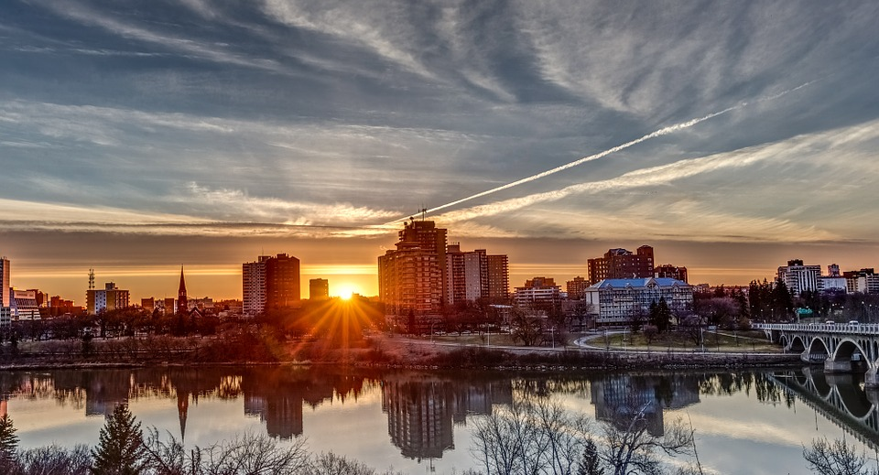


Student Action on Saskatoon Water Attitudes
2017/2018 School Year Competition

Slide 2
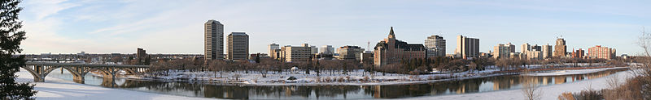
Outline
About Us
About You
Student Action Competition
  Who will be competing
  Why you should participate
What will you have to do?
  Identifying water issues in your community
  What is a survey?
  Who can you survey?
  Informing your community
  What does your information tell you?
  Creating a report
Future Webinars
Acknowledgements
Questions?
www.safewater.org

Slide 3
SDWF
The Safe Drinking Water Foundation (SDWF) has been a registered charity since 1998. Since then we have been actively focused on water quality issues in Canada. Through providing information and creating educational kits for elementary and high school students, the SDWF has been focussed on educating the leaders of tomorrow on the importance of water quality for all.
If you would like more information, or are interested in ordering water kits from SDWF, please visit our website:
www.safewater.org
www.safewater.org

Slide 4

Questions?
Industrial Pollution
www.safewater.org

Slide 5
What Grade Do You Teach?
Type your answer in the chat to see what grades are represented today!
A: K-4
B: 5-8
C: 9-12
www.safewater.org

Slide 6
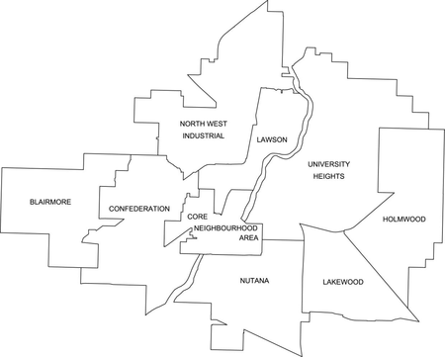
Where is Your School?
Please type in the name of the area in Saskatoon in which your school is located! Or tell us in which community you are located if your school is not in Saskatoon!
www.safewater.org

Slide 7
Student Action on Saskatoon Water
Attitudes
Investigating, educating, and reporting on a water issue in their community.
The first ten schools which registered received/will receive sponsored Operation Water Drop kits, it’s an excellent idea to use these kits soon to have background information about Saskatoon’s tap water quality, Guidelines for Canadian Drinking Water Quality, etc.
Open to K-12 students across Saskatoon.
The project must take place in Saskatoon.
Prizes will be a water bottle filling station for your school and a commemorative plaque.
www.safewater.org

Slide 8
Competition Outline
Topics
Surveys
Informing the Community
Report
Prizes
Webinars
www.safewater.org

Slide 9
Surveys
Create a sample group
  Ask questions to your friends and family to create your sample community.
What questions to ask
  Once you have decided on an issue to study, see how much your community knows about it already.
Follow up with the same questions after you’ve informed the group to see how big of a difference you have made.
www.safewater.org

Slide 10
Educating the Community
Create educational material based on your survey results.
After your initial survey, you will go to your community and teach them what you think they need to know and how they can be part of the solution.
www.safewater.org

Slide 11
What Does Your Information Tell You?
There will be a follow up survey to give the community to determine how their attitudes have changed on the subject.
The follow up survey will have very similar questions to the first survey. This will show you how things have changed.
How many people have changed their attitudes and actions on the problem you’re facing?
www.safewater.org

Slide 12
Report
Your class will create a report that presents what you learned from the problem you chose and what you did to help fix it.
The report will be submitted, we have set a tentative due date of February 16, 2018, and reviewed by our panel of judges as well as ourselves. We will be marking the objective criteria and the panel of judges will be marking the subjective criteria.
We will be providing information on exactly what will need to be in the report. This webpage has a list of information you will need to submit your final report: https://www.safewater.org/student-action-competition
Based on the report, the judges will determine the winners of the grand prize!
www.safewater.org

Slide 13
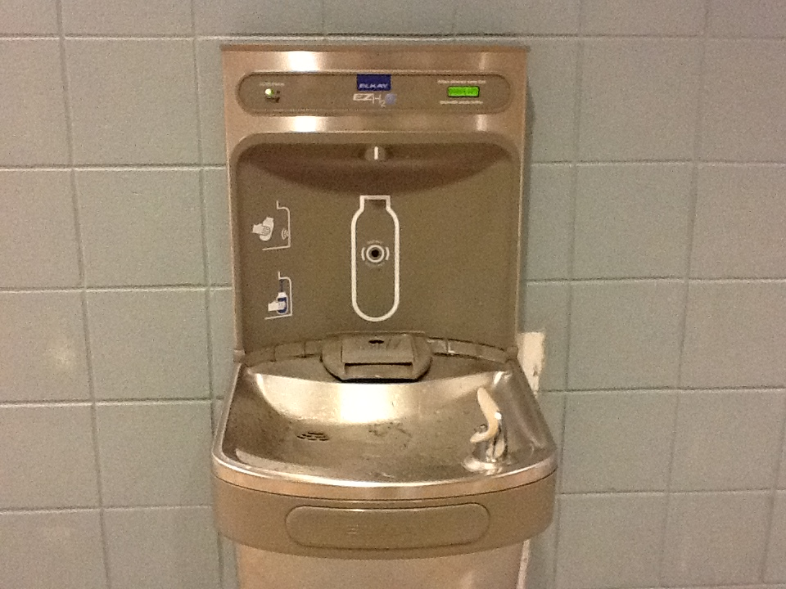
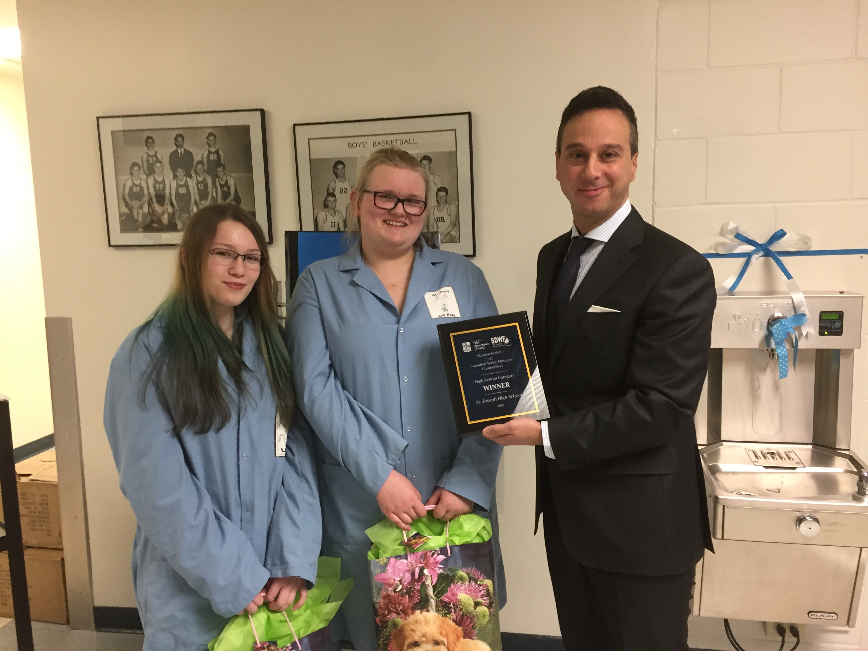
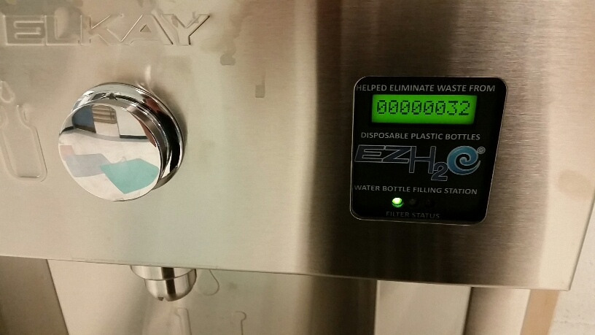
The Grand Prize!
The winning school will be presented with a water bottle filling water fountain and a plaque.
www.safewater.org

Slide 14

Questions?
Industrial Pollution
www.safewater.org

Slide 15
How to Discover an Issue
Follow your water supply from source water to wastewater and think of all the inputs and outputs.
  An RBC Blue Water Project survey found that few Canadians know from where their water comes.
  Students must raise awareness about where their community’s water comes from.
Have a look at local bodies of water and consider their uses.
Contact environmental groups or watershed authorities in your area.
Do you see people around you wasting water (leaving the tap on when they brush their teeth, taking too long of showers, etc.)?
Discuss your ideas with us.
www.safewater.org

Slide 16
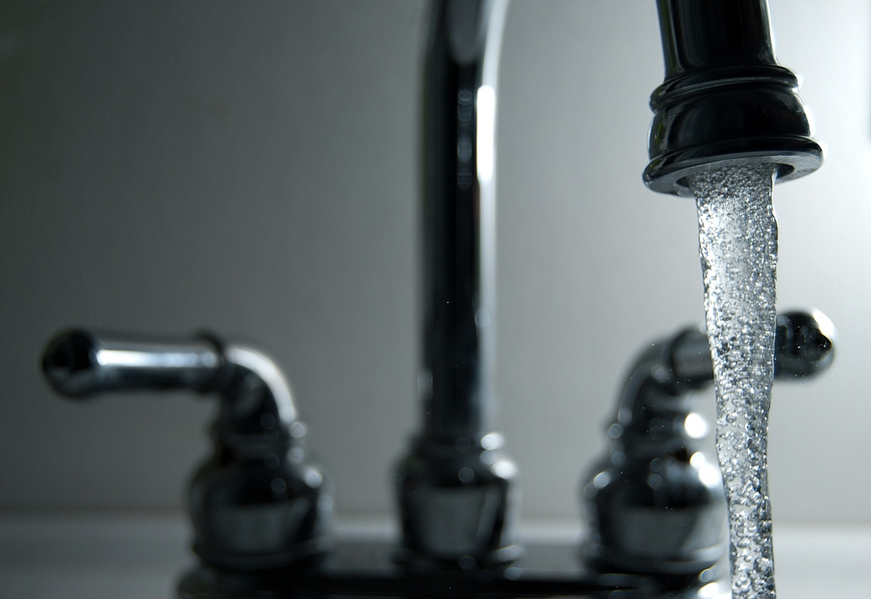
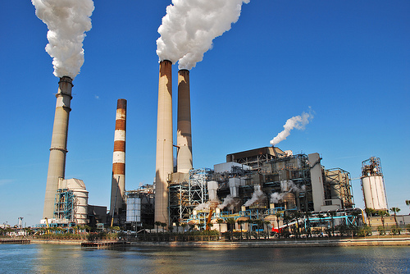
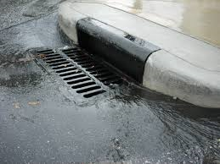
Saskatoon Water Issues
Think about a water issue which exists in Saskatoon.
Think about where your water comes from, what happens to it before it comes into your house and after it leaves.
Not limited to drinking water issues.
www.safewater.org

Slide 17
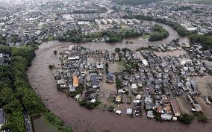
Water Issues More Prevalent Due to
Climate Change
** 2015 flooding in Japan
www.safewater.org

Slide 18
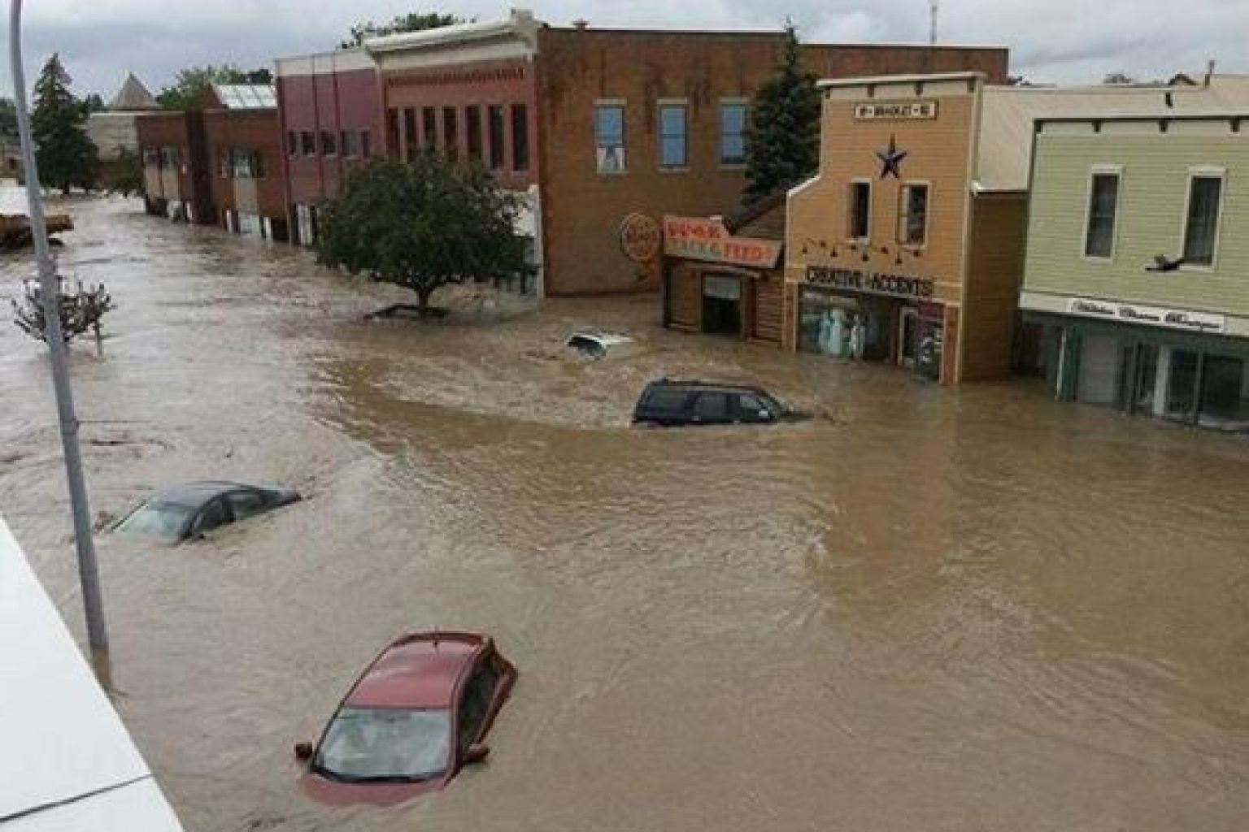
Water Issues More Prevalent Due to
Climate Change
* Flooding in High River, Alberta
www.safewater.org

Slide 19
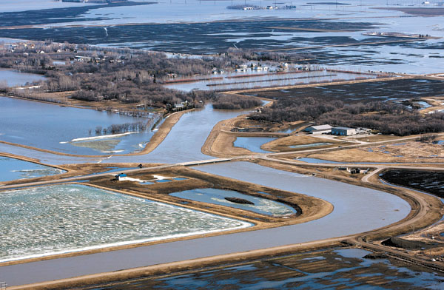
Flooding
What causes a flood?
How do some communities control excess runoff?
Water cannot get through pavement so it takes a lot longer to get absorbed into the soil.
  Potential investigation to get rid of paved areas or use material that lets water through.
www.safewater.org

Slide 20
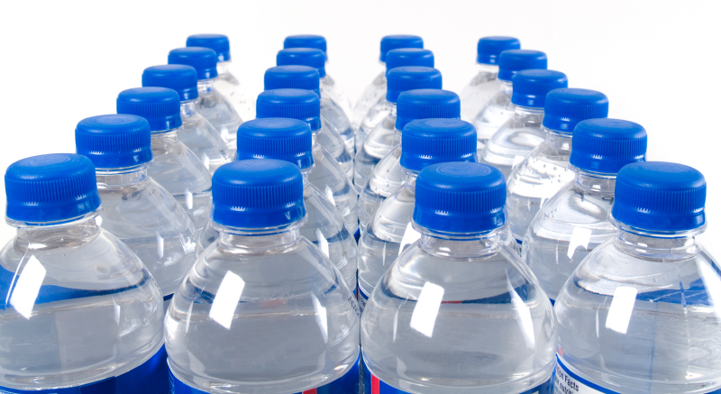
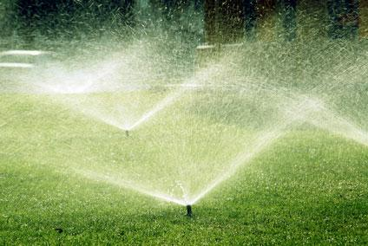
Water Use
Saskatoon residents use a combined total of more than 150 million litres of water per day on average.
Do you know how much water your family uses?
What are some ways you can control the amount of water that you use?
  You may be able to check the water meter in your house to see how much water you use, how much water you save.
www.safewater.org

Slide 21
Water Use
Potential Projects:
  Turning off the tap when you brush your teeth
  Taking shorter showers
  Not watering your lawn
  Washing your car at a car wash vs. at home
All of these things can be measured to see how much water you can save with a change in attitude!
www.safewater.org

Slide 22
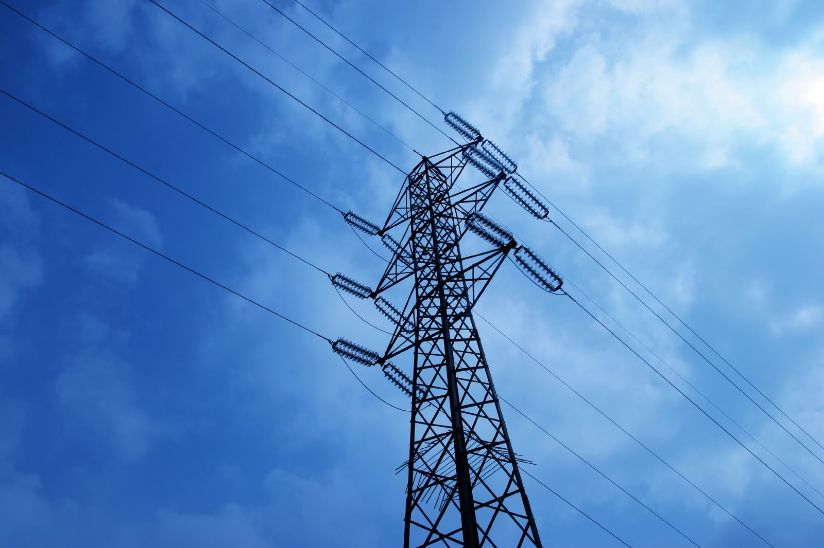
Energy Consumption
Large urban areas require a lot of clean drinking water.
This means that water treatment plants have to use a lot of energy to make water safe.
How does energy use affect our environment?
It may be a possibility to figure out how much energy is required to treat and distribute a litre of water.
If you reduce water use it will save energy, which might mean less pollution in the air.
www.safewater.org

Slide 23
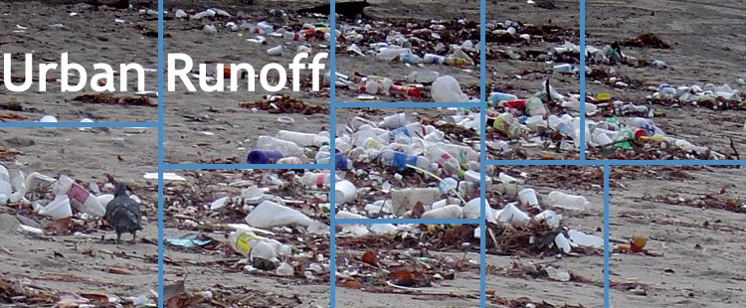
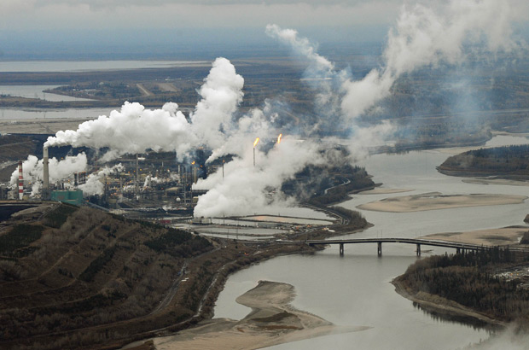
Contaminated Water Sources
What are some causes of water pollution?
Who uses water before it comes to your home?
What needs to happen for the water to be drinkable?
Industrial Pollution
www.safewater.org

Slide 24

Questions?
Industrial Pollution
www.safewater.org

Slide 25
Acknowledgements
Thank you all for joining today!
RBC Blue Water Project
Industrial Pollution
www.safewater.org

Slide 26
Next Webinar
Our next webinar will focus on how to conduct surveys and who to survey.
Tentatively set for two weeks from today (Monday, October 30 at 11:00 a.m. – does that work for you?).
Recordings of the webinars will be available in case there is a day you cannot attend the webinar or something comes up.
Industrial Pollution
www.safewater.org

Slide 27

Questions?
Industrial Pollution
www.safewater.org

Slide 28
Contact Information
If you have questions at any point after this webinar, or you would just like the opportunity to chat about your project, please feel free to contact Audrey or Nicole at:
Safe Drinking Water Foundation
Registered Canadian Charity #868384892RR0001
#1-912 Idylwyld Drive North
Saskatoon, SK S7L 0Z6
Ph. 306-934-0389 Fax 306-934-5289
E-mail: info@safewater.org
Website: www.safewater.org
We’re really good at math! Let us know if you need any help with your calculations!
Industrial Pollution
www.safewater.org

