Slide 1
Removing Iron from Drinking Water

Slide 2
Iron in drinking water Guidelines
Iron is essential for humans
Where does the iron that we need come from??
___________________________________– not necessary in water
Canadian Drinking Water Quality GL is ______

Slide 3
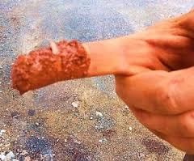
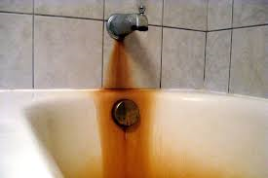
Why have these guidelines?
Iron GL are for _________________ only – no health risks with iron and iron bacteria
_____________________
_____________________

Slide 4
Problems with Iron Bacteria
Iron bacteria will grow & build up anywhere _________________
Form thick layers of “___________” in pipes
___________________________ to repair
Water has _______________________
Bad for ________________________
All iron needs to be _____________ from water to __________________

Slide 5
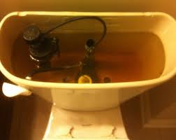
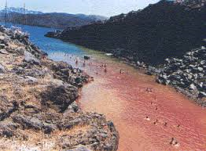

Slide 6
More about Iron
Iron can be in a _______________- Soluble in water – ________________
Iron can be in an __________________– NOT soluble in water – well water that has come in contact with _____________
Iron must be ___________________________ -i.e. _________________!

Slide 7
Filtering Iron out of Drinking Water
Three main methods of oxidizing iron:
Simplest method – _________ – let the water sit in a ________, exposed to _________ and most of the ______________to the bottom of the pool
This is a ___________ process

Slide 8
Filtering Iron out of Drinking Water
Use __________________
Cause _________________in tiny lumps that will then be _________________of the water
Filters must be _________and they _________ easily
Usually add a ______________ – causes bigger clumps that are more easily filtered out
Clumps are called a “__________”

Slide 9
Filtering Iron out of Drinking Water
A different process is the use of a __________ process
Water is passed through a filter containing ___________that will ___________________
Iron bacteria take in ____________ (dissolved in water) and make it into ____________ through a _______________________
Form a ___________________

