Slide 1
Removing Iron from Drinking Water

Slide 2
Iron in drinking water Guidelines
Iron is essential for humans
Where does the iron that we need come from??
Usually from the food that we eat – not necessary in water
Canadian Drinking Water Quality GL is
0.3 mg/L

Slide 3
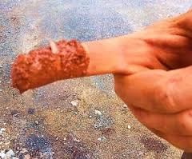
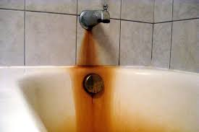
Why have these guidelines?
Iron GL are for aesthetic reasons only – no health risks with iron and iron bacteria
Discolour water
Promote bacterial growth

Slide 4
Problems with Iron Bacteria
Iron bacteria will grow & build up anywhere water flows
Forms thick layers of “biofilm” in pipes
Difficult and expensive to repair
Water has unpleasant smell
Bad for washing and cooking
All iron needs to be removed from water to stop bacteria

Slide 5
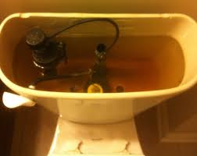
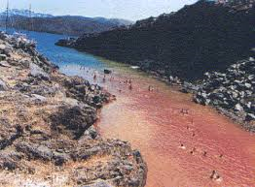

Slide 6
More about Iron
Iron can be in a reduced state - Soluble in water – water in a well
Iron can be in an oxidized state (rust) – NOT soluble in water – well water that has come in contact with oxygen
Iron must be oxidized from drinking water -i.e. totally removed!

Slide 7
Filtering Iron out of Drinking Water
Three main methods of oxidizing iron:
Simplest method – settling – let the water sit in a reservoir, exposed to oxygen and most of the iron will settle to the bottom of the pool
This is a slow process

Slide 8
Filtering Iron out of Drinking Water
Use oxidizing chemicals
Cause iron to clump in tiny lumps that will then be filtered out of the water
Filters must be very fine and they clog up easily
Usually add a flocculent – causes bigger clumps that are more easily filtered out
Clumps are called a “floc”

Slide 9
Filtering Iron out of Drinking Water
A different process is the use of a biological process
Water is passed through a filter containing bacteria that will oxidize the iron
Iron bacteria take in reduced iron (dissolved in water) and make it into oxidized iron through a Bio-oxidation reaction
Form a natural floc

