Slide 1
Total Chlorine Test

Slide 2
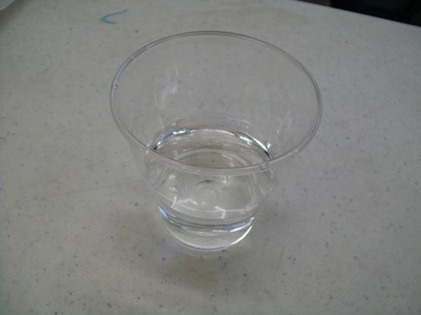
1. Label the two glasses with their respective names. 2. Put about 50 mL of sample in respective glasses (volume is really not critical).

Slide 3
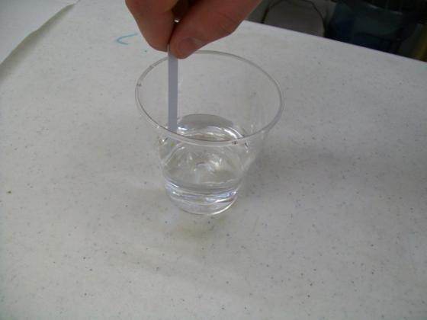
3. Dip one test strip in glass for 5 seconds with constant back and forth motion, so that water passes through the small aperture in the test strip.

Slide 4
4. Remove and shake the test strip once, briskly, to remove any excess water on the strip.

Slide 5
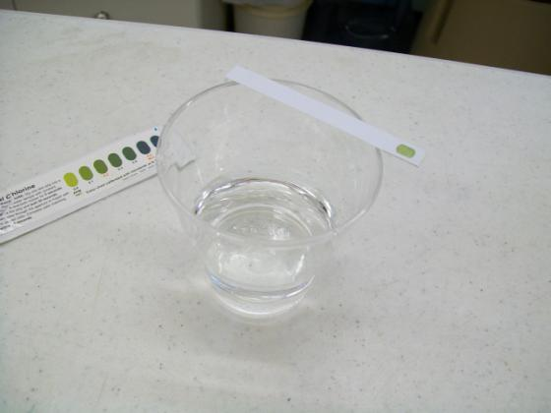
4. (Continued) Allow the test strip to dry for 30 seconds by lying across glass.

Slide 6
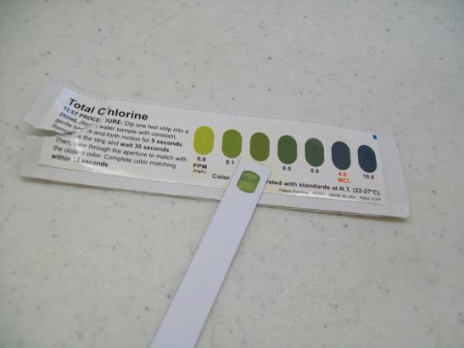
5. Match with the best colour to determine the Total Chlorine concentration in mg/L or parts per million (ppm). Complete the colour matching within 15 seconds. Do one sample at a time. 6. Write up your results. Results: Compare results to the United States Environmental Protection Agency’s maximum residual disinfectant level goal for chlorine of 4 ppm; a darker colour of green means that the water Does Not meet the United States Environmental Protection Agency’s maximum residual disinfectant level goal for chlorine. Please refer to the facts sheet portion of the instructions for more information about chlorine.

