Slide 1

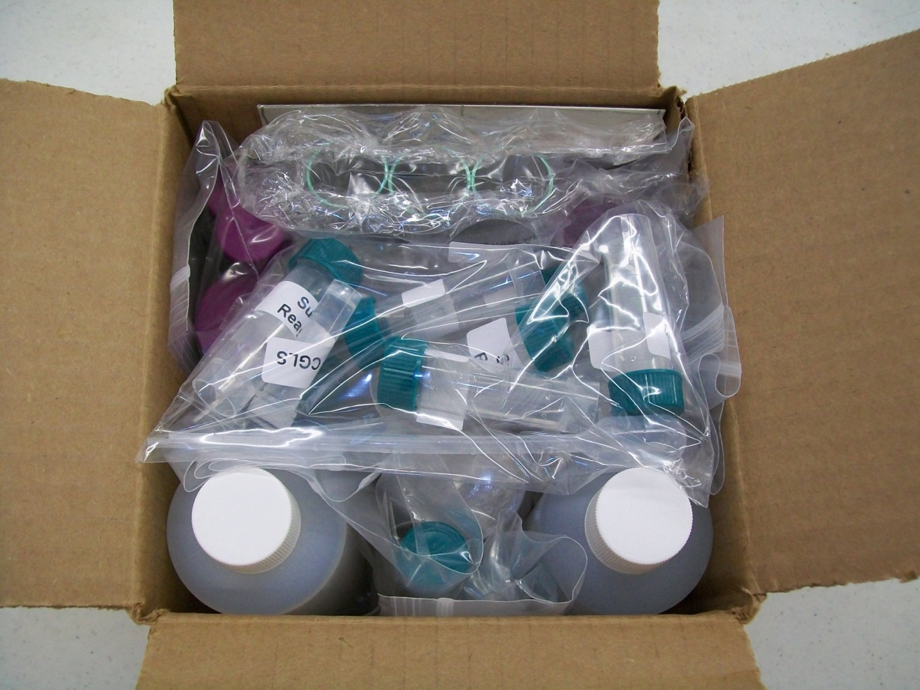

Elementary Operation Water Drop Kits

Slide 2

How do I get this awesome kit?
Many kits are sponsored by generous companies and foundations.
Kits can, of course, also be purchased by schools/school divisions themselves at reasonable cost-recovery prices. To find out whether your school is eligible to receive a sponsored kit please contact us!
E-mail info@safewater.org
Phone 306-934-0389

Slide 3
REMEMBER: Although the materials in the kit are safe to use, it is important to always use proper lab procedures and be careful when working in the lab.

Slide 4
The Two Tests That the Teacher Demonstrates

Slide 5
Alkalinity Test

Slide 6
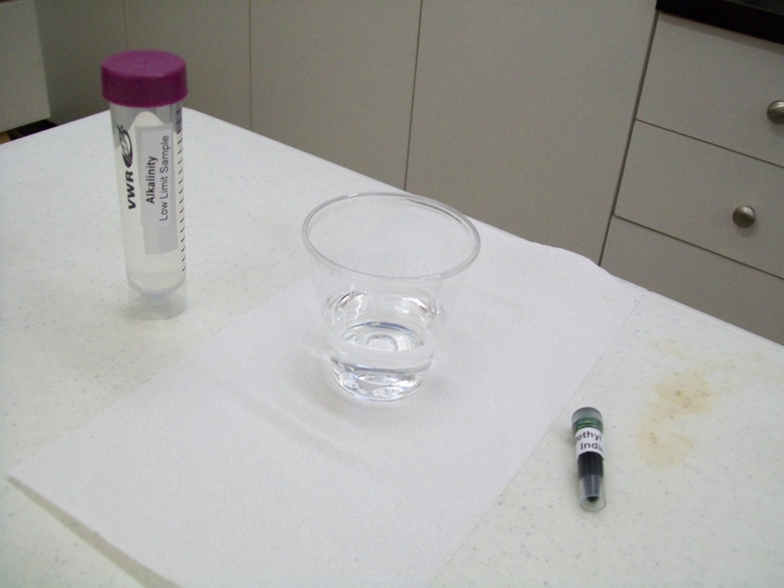
1. Cover the area that you are working on with paper and use gloves as the Methyl Purple Indicator that you will be using may stain. 2. Label the 2 plastic cups as follows; label one cup Alkalinity LLS and the other cup Local Community Treated Water. 3. Pour the 50 mL of Alkalinity LLS into the cup labeled Alkalinity LLS.

Slide 7
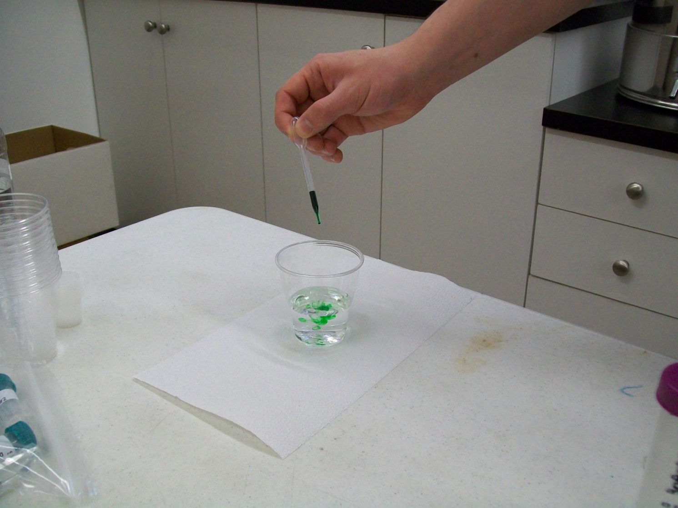
4. Add 7 drops of Methyl Purple Indicator to the cup by using the small plastic pipette.

Slide 8
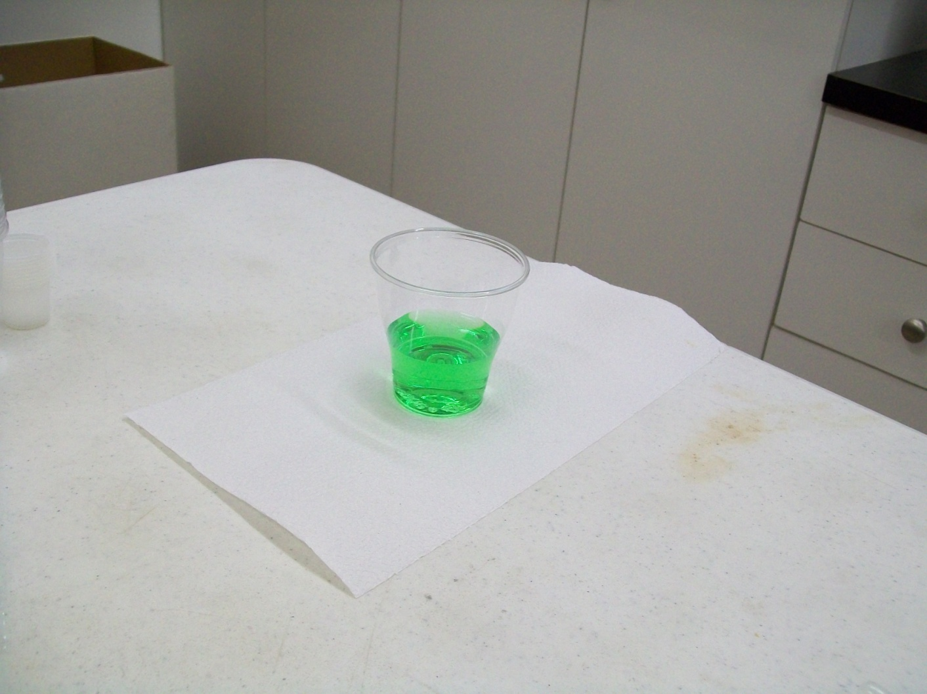
4. (Continued) This causes the water to turn green. Be careful when using the Methyl Purple Indicator as it may stain.

Slide 9
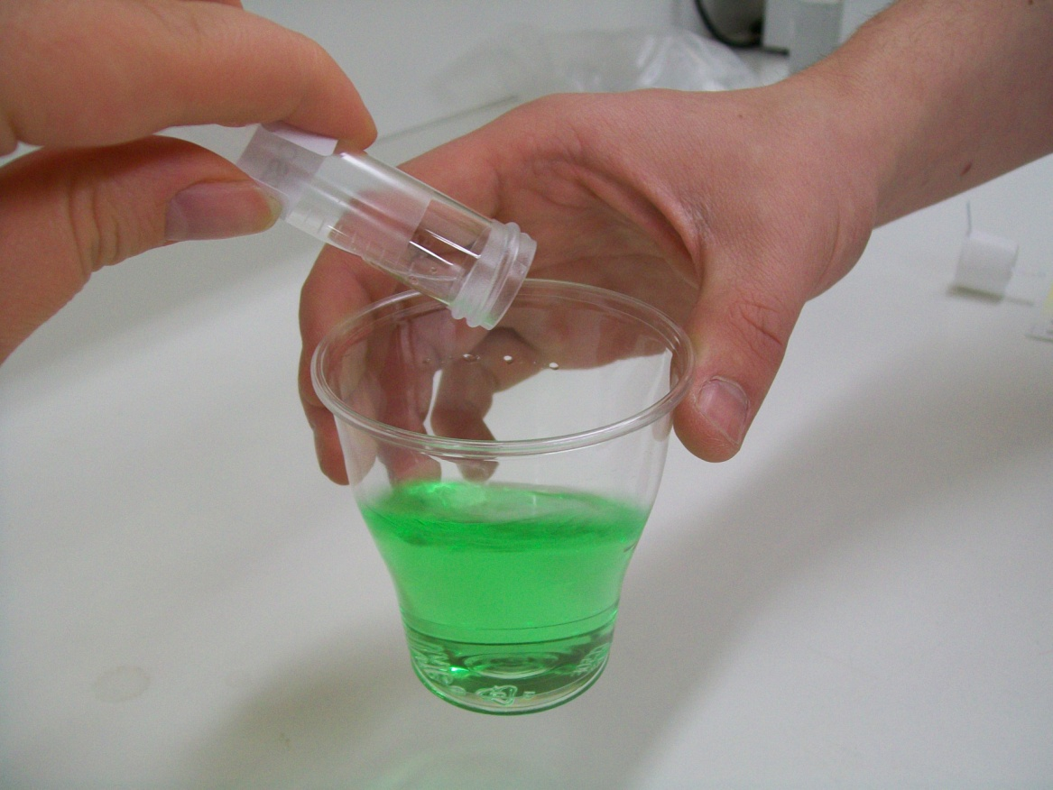
5. While swirling the water in the cup, add the 0.02 N H2SO4 slowly until the water turns purple, the LLS should take around 2.5 mL, record your reading (the volume you used is initial – the next reading, say 12.5 – 10.0 = 2.5) after you see the colour change. The other samples may take more or less than the LLS. Record the amount of H2SO4 used.

Slide 10
5. (Continued) Then add the remaining Sulphuric acid to see the colour changes (there should be a slightly darker colour after you add all of the acid). 6. Using the graduated cylinder, measure 50 mL of the Local Community Treated Water sample and pour it into the cup labeled Local Community Treated Water sample. 7. Repeat steps 4 & 5. 8. Calculate the amount of alkalinity in the different water sources. You can do that by knowing that the LLS is 50 mg/L and it required around 2.5 mL of acid. Results: If the water sample requires less than 2.5 mL of 0.02 N H2SO4 to change colour then the water may be quite corrosive. You can multiply the amount of acid added by 20 and change the units to ppm in order to get the result in parts per million. For example, if 2.5 mL of acid is added then the calculation is 2.5 x 20 = 50 ppm.

Slide 11
Sulphate Test

Slide 12
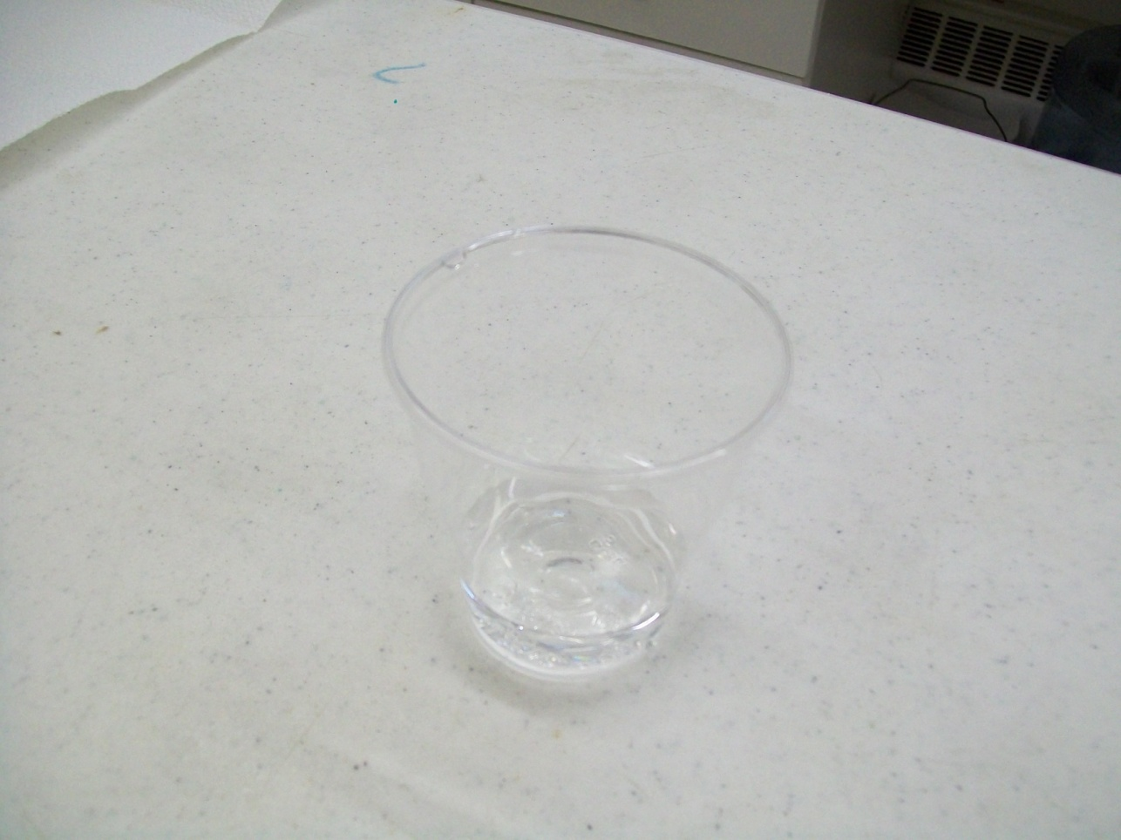
Label the 3 plastic cups with appropriate number and name:
#1 – Control
#2 – Canadian Guideline (CGLS)
#3 – Local community treated water

Slide 13
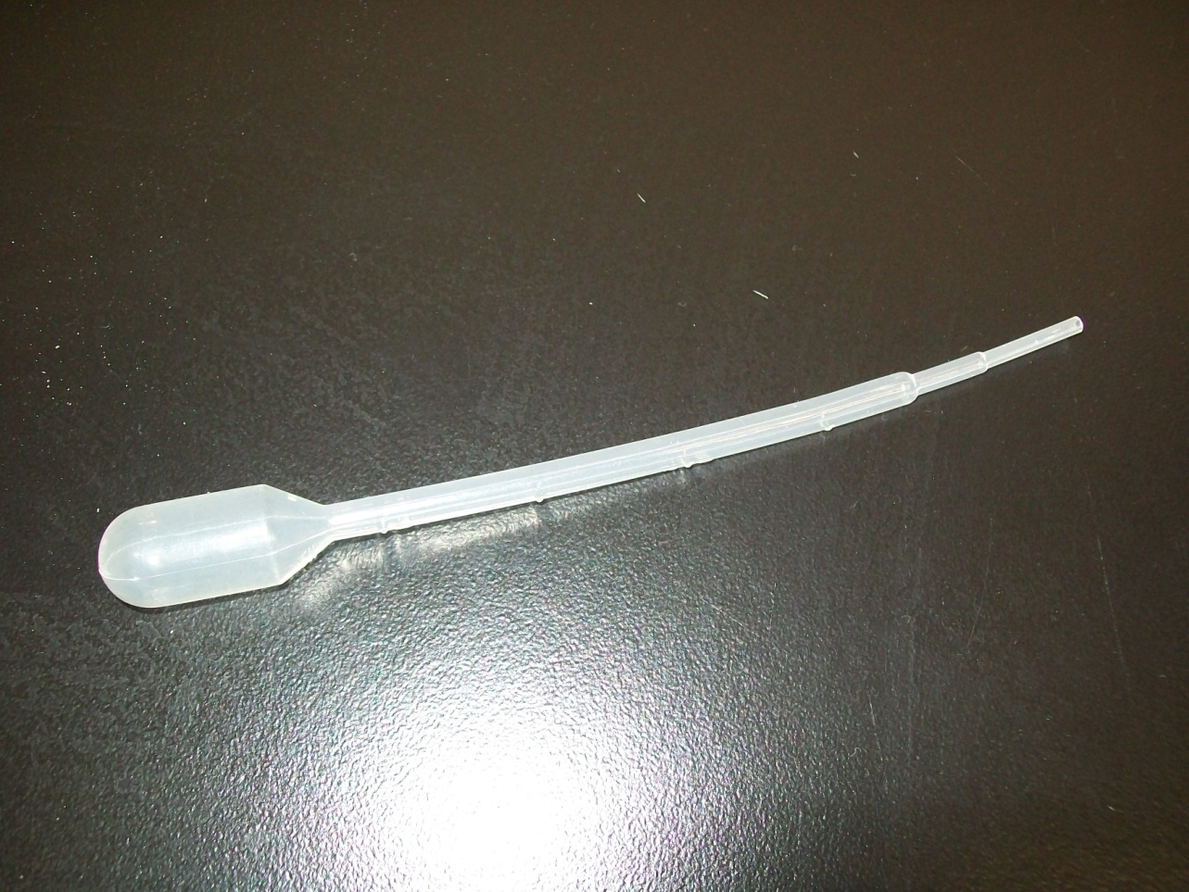
2. Label the 2 pipettes: DI (for Deionized Water), LTW (for Local Community Treated Water).

Slide 14
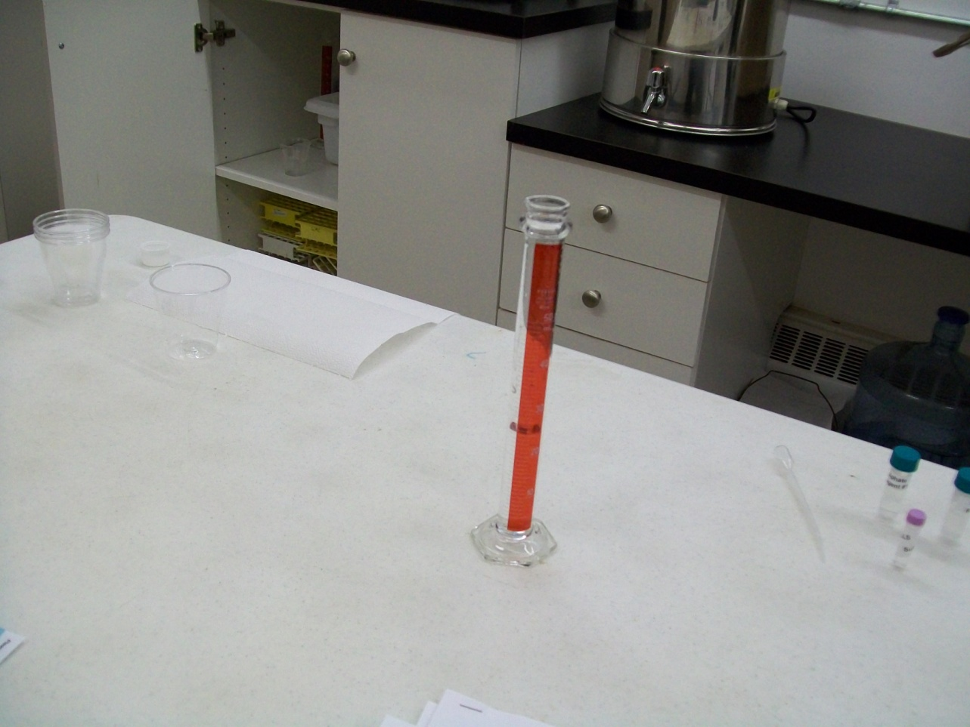
3. Using a graduated cylinder, measure out 25 mL of Deionized Water to each of the 3 cups.

Slide 15
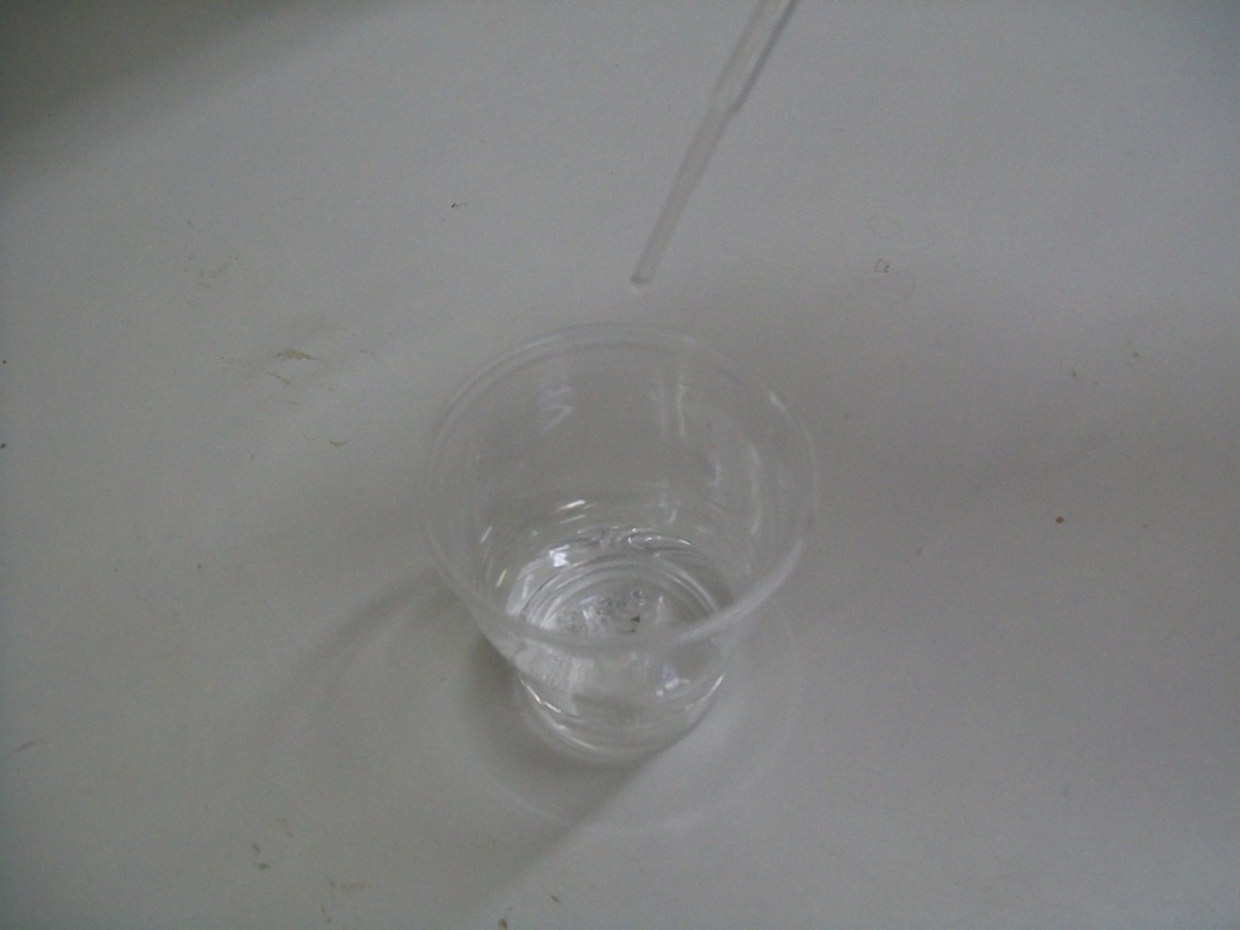
4. To the #1 Control cup, add 2 mL of the Deionized Water using the pipette labeled DI.

Slide 16
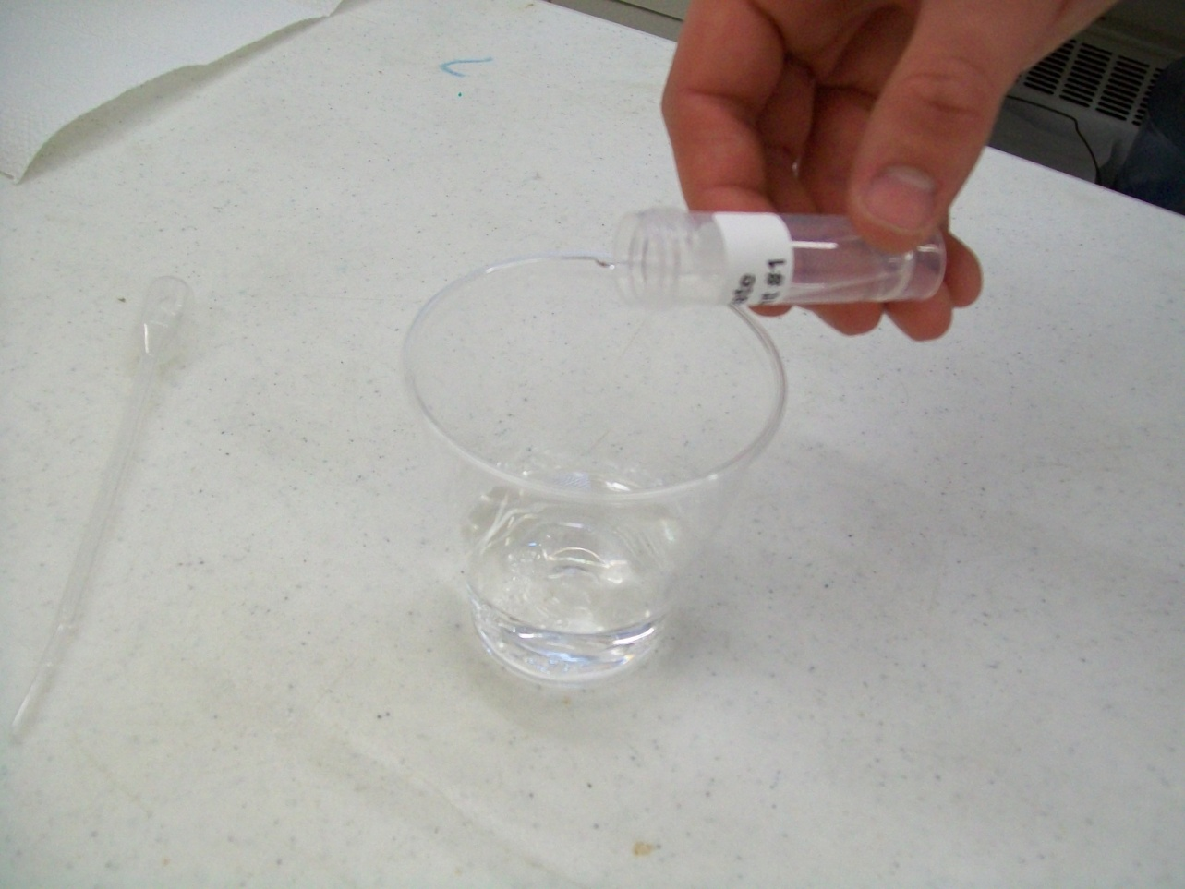
5. To the #1 Control cup, add contents of one of the Sulphate Reagent 1 tubes.

Slide 17
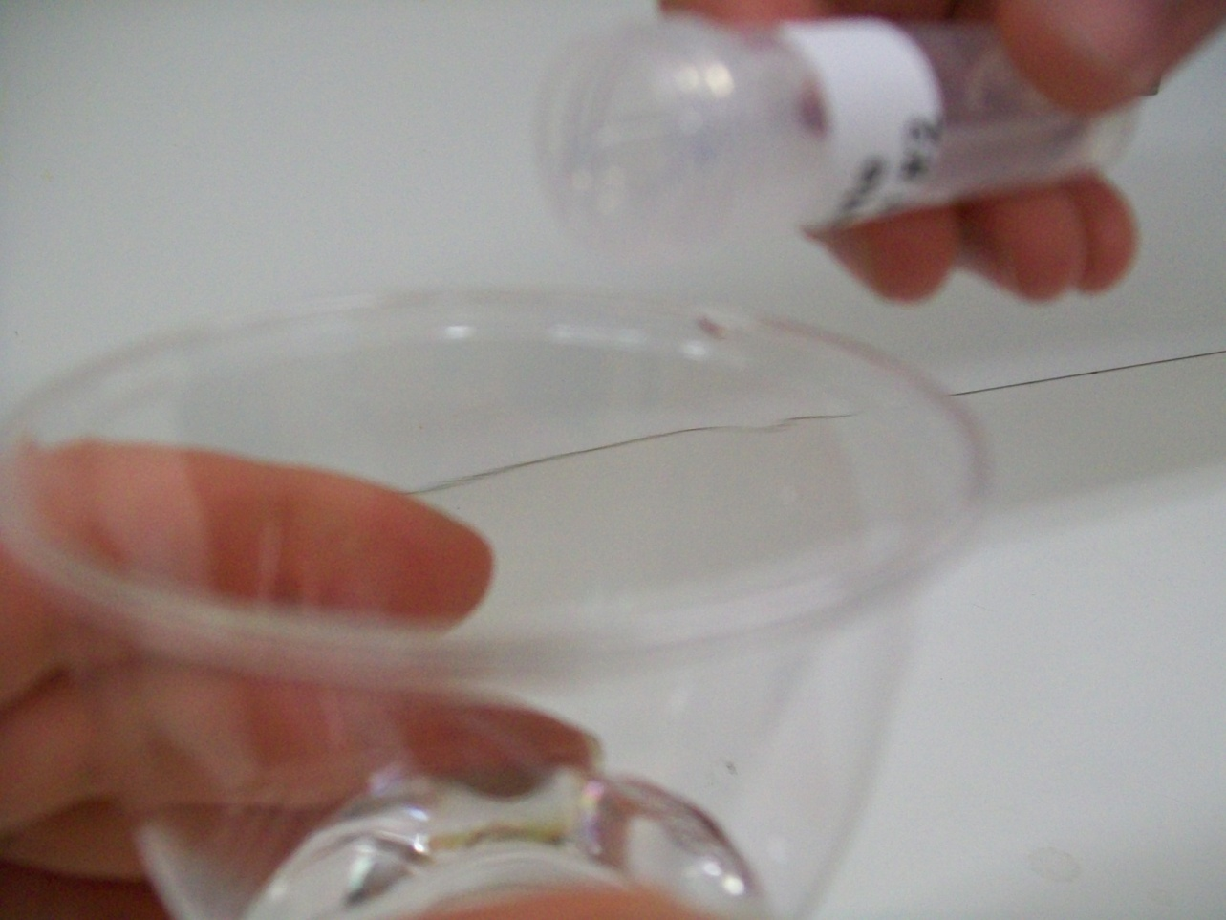
6. To the #1 Control cup while swirling, add contents of one of the Sulphate Reagent 2 tubes.

Slide 18
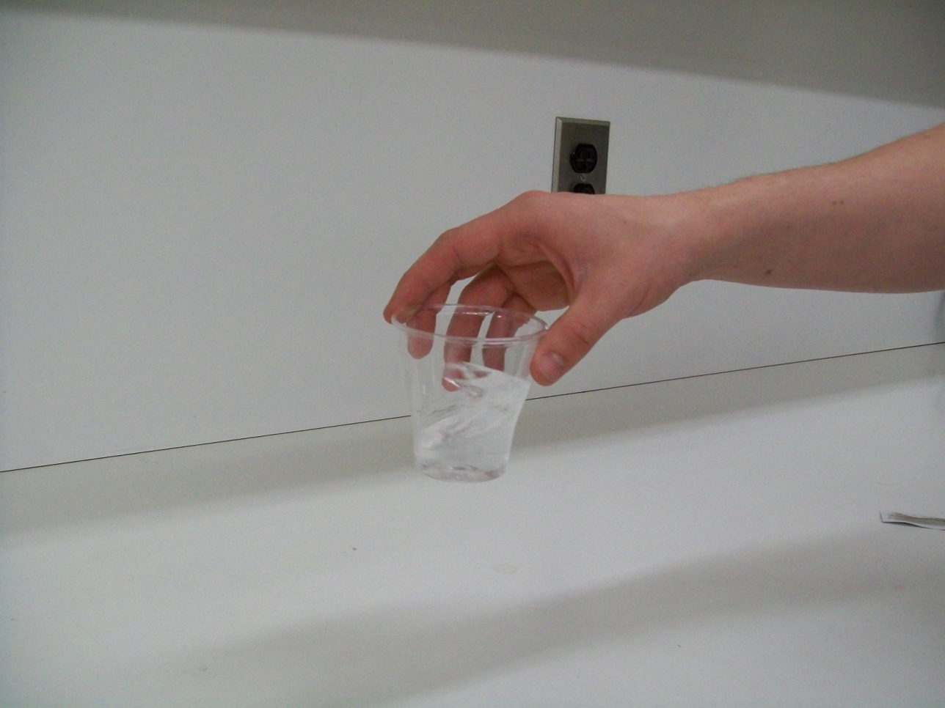
6. (Continued) Continue swirling for 1 minute and then set the cup aside.

Slide 19
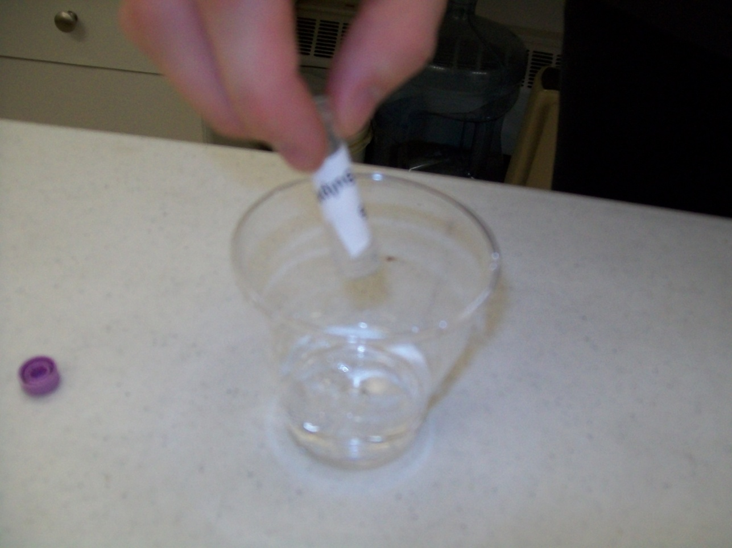
7. To the #2 cup [Canadian Guideline (CGLS)], add contents of tube labeled Canadian Guideline (CGLS). 8. To the #2 cup, add contents of one of the Sulphate Reagent 1 tubes. 9. To the #2 cup while swirling, add contents of one of the Sulphate Reagent 2 tubes. Continue swirling for 1 minute and then set the cup aside. 10. To the #3 cup, using the pipette labeled LTW, add 2 mL of the Local Community Treated Water. 11. To the #3 cup, add contents of the Sulphate Reagent 1 tube. 12. To the #3 cup while swirling, add contents of the Sulphate Reagent 2 tube. Continue swirling for 1 minute and then set the cup aside.

Slide 20
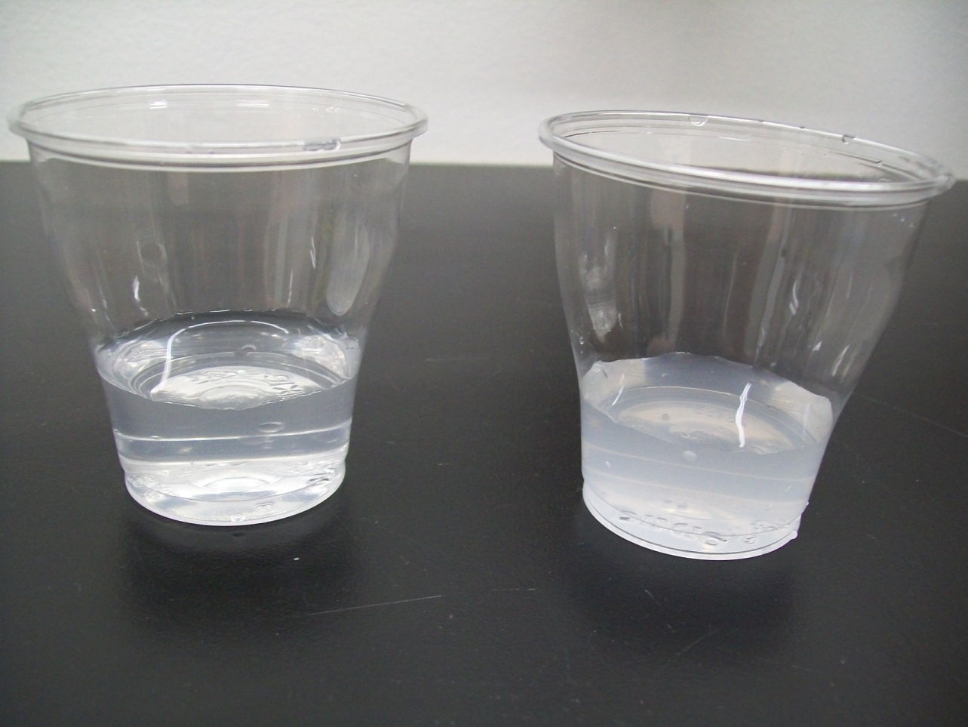
13. Determine the cloudiness of the cups Relative to the Canadian Guideline for Sulphate sample (CGLS) (more or less cloudy) and record the results. Results: The Canadian Guideline sample should be cloudy. If the water sample is less cloudy than the Canadian Guideline, then it passes the Guidelines for Canadian Drinking Water Quality guideline for sulphate, which is 500 mg/L. The Control should not have any cloudiness present.

Slide 21
The Six Tests That the Students Do in Groups

Slide 22
Ammonium Test

Slide 23
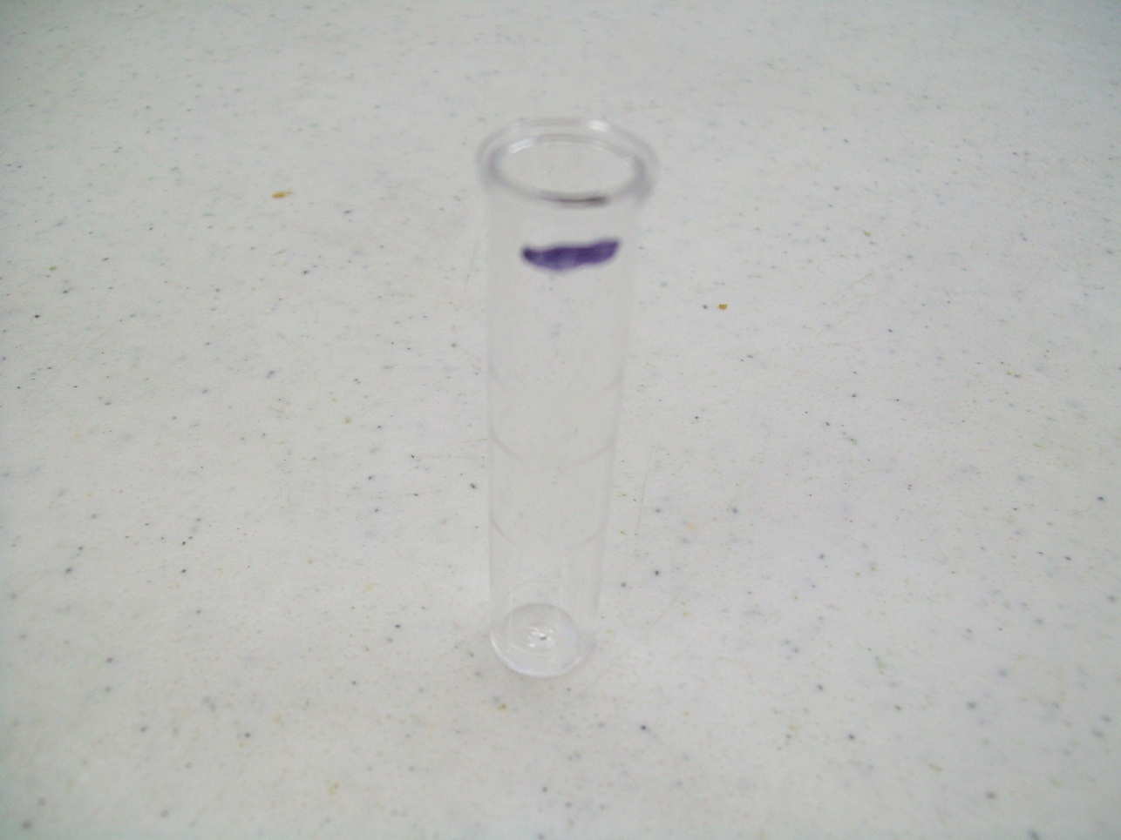
1. Draw a line 5 mm from the top of the cuvette.

Slide 24
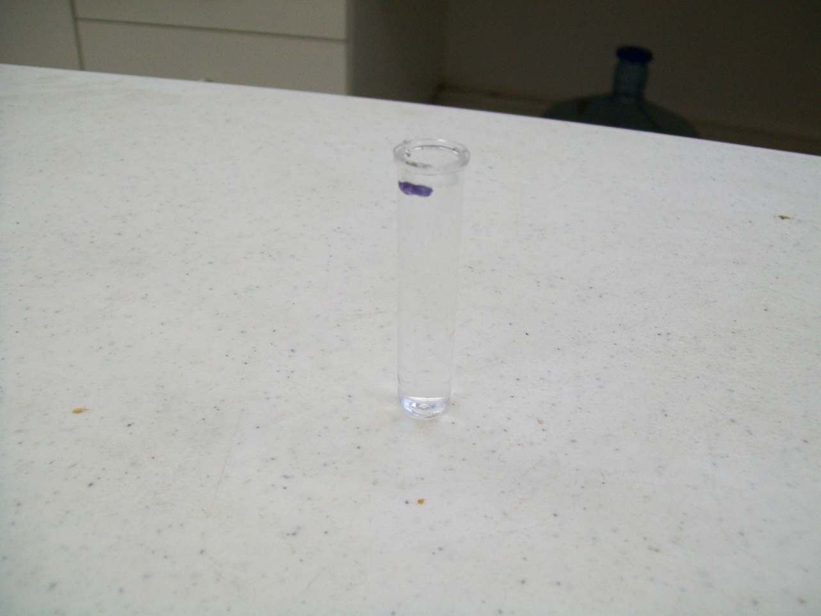
1. (Continued) Begin with the Local Community Treated Water sample and pour the sample up to the marked line.

Slide 25
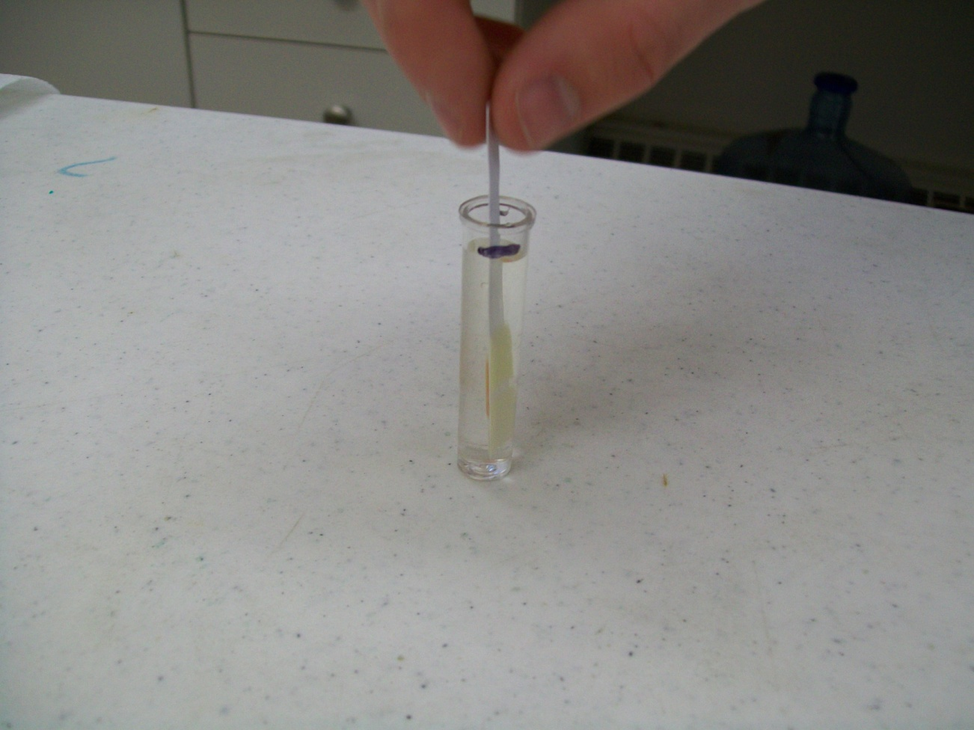
2. Dip one Ammonia Reagent Strip into the Sample for 40 seconds with a gentle, steady, up and down motion. 3. Remove and discard the strip.

Slide 26
3. Pour the 4 mL of AEUL from the vial into the other cuvette.

Slide 27
4. Dip one Ammonia Reagent Strip into the AEUL for 40 seconds with a gentle, steady, up and down motion. 5. Remove and discard the strip.

Slide 28
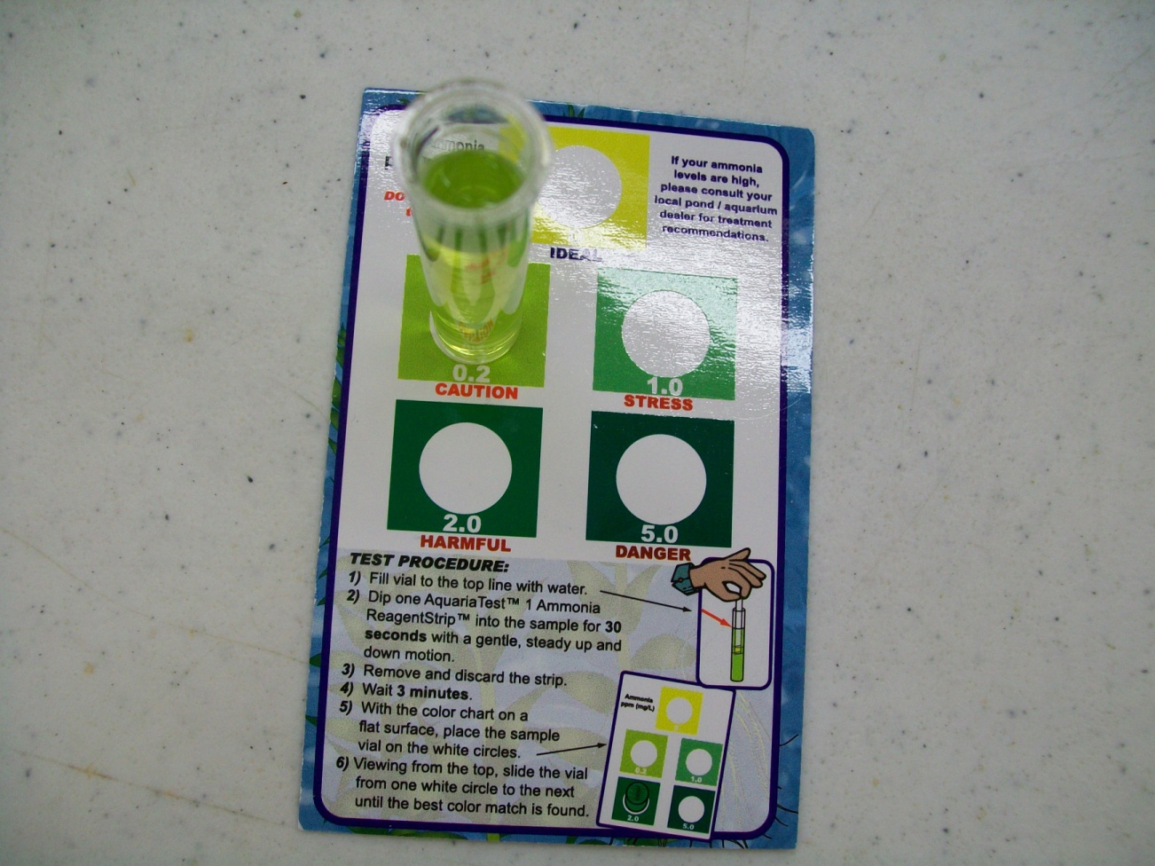
6. After 5 minutes, match the colour by placing the vial on the white circles on the card. Look into the top of the vial to see which colour matches best. A colour change from yellow (< 0.1 mg/L) to shades of green indicates the presence of ammonia. Use the colour chart to determine the ammonia concentration. Results: Since there is no Canadian Drinking Water Guideline for Ammonia you will compare results to the European Union limit. The standard should give a result very close to the 0.5 mg/L AEUL; if the colour is darker then it DOES NOT meet the guidelines.

Slide 29
Colour Test

Slide 30
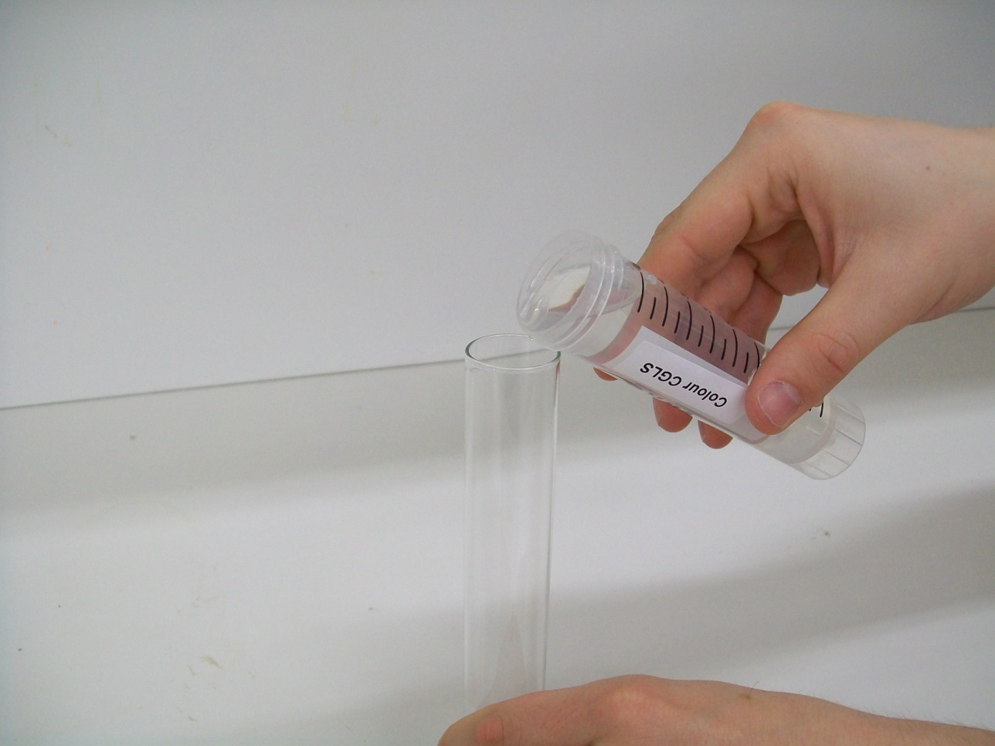
1. Label the test tubes; Control, Canadian Guideline, and Local community sample. 2. Pour the 50 mL of Canadian Guideline Limit Sample into the Canadian Guideline test tube.

Slide 31
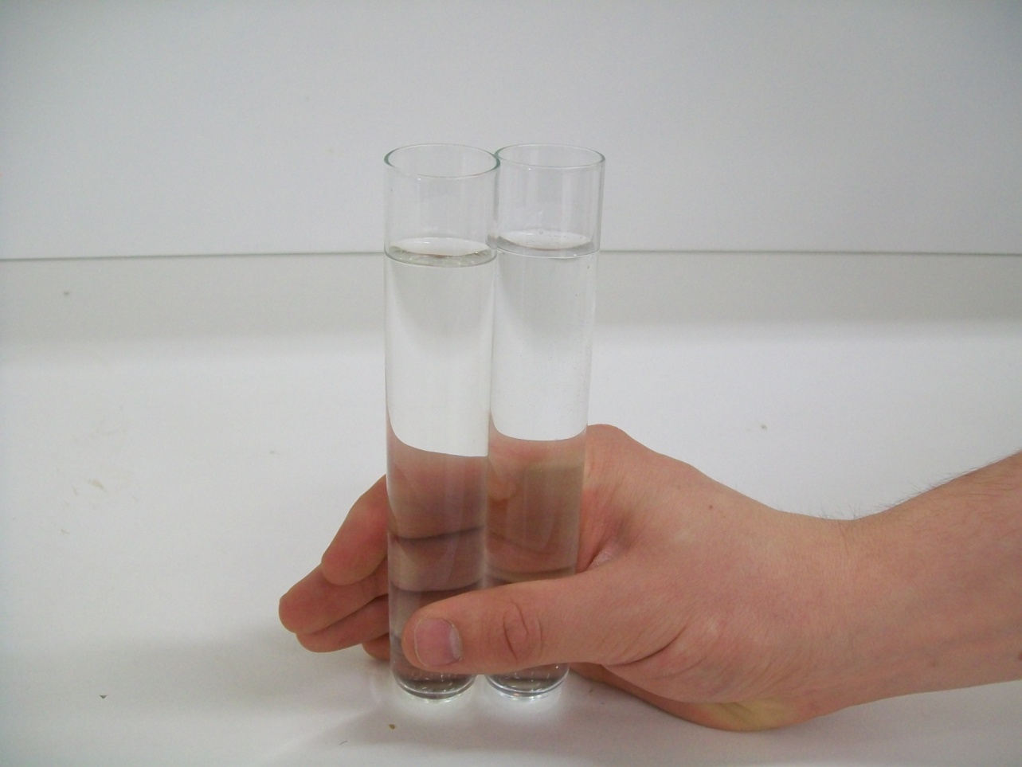
3. Fill the Control test tube with the deionized water to the same level as the Canadian Guideline test tube. 4. Fill the Sample test tube with Local community treated water to the same level as the Canadian Guideline test tube.

Slide 32
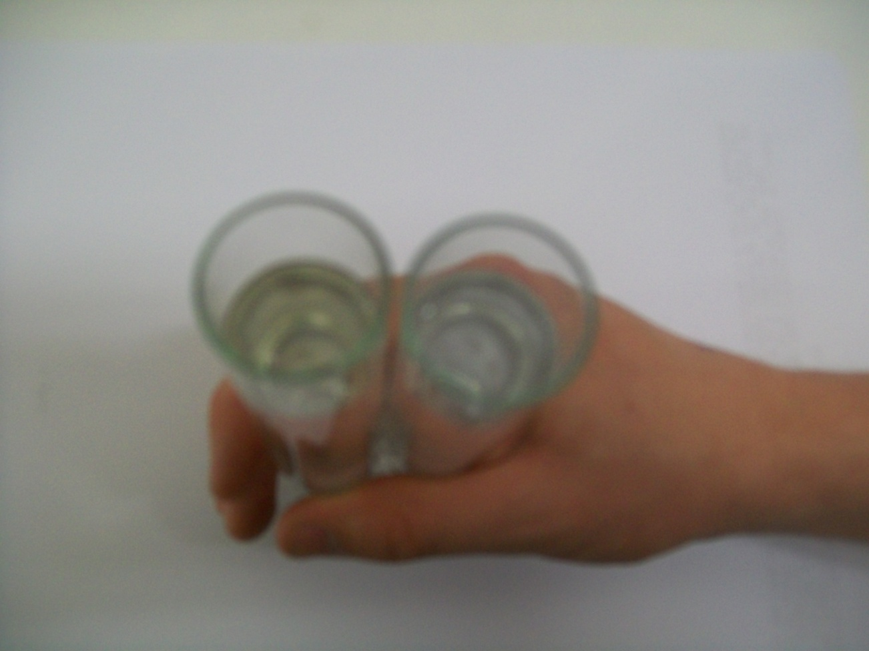
5. Hold the Local community treated water test tube side by side with the Control and Canadian Guideline tubes over a white piece of paper. 6. View the test tubes from above: Is the colour of the Sample lighter or darker than the colour of the Canadian Guideline tube? 7. Record the results. Results: If the water sample has a colour lighter or equal to that of the Canadian Guideline then it passes the Guidelines for Canadian Drinking Water Quality guideline for colour. If the water sample is darker in colour than that of the Canadian Guideline, it fails the Canadian Drinking Water Guideline of 15 TCU (True Colour Units).

Slide 33
Copper Test

Slide 34
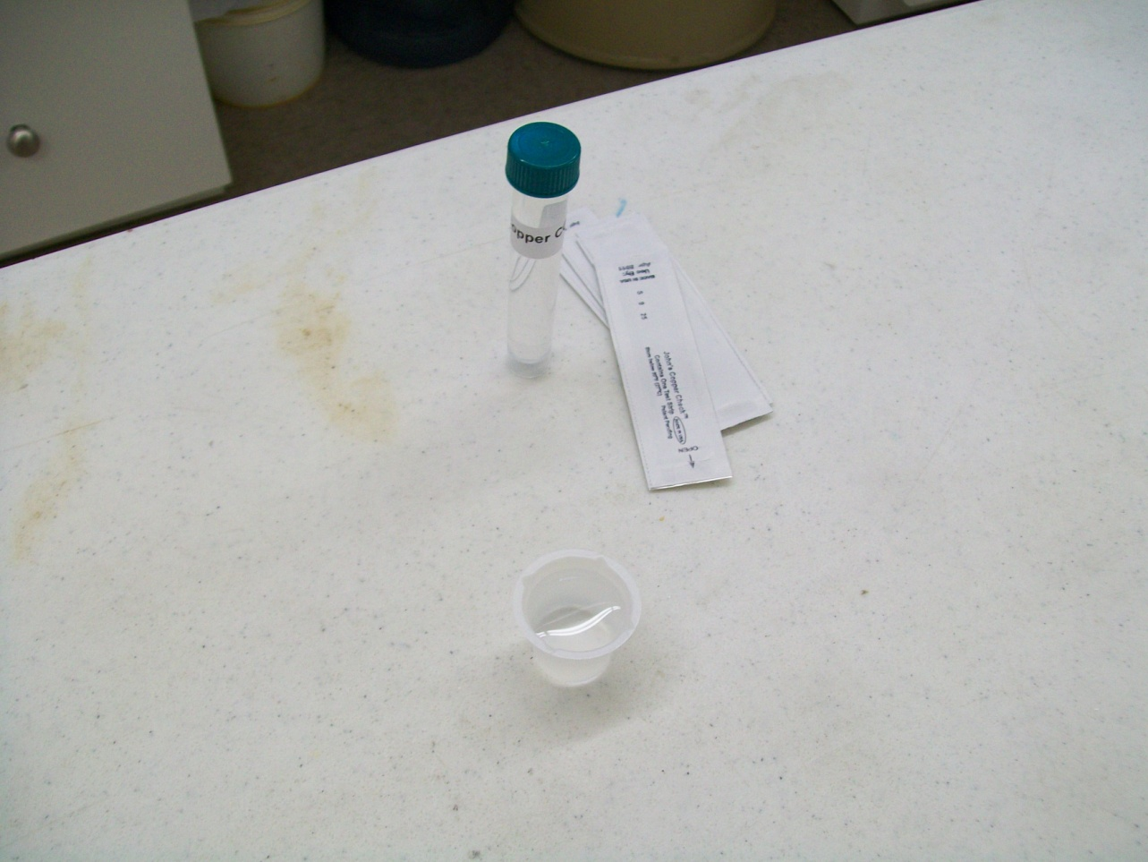
1. Label the two beakers with their appropriate water sample names. 2. Put 10 mL of sample in their respective beakers.

Slide 35
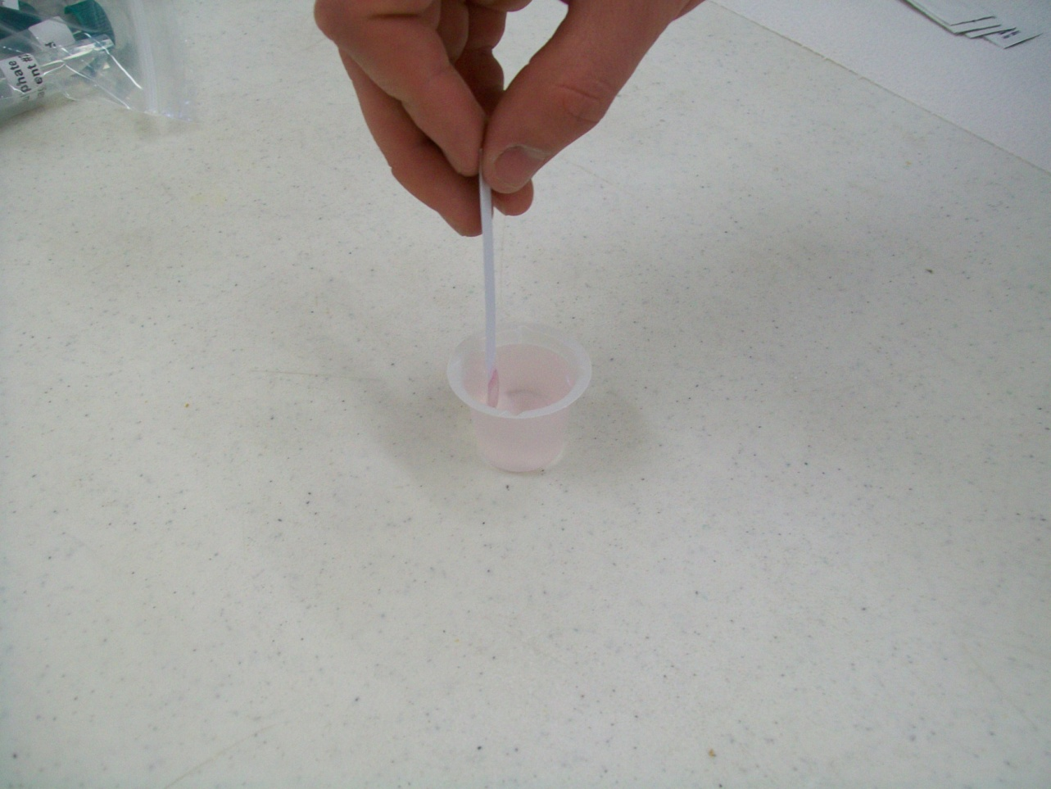
3. Dip one test strip in sample or (CGLS) beaker for 30 seconds with constant back and forth motion.

Slide 36
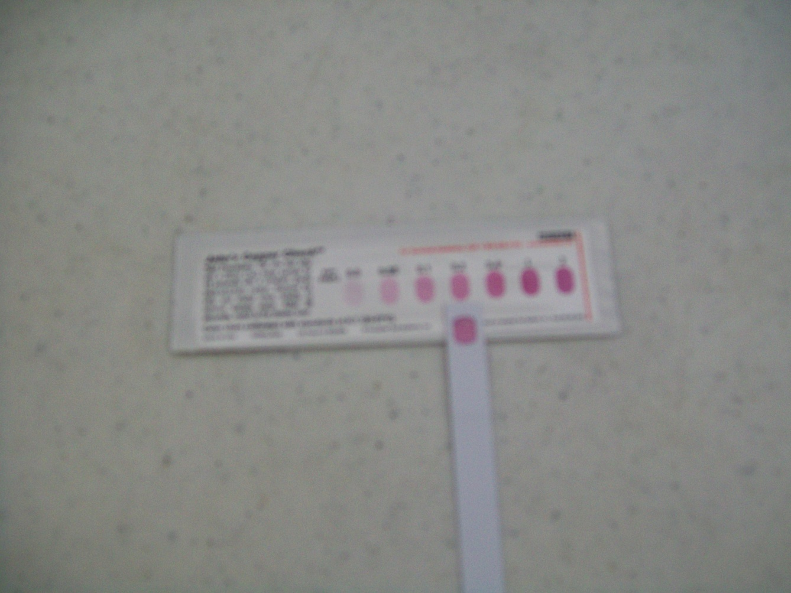
4. Remove and match colour after 2 minutes to determine the Copper concentration in mg/L or parts per million (ppm). Results: Compare results to the Guidelines for Canadian Drinking Water Quality. The Canadian Guideline should give a result very close to the 1 mg/L guideline; a darker colour means that the water Does Not meet the Guidelines for Canadian Drinking Water Quality.

Slide 37
Total Chlorine Test

Slide 38
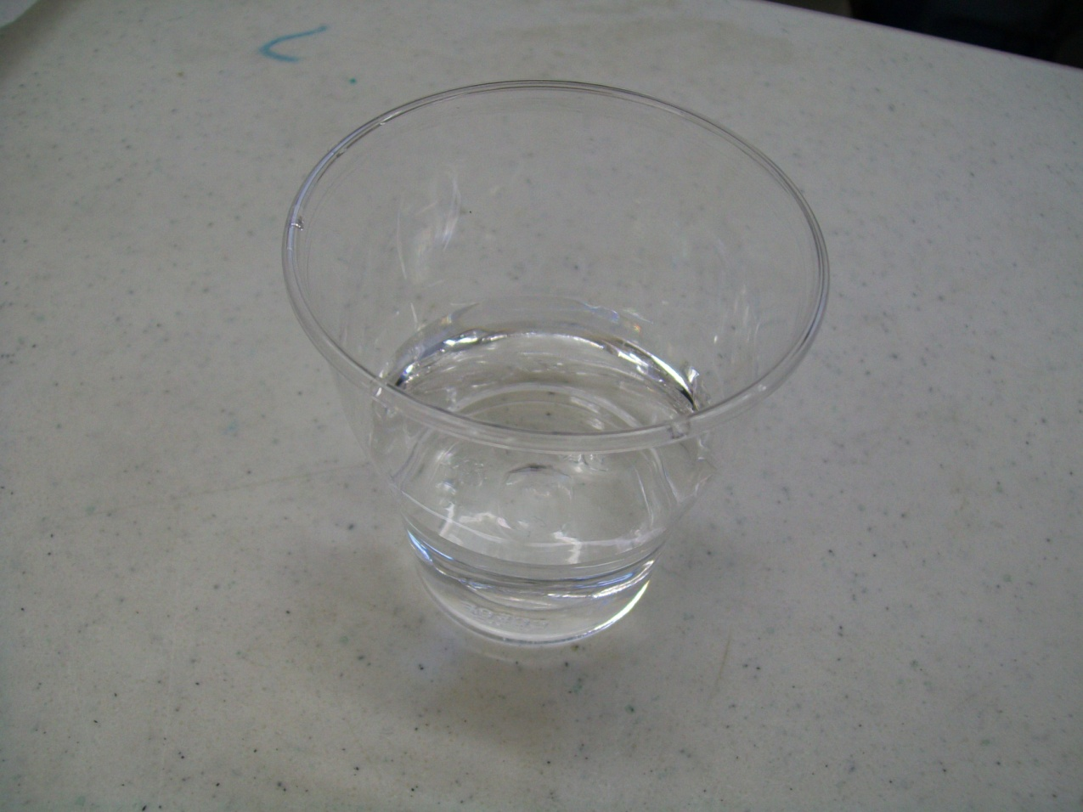
1. Label the two glasses with their respective names.
2. Put about 50 mL of sample in respective glasses (volume is really not critical).

Slide 39
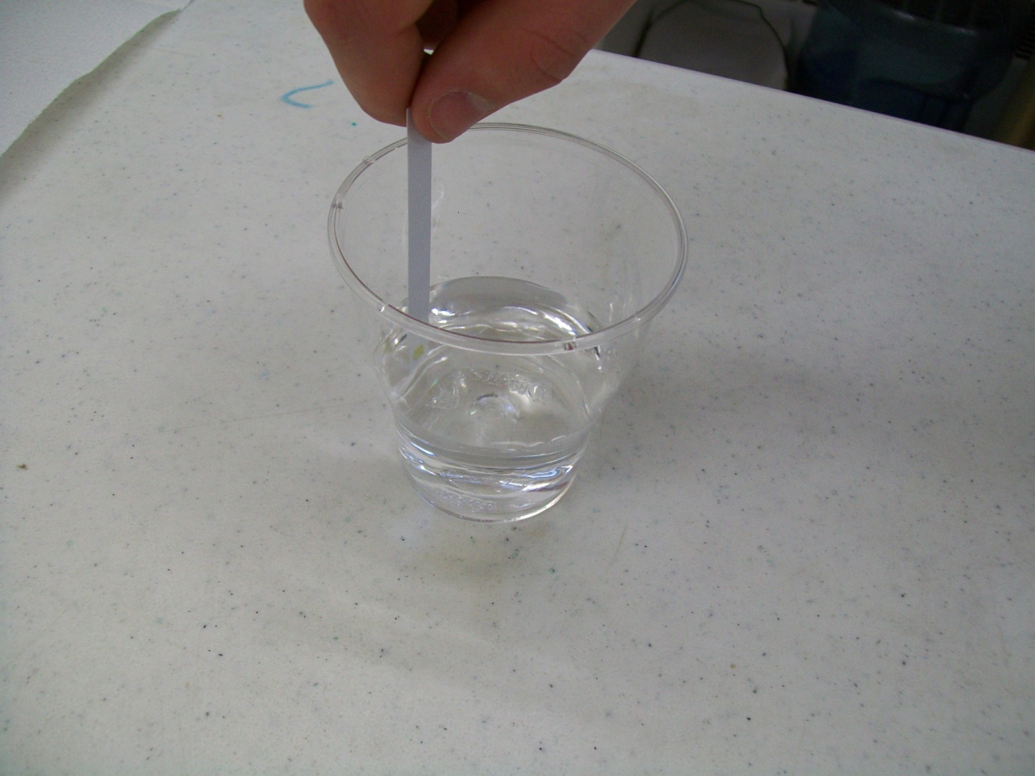
3. Dip one test strip in glass for 5 seconds with constant back and forth motion, so that water passes through the small aperture in the test strip.

Slide 40
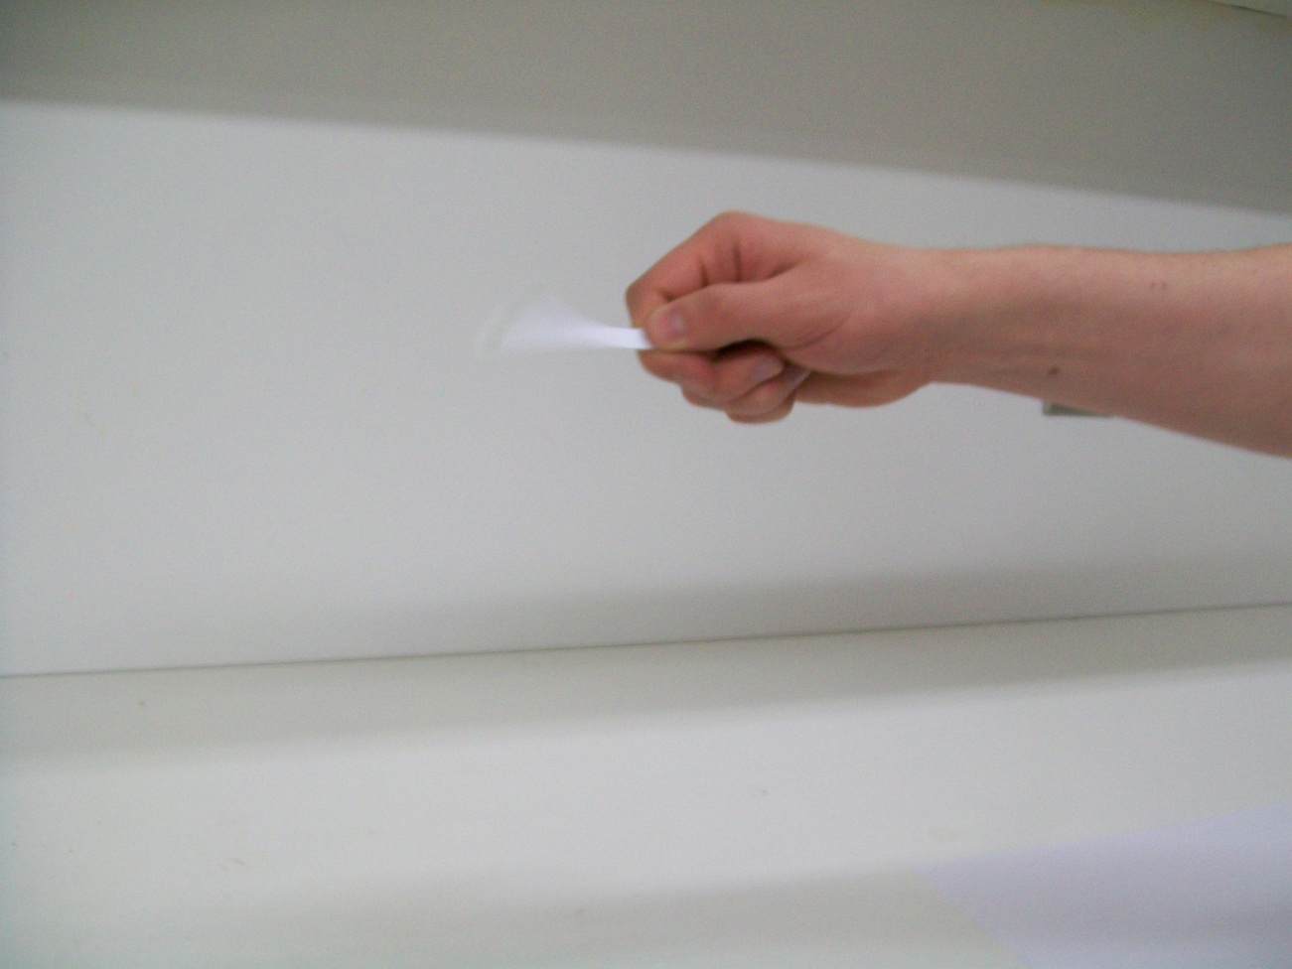
4. Remove and shake the test strip once, briskly, to remove any excess water on the strip.

Slide 41
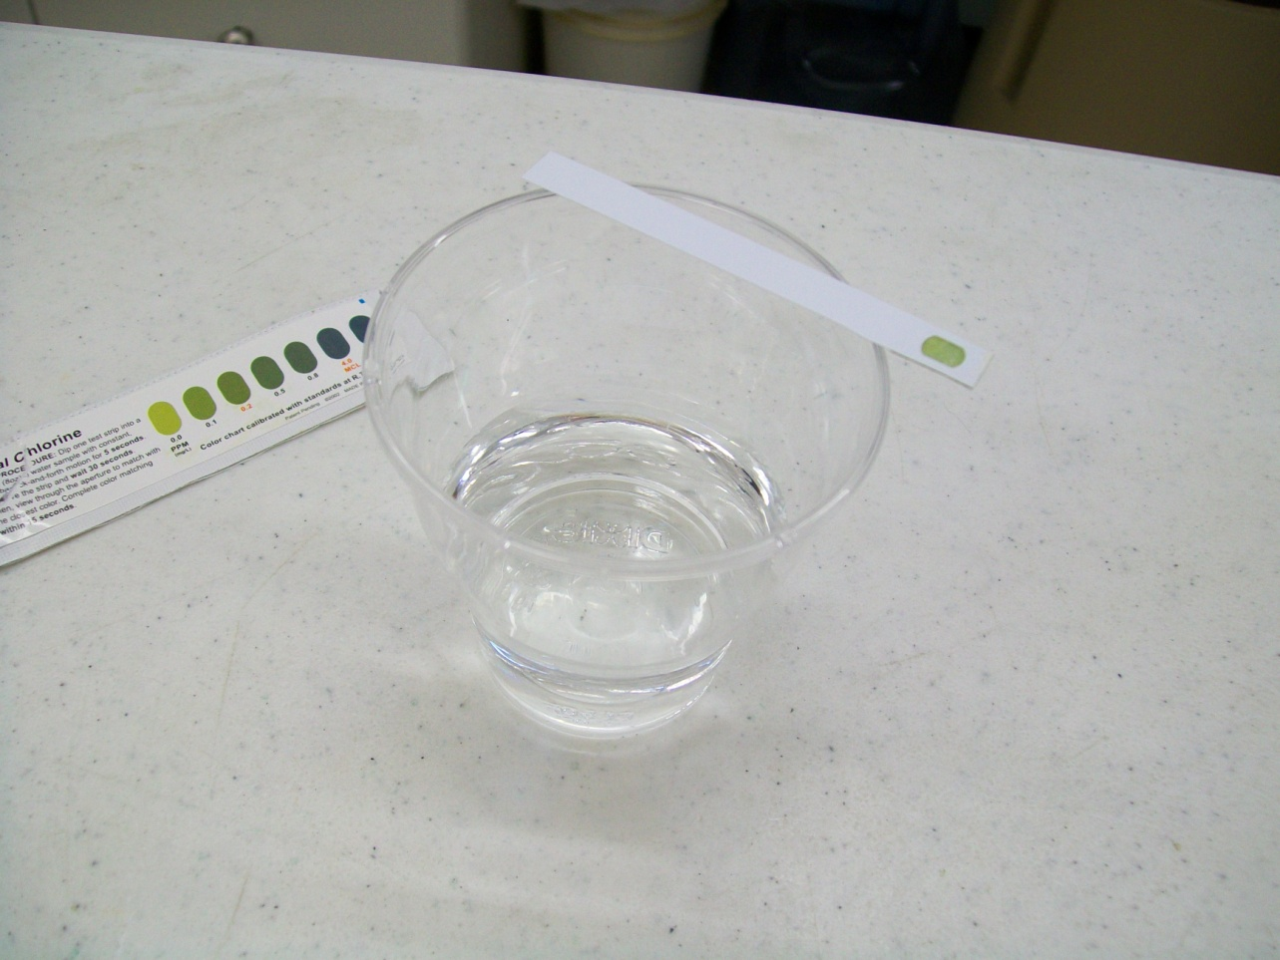
4. (Continued) Allow the test strip to dry for 30 seconds by lying across glass.

Slide 42
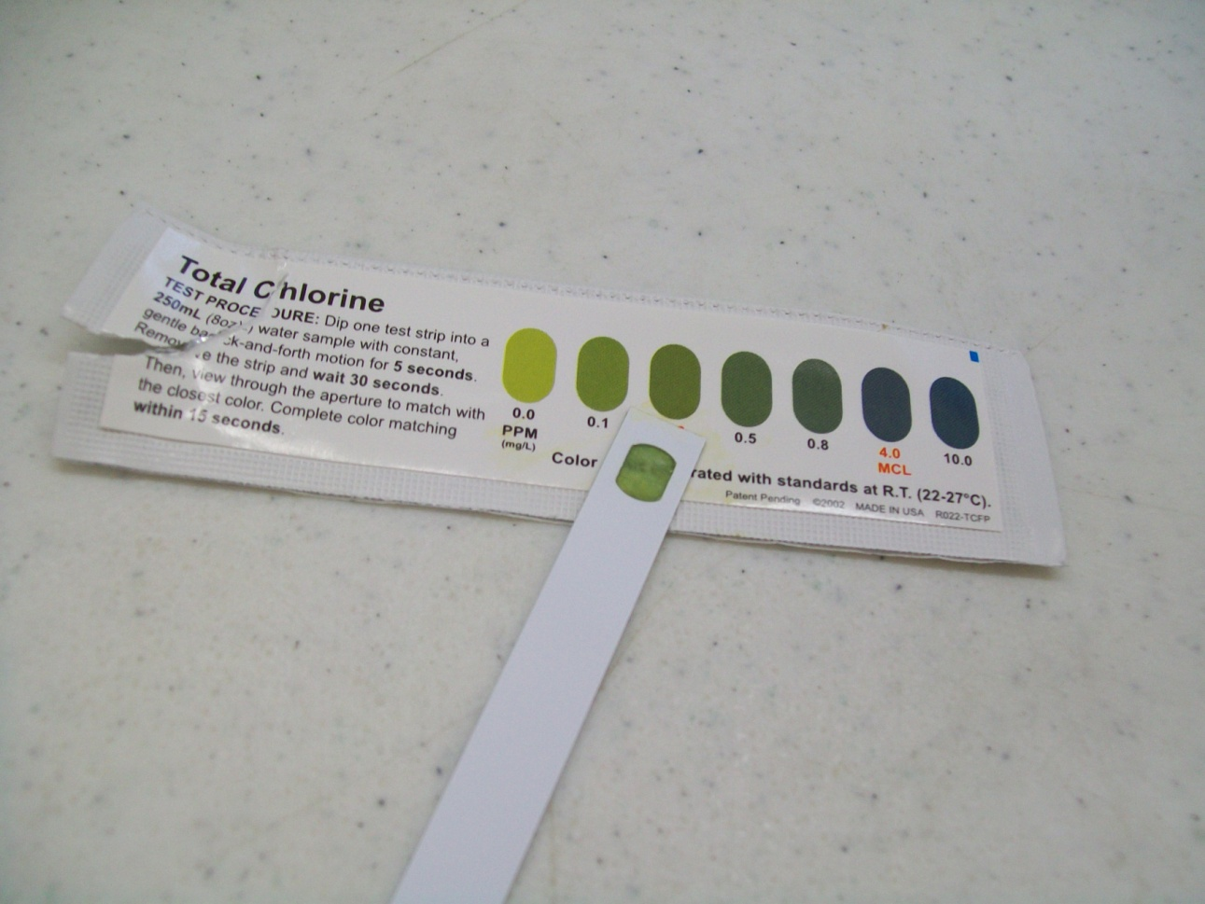
5. Match with the best colour to determine the Total Chlorine concentration in mg/L or parts per million (ppm). Complete the colour matching within 15 seconds. Do one sample at a time. 6. Write up your results. Results: Compare results to the United States Environmental Protection Agency’s maximum residual disinfectant level goal for chlorine of 4 ppm; a darker colour of green means that the water sample Does Not meet the United States Environmental Protection Agency’s maximum residual disinfectant level goal for chlorine. Please refer to the facts sheet portion of the instructions for more information about chlorine.

Slide 43
Total Hardness Test

Slide 44
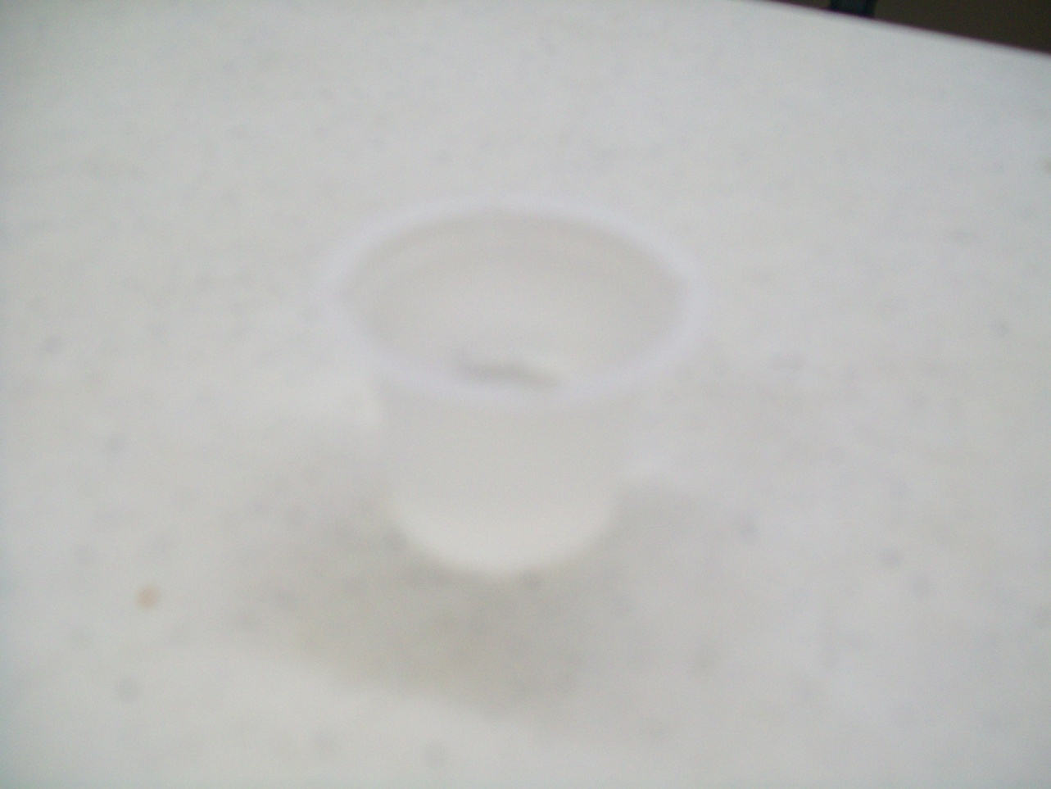
1. Label the two beakers with their respective names.
2. Put 10 mL of sample in their respective beakers.

Slide 45
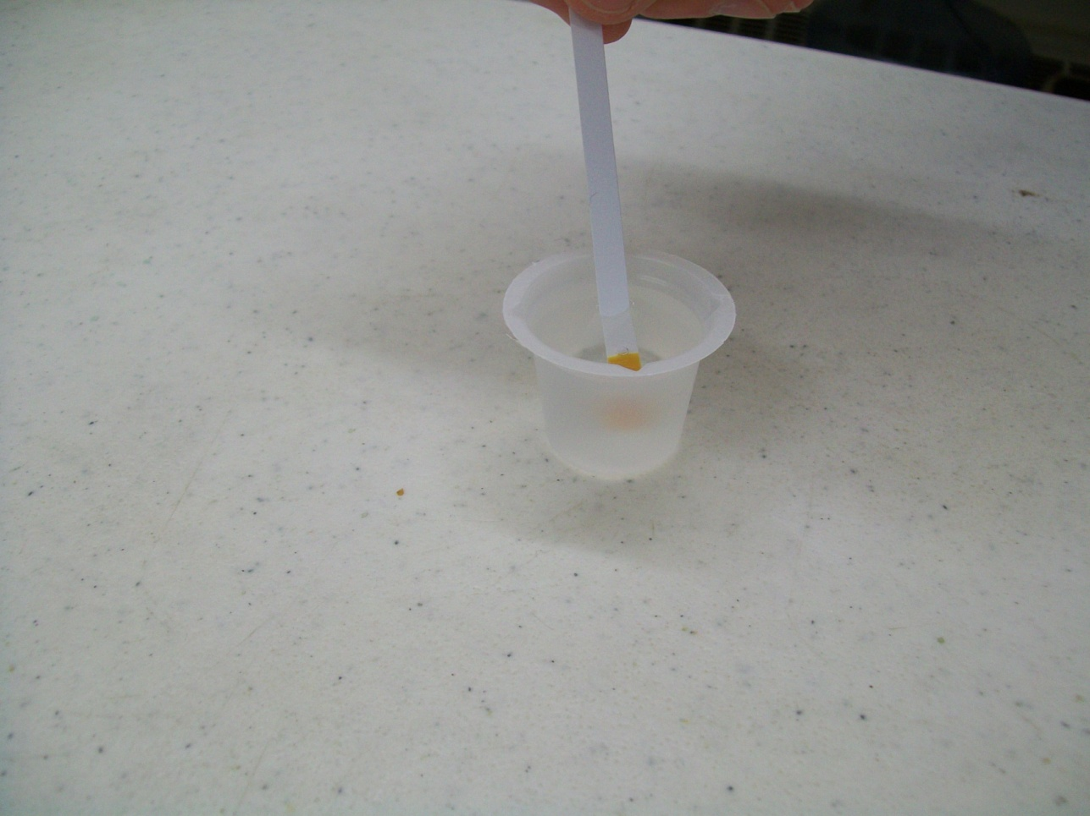
3. Dip one test strip in sample beaker for 3 seconds.

Slide 46
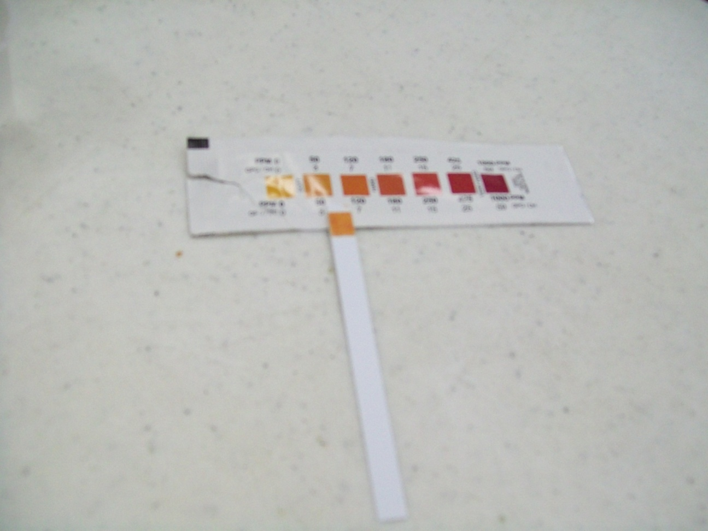
4. Remove and immediately match to the closest colour on the colour chart that is located on the test strip packet. Colour is only stable for 1 minute. 5. Read and record results as mg/L (parts per million), match with the best colour to determine the Total Hardness concentration. 6. Repeat for the Guideline Limit Sample. Results: The Saskatchewan Guideline Limit Sample (SGLS) for Total Hardness should give a result very close to the 800 mg/L guideline; this is a very high level of hardness and should only be encountered in untreated well water sources.

Slide 47
pH Test

Slide 48
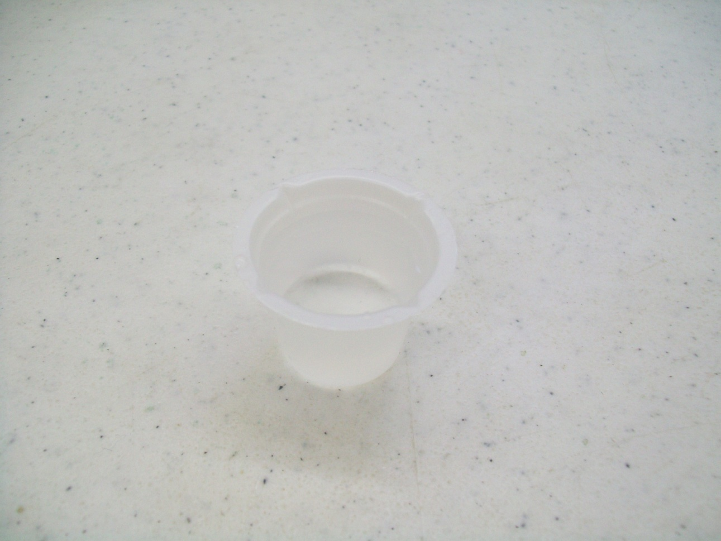
1. Label the three beakers with their respective names (do not include the buffer; this can be tested in the tube). 2. Fill the beakers with their respective samples.

Slide 49
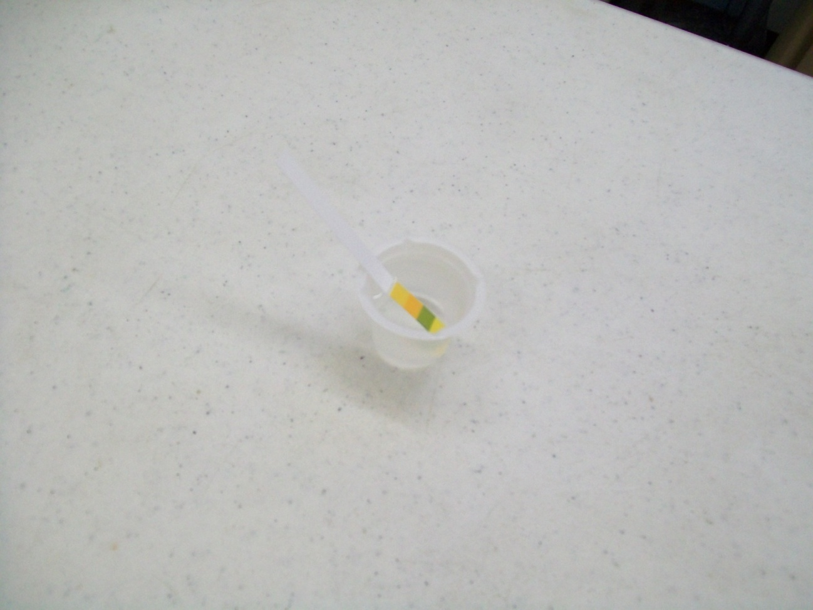
3. Place the pH strip into the beaker/vial. 4. Leave for 2 minutes.

Slide 50
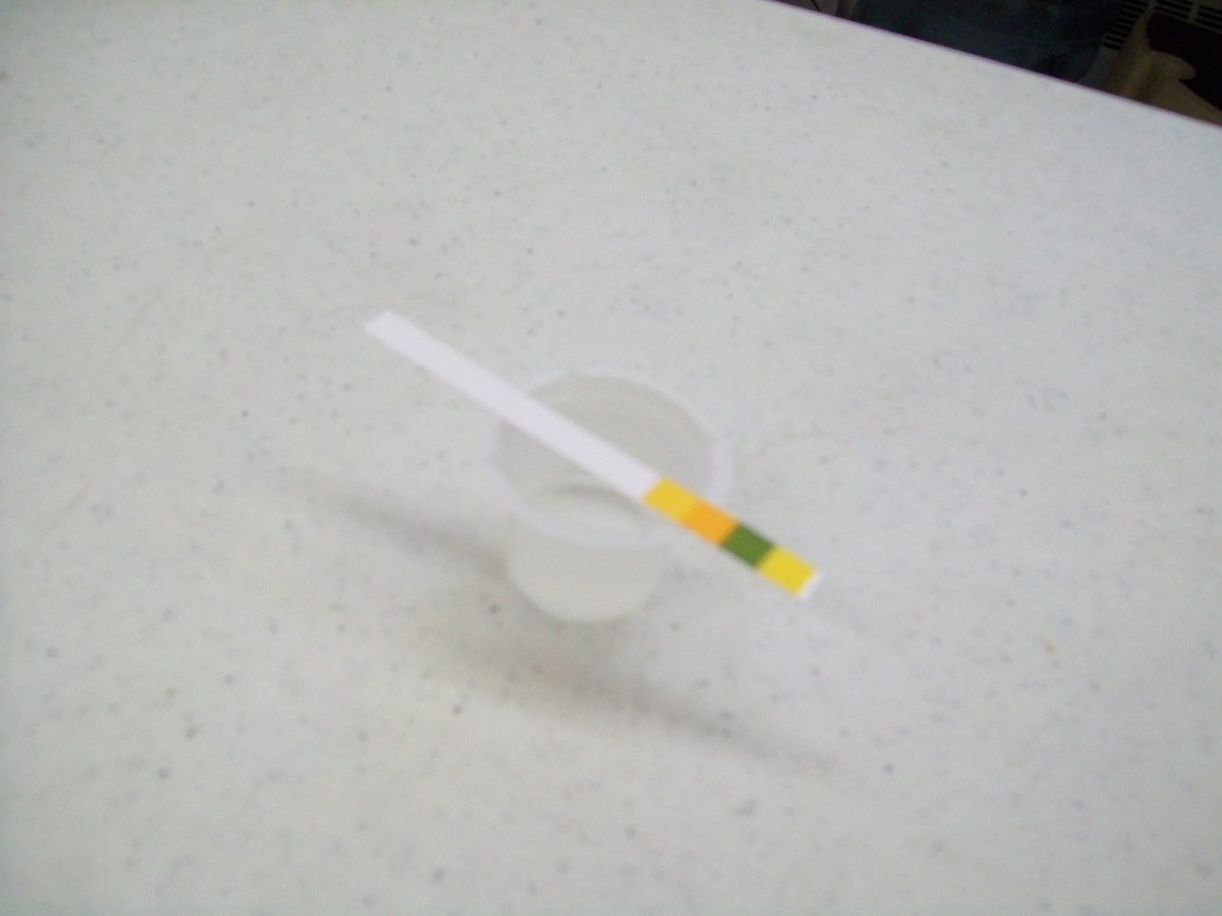
5. Remove the pH strip and lay it across the beaker, coloured side up. Wait 30 seconds.

Slide 51
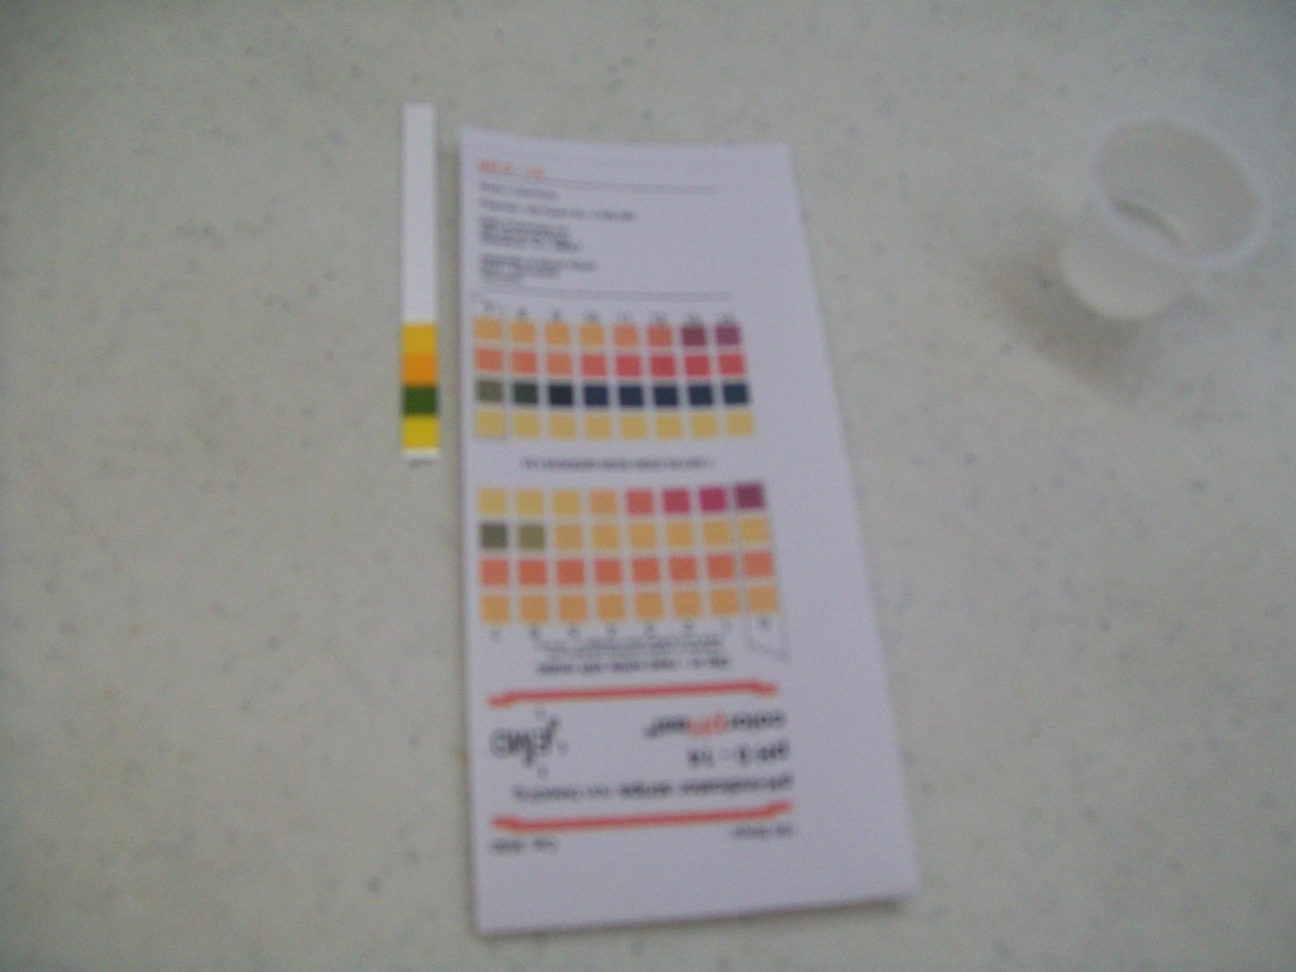
6. Determine the pH of the strip by comparing it to the pH scale card. 7. Record your results. Results: Sample water with a pH between 7.0 and 10.5 meets the Guidelines for Canadian Drinking Water Quality guideline for pH. The buffer should give a result very close to 7.

Slide 52
Tell me again, how do I get this awesome kit?
Many kits are sponsored by generous companies and foundations.
Kits can, of course, also be purchased by schools/school divisions themselves at reasonable cost-recovery prices. To find out whether your school is eligible to receive a sponsored kit please contact us!
E-mail info@safewater.org
Phone 306-934-0389

Slide 53
We Have Six Other Environmental Education Programs Available!

Slide 54
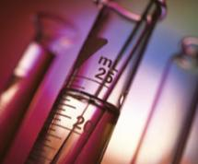
Operation Water Pollution (OWP)
A program for students in Grades 5 to 12 which teaches them about what water pollution is, what causes water pollution, what can be done about water pollution and what they, personally, can do about the problem.
Includes a digital TDS and digital pH meter, both are reusable for at least two years.

Slide 55
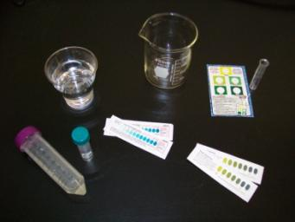
Operation Water Biology (OWB)
A series of 8 lesson plans designed for use with students in Grades 9 to 12.
Teaches students about biological water treatment, a more environmentally friendly and effective method of treating drinking water, compared to conventional (chemical) water treatment.
Also teaches students about chlorine, chloramine, ammonia and iron.

Slide 56
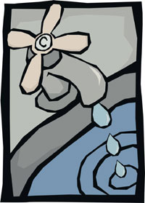
Operation Community Water Footprint (OCWF)
Designed for students in Grades 6 to 12.
Students calculate the amount of source water that is required to produce 1 litre of drinking water in their community, it is often more than they expect!
Then, students can “Put their school on the map” by using the website application on the SDWF website and entering their community’s water footprint as well as what they are doing in order to improve the drinking water situation and to share information with others.
This program is available free of charge online.

Slide 57
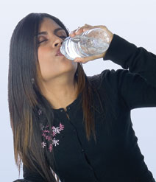
Operation Water Health (OWH)
Designed for students in Grades 5 to 12.
The students explore common disease-causing microbes found in water, how these microbes are removed or inactivated in water with water treatment, and the diseases these microbes cause when they are not identified and treated in drinking water systems.
The students ponder the question: is it cheaper to treat the illness or treat the water?
This program is available free of charge online!

Slide 58
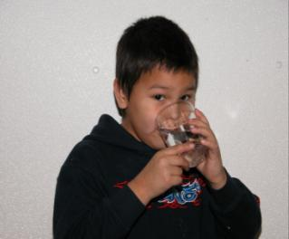
Operation Water Spirit (OWS)
Designed for students in Kindergarten, Grade 2, Grade 5 and Grades 7 to 12.
Reinforces Aboriginal culture and perspectives regarding water for Aboriginal students - while at the same time providing an Aboriginal perspective to non-Aboriginal students about water issues.
Invites teachers to encourage classroom discussions to enable students to gain a closer understanding of Aboriginal issues and perspectives surrounding drinking water.
This program is available free of charge online!

Slide 59
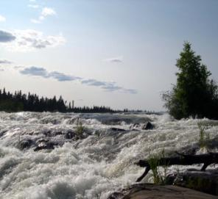
Operation Water Flow (OWF)
Recommended for students in Grades 6 to 12.
Encourages students to establish the true cost of water (economic and environmental); the social responsibilities of providing safe drinking water; the need for national regulations; and the need for water conservation, source water protection, etc.
Operation Water Flow is a cross-curricular program which supports and encourages a broad understanding of information related to drinking water issues.
This program is available free of charge online!

Slide 60


SDWF Mission
We will educate the leaders of today and tomorrow about drinking water quality issues to realize our goal of safe drinking water being available to every Canadian.

Slide 61
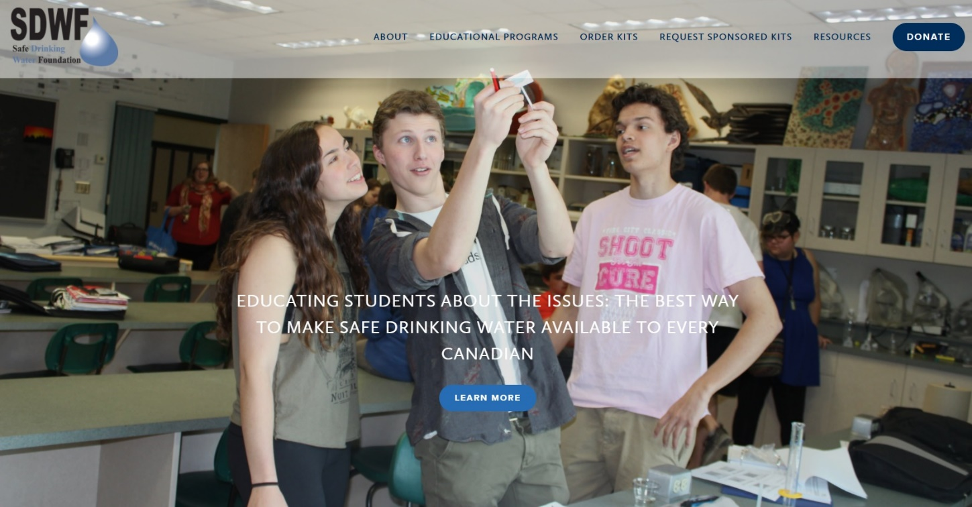
Please visit us at:
www.safewater.org

