Slide 1
Copper Test

Slide 2
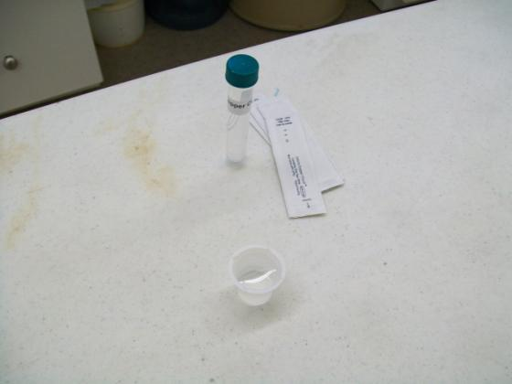
1. Label the two beakers with their appropriate water sample names. 2. Put 10 mL of sample in their respective beakers.

Slide 3
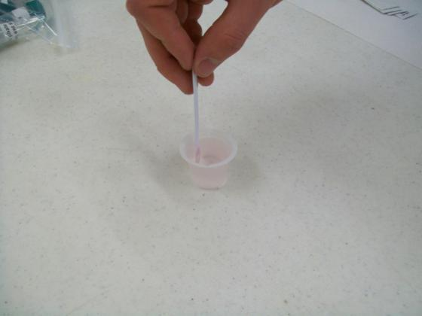
3. Dip one test strip in sample or (CGLS) beaker for 30 seconds with constant back and forth motion.

Slide 4
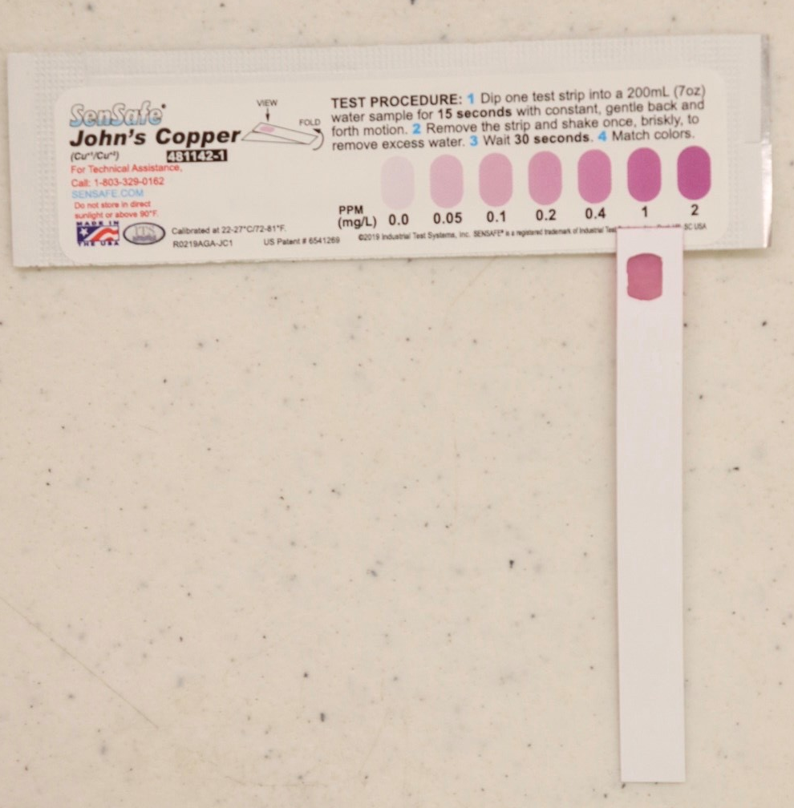
4. Remove and match colour after 2 minutes to determine the Copper concentration in mg/L or parts per million (ppm). Results: Compare results to the Guidelines for Canadian Drinking Water Quality. The Canadian Guideline should give a result very close to the 1 mg/L guideline; a darker colour means that the water Does Not meet the Guidelines for Canadian Drinking Water Quality.

