Slide 1

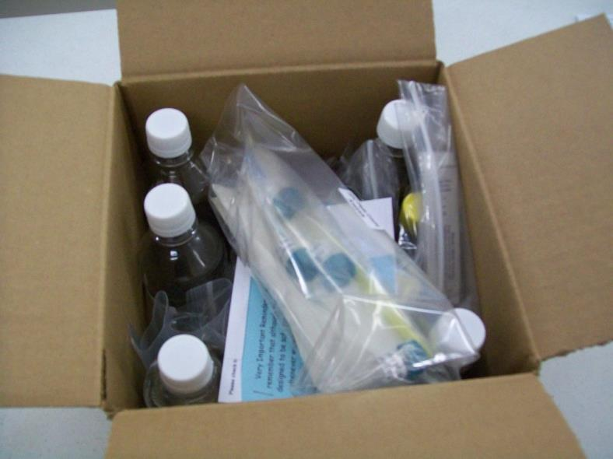
High School Operation Water Drop Kits

Slide 2

How do I get this awesome kit?
Many kits are sponsored by generous companies and foundations.
Kits can, of course, also be purchased by schools/school divisions themselves at reasonable cost-recovery prices. To find out whether your school is eligible to receive a sponsored kit please contact us!
E-mail info@safewater.org
Phone 306-934-0389

Slide 3
REMEMBER: Although the materials in the kit are safe to use, it is important to always use proper lab procedures and be careful when working in the lab.

Slide 4
Split Up the Materials for the Four Groups of Students

Slide 5
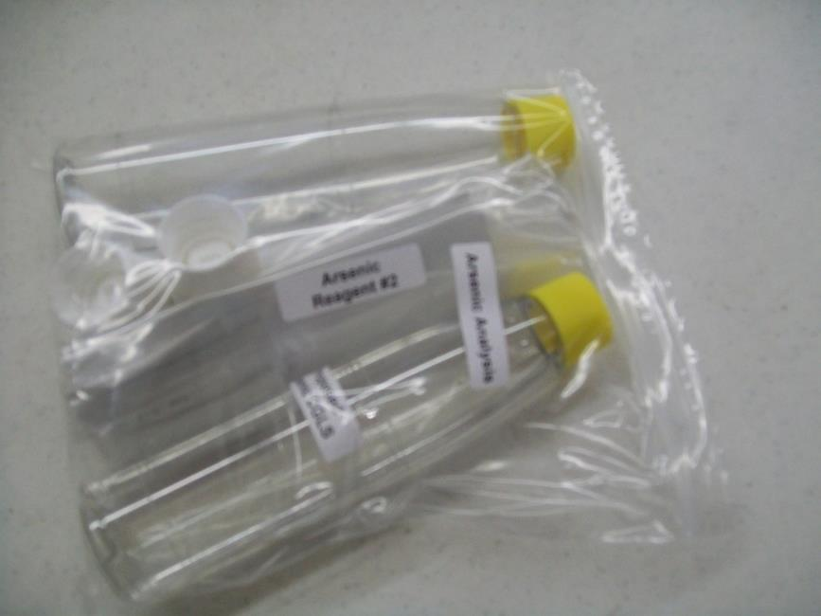
Group 1: Arsenic Alone

Slide 6
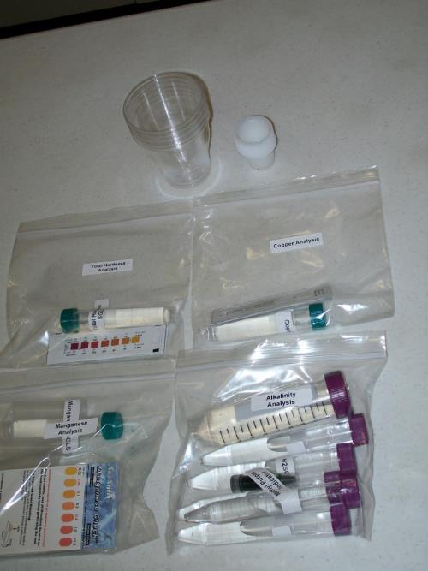
Group 2: Alkalinity, Copper, Manganese, and Total Hardness

Slide 7
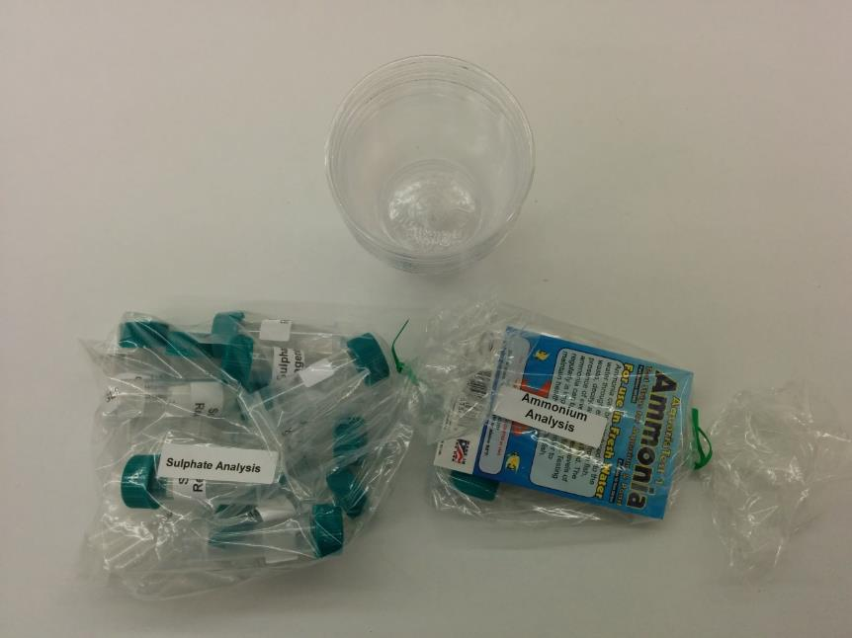
Group 3: Ammonium and Sulphate

Slide 8
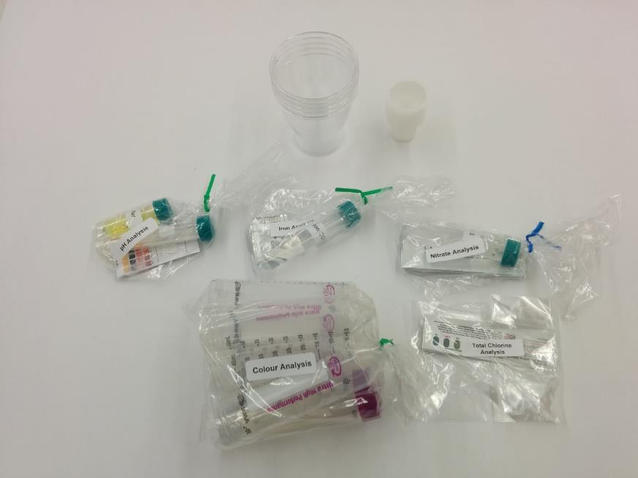
Group 4: Colour, Nitrate, Total Chlorine, Iron, and pH

Slide 9
Instructions for Group 1: Arsenic

Slide 10
Arsenic Test

Slide 11
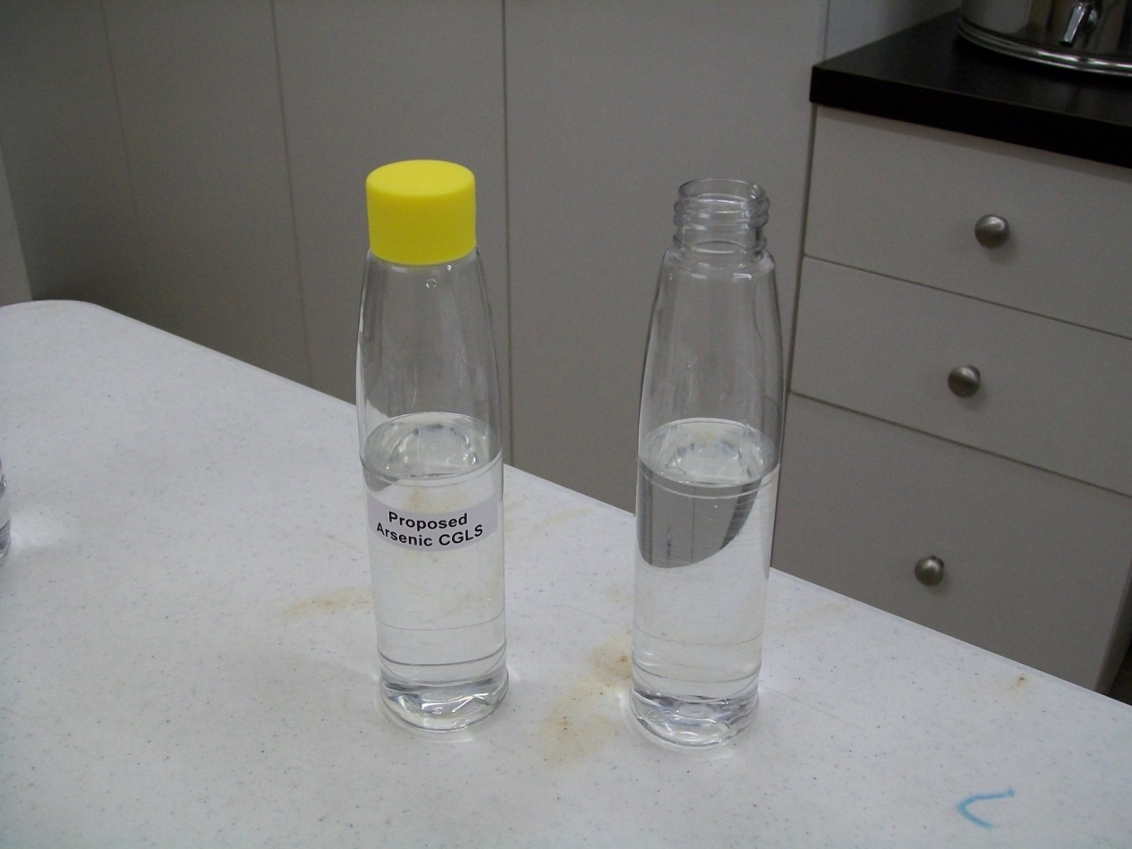
1. One bottle contains 5 micrograms/L arsenic. Put 100 mL of water sample in the second plastic bottle with lid (not the flip top type). Water should be room temperature (20-25 degrees C).

Slide 12
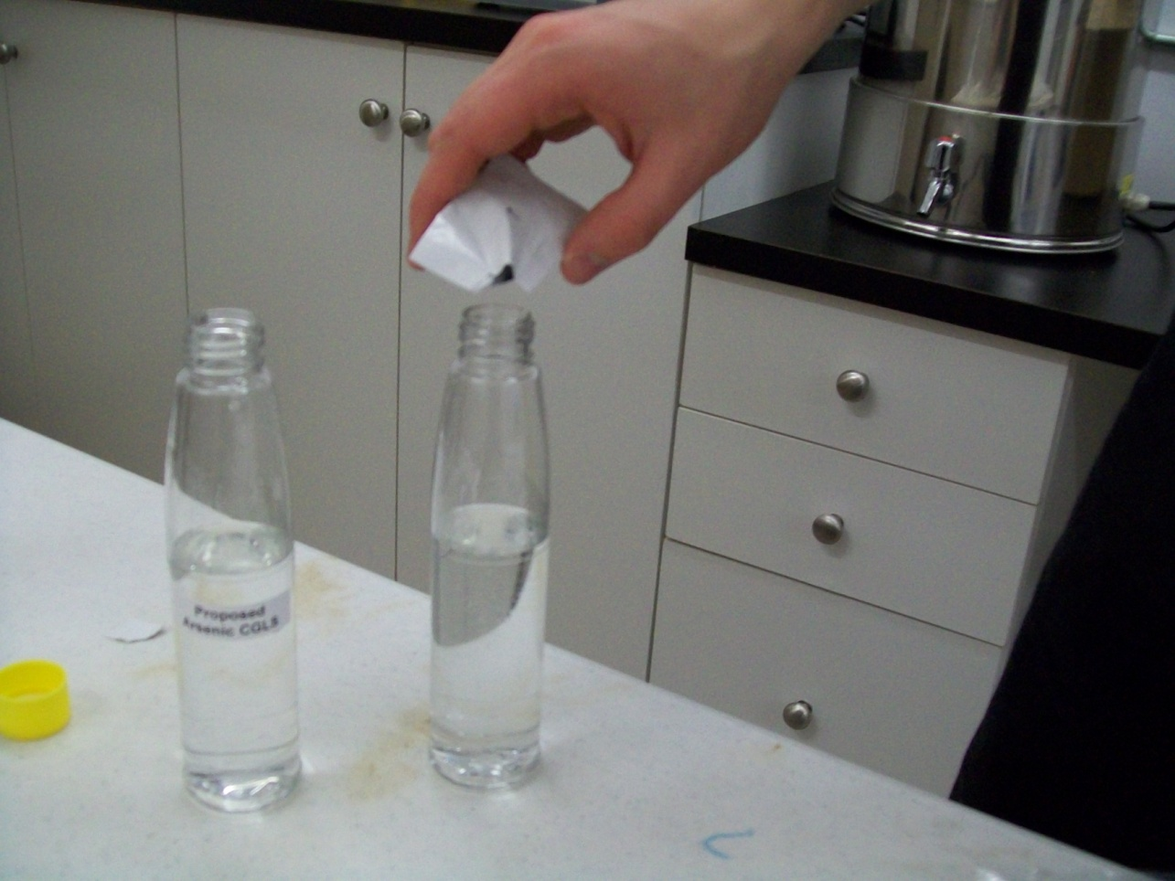
2. Add one reagent #1 packet to each bottle.

Slide 13
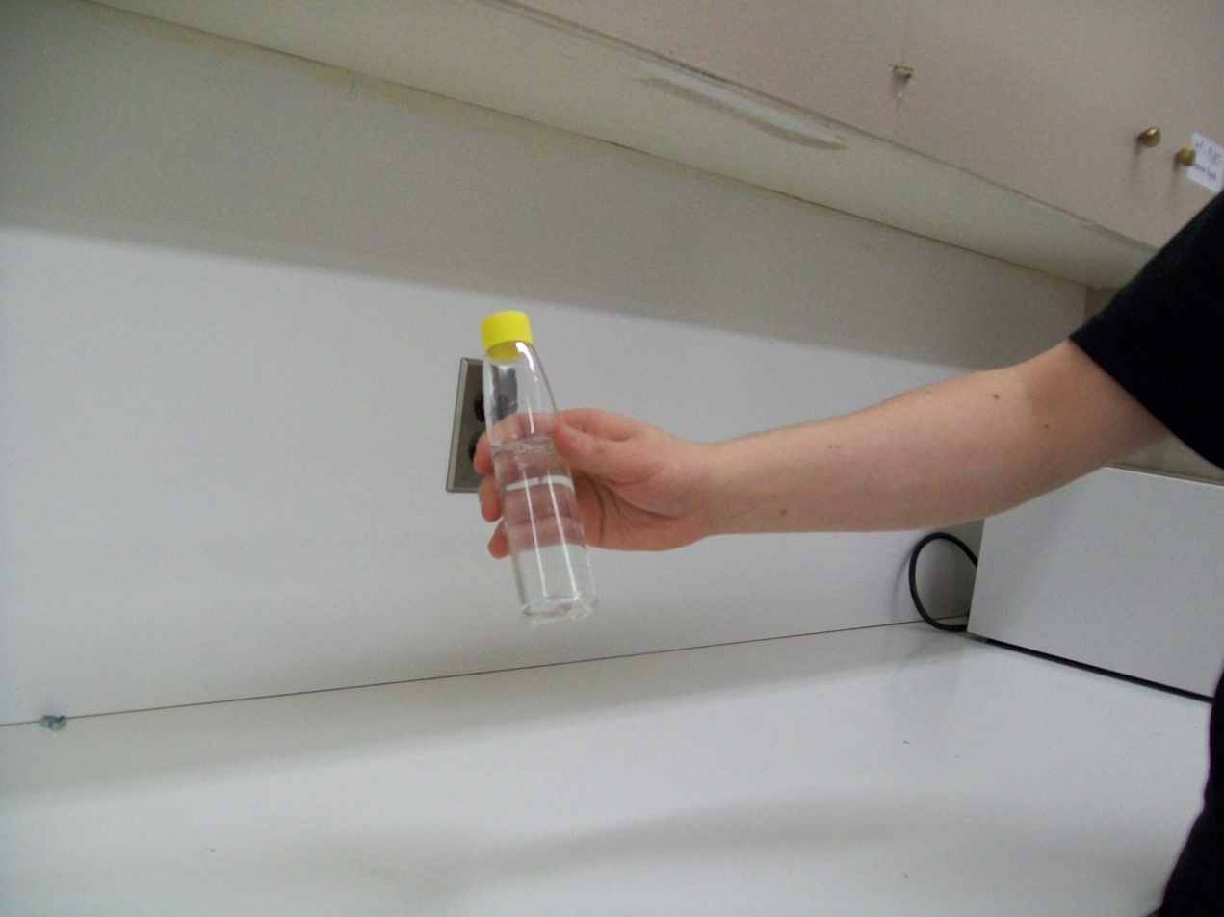
2. (Continued) Cap securely and shake vigorously with bottle upright for 15 seconds.

Slide 14
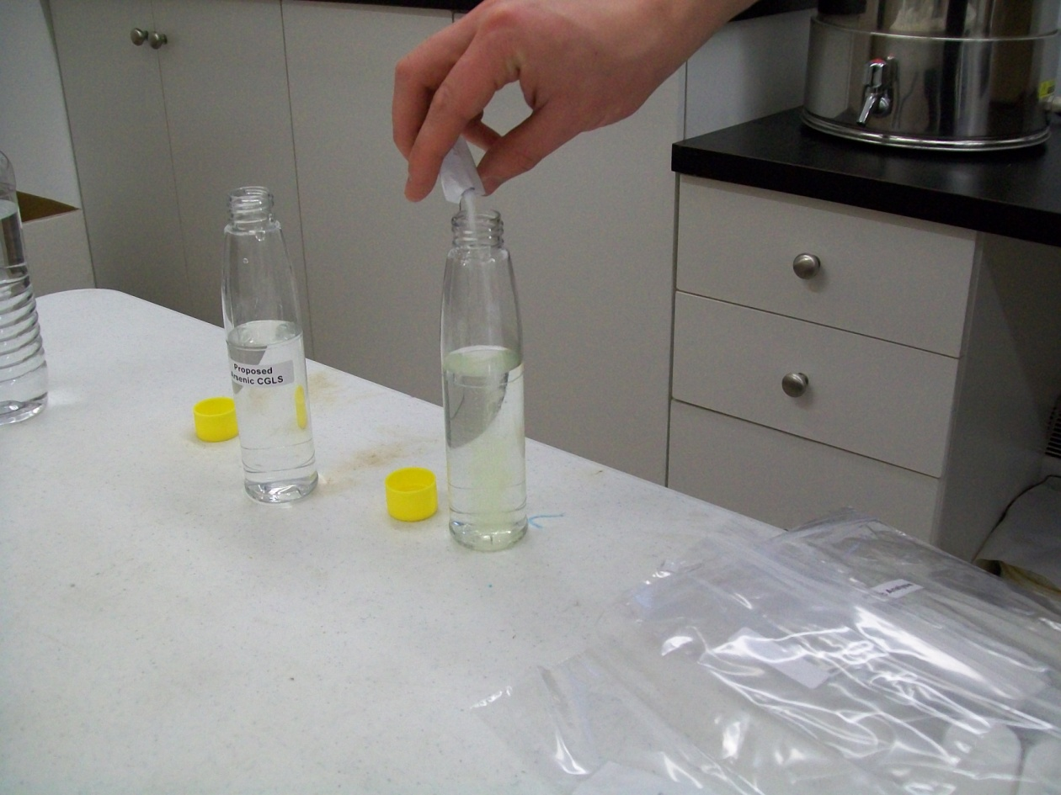
3. Uncap the reaction bottles, add one reagent #2 packet to each bottle.

Slide 15
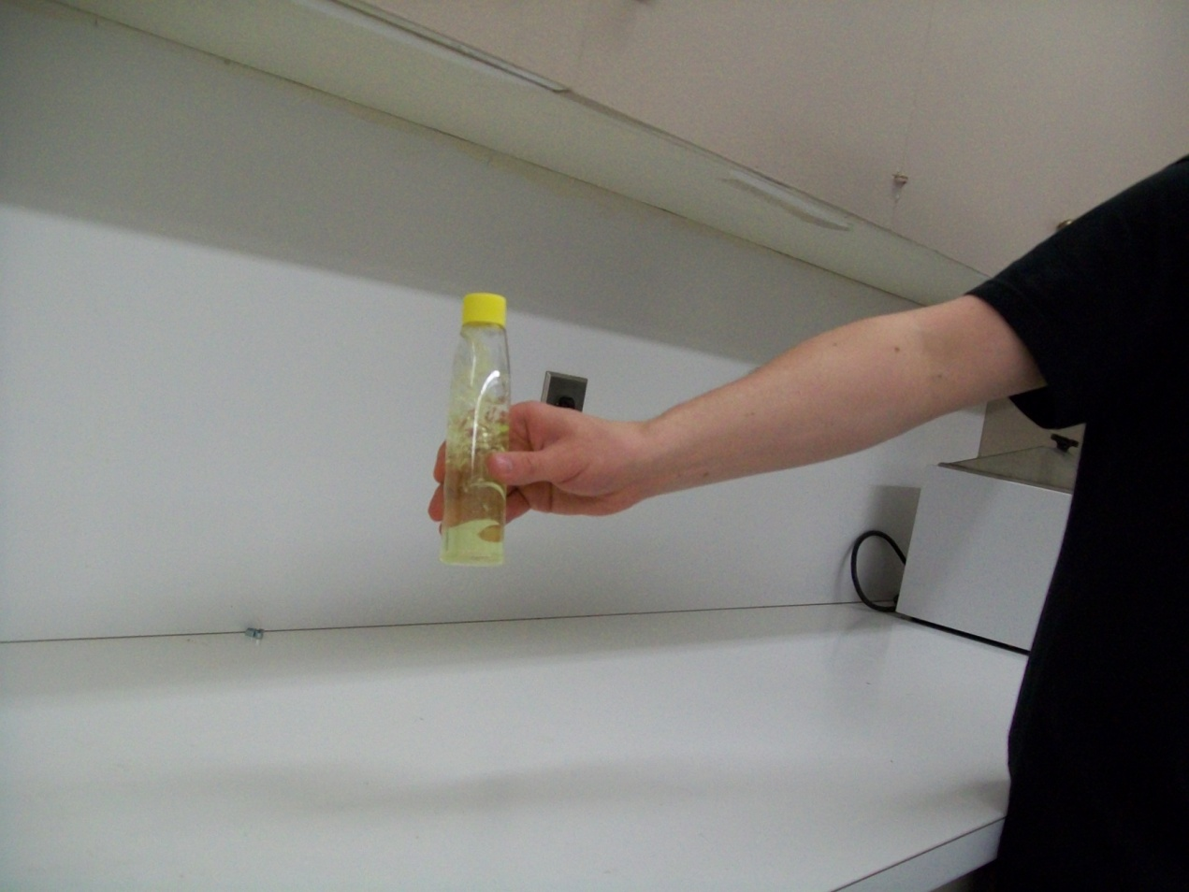
3. (Continued) Cap securely and shake vigorously with bottle upright for 15 seconds.

Slide 16
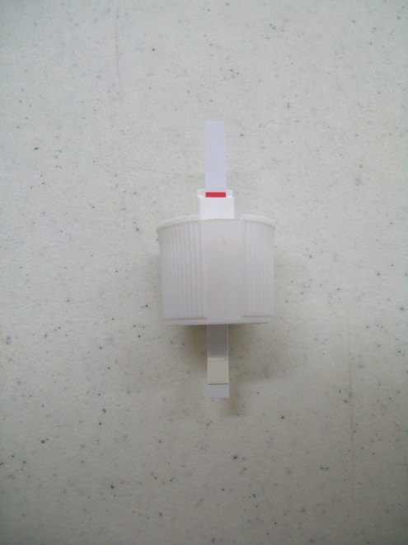
4. Allow the reaction bottles to stand undisturbed for 2 minutes (this will ensure that there is no Hydrogen Sulfide interference). 5. While waiting, prepare reagent strips by inserting into flip top caps. (Do not touch the small pads on the test strip). Insert the strip into the turret pad end first, until the red line is even with the top of the turret.

Slide 17
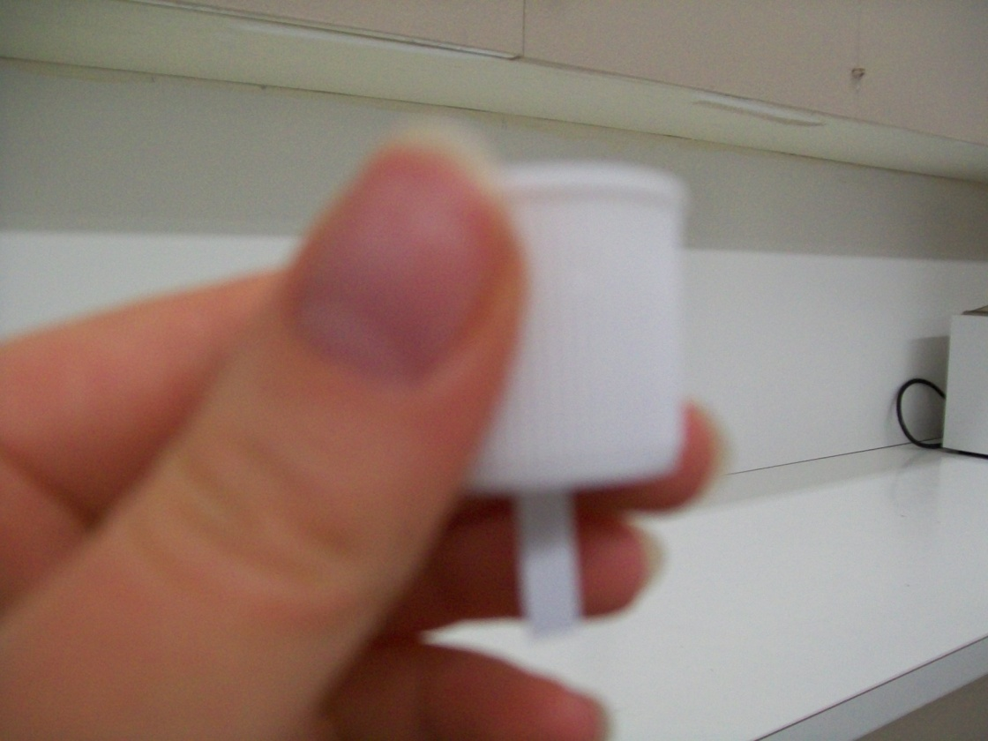
5. (Continued) Now close (flip down) the turret, which will hold the test strip in place. Make sure that the test strip is positioned in the middle of the cap, so that it is hanging straight down from the cap, do this by bending the test strip but be careful NOT to touch the test pad.

Slide 18
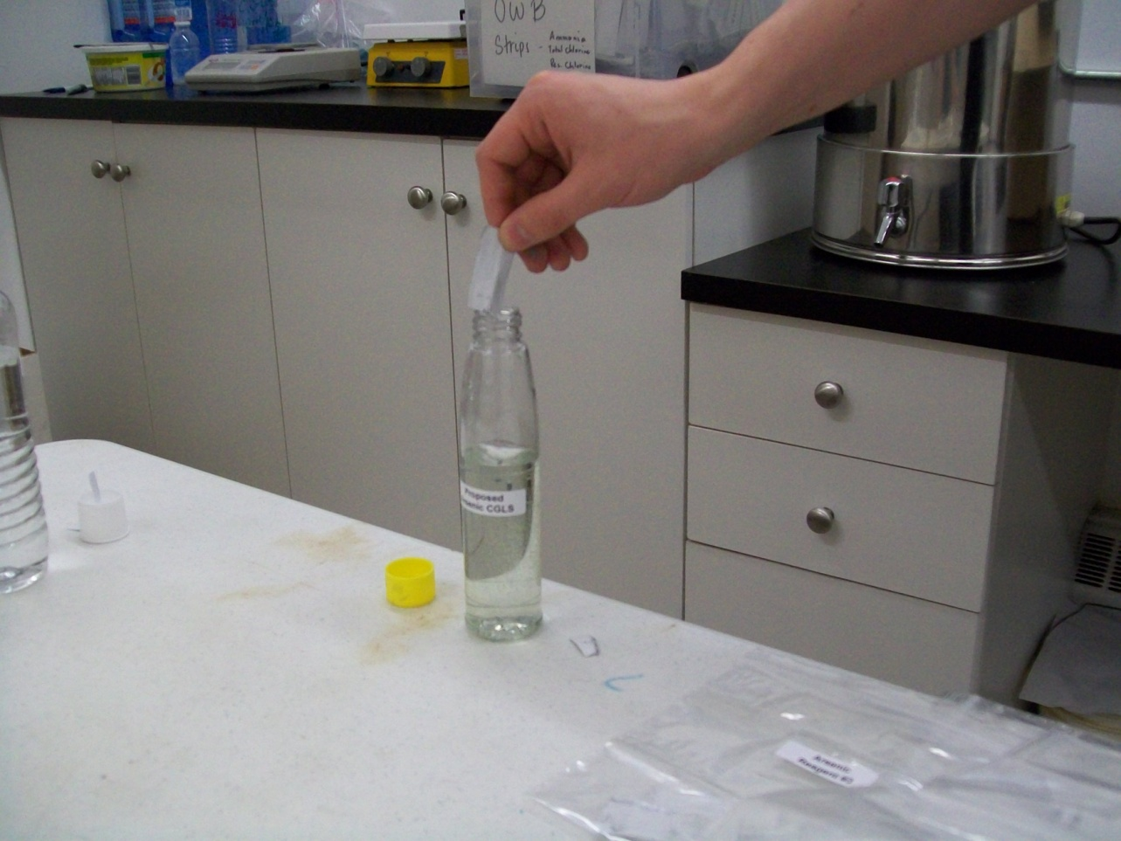
6. Uncap the reaction bottles and add one reagent #3 packet to each reaction bottle.

Slide 19
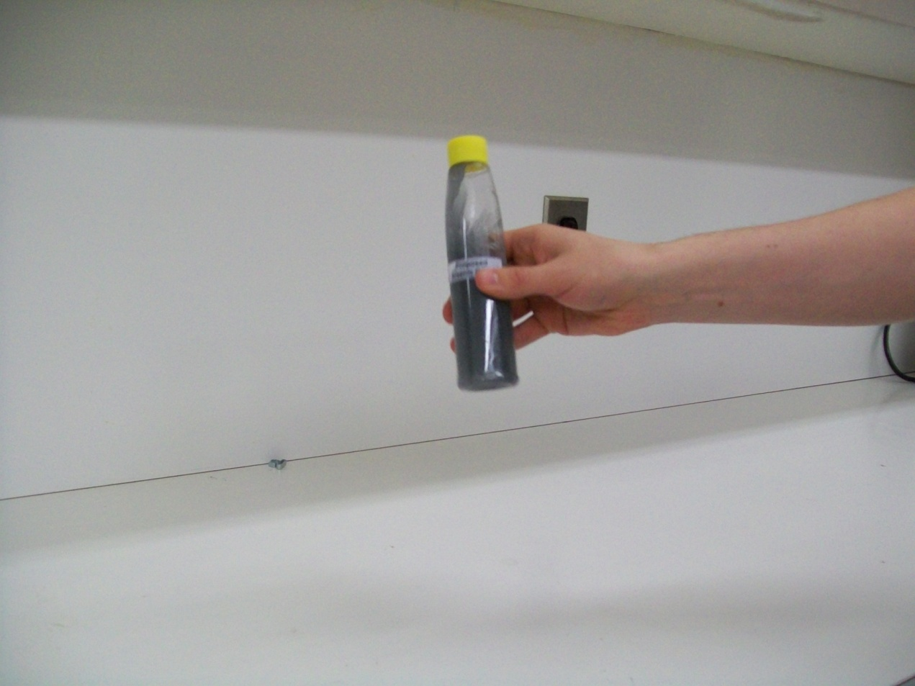
6. (Continued) Cap securely with the yellow cap and shake vigorously with bottle upright for 15 seconds.

Slide 20
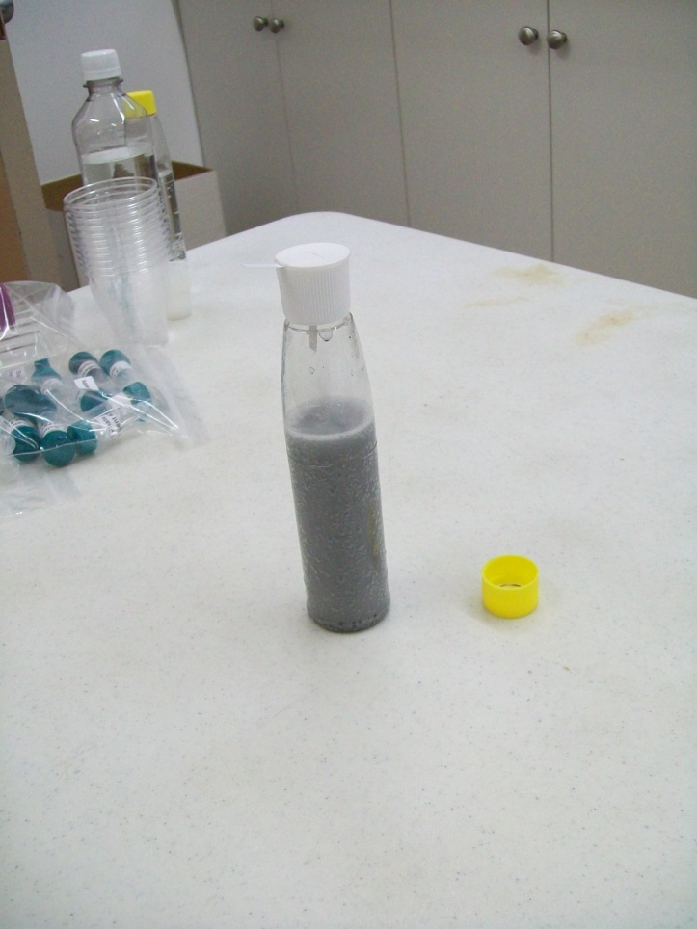
7. Uncap; now recap securely using the flip top cap with the strip in it. Ensure that the test strip is hanging straight down from the cap.

Slide 21
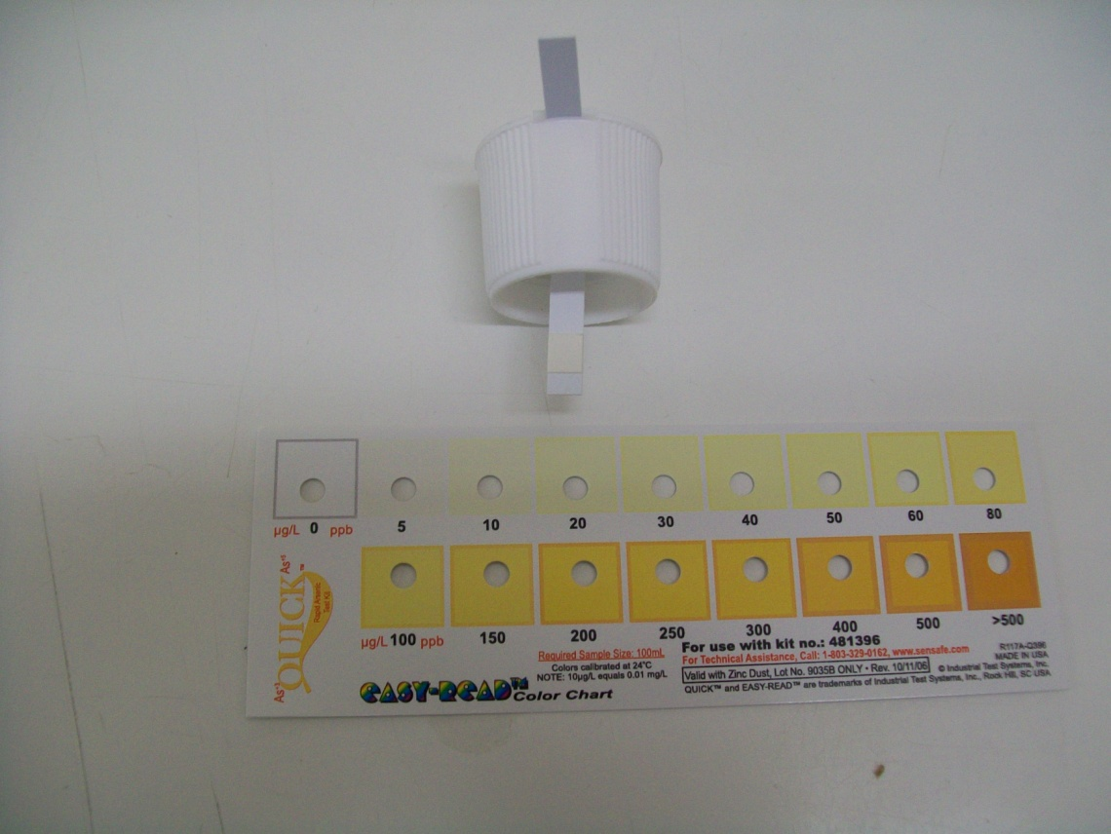
8. After 10 minutes, carefully remove indicator strip from cap and compare colour to that of the colour chart. Please Note: The scale on the arsenic colour chart to match the test strips to is measured in milligrams/L (mg/L). Therefore, the proposed CGLS is 5 micrograms/L (ug/L) which is equal to 0.005 milligrams/L (mg/L) on the colour chart. Therefore, the test strips should be close to the 0.005 mg/L colour in order to meet the proposed arsenic CGLS of 5 ug/L.

Slide 22
9. Rinse bottles twice with Deionized Water, and twice with new sample water. Fill the bottles with 100 mL of the next water samples to be tested. Repeat steps 2-8 with the 2 remaining water samples. 10. Put indicator strips back in Ziploc bag and dispose of in garbage.

Slide 23
Instructions for Group 2: Alkalinity, Copper, Manganese, and Total Hardness

Slide 24
Alkalinity Test

Slide 25
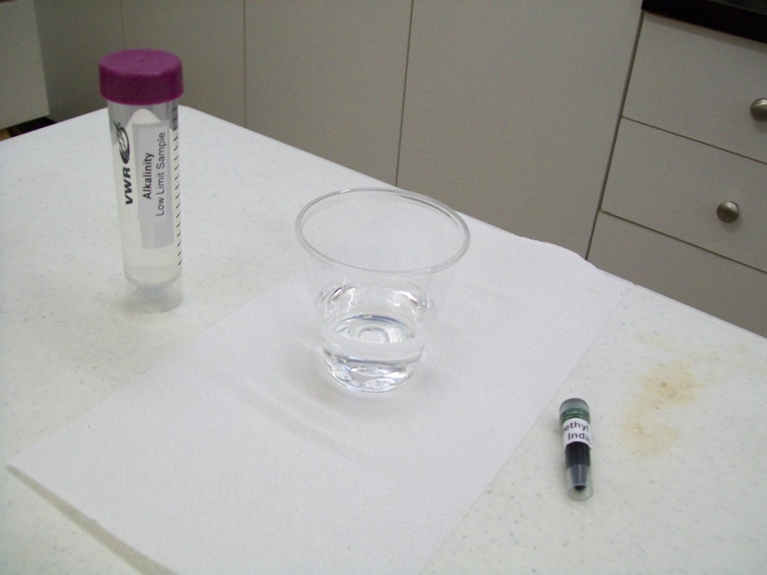
1. Cover the area that you are working on with paper and use gloves as the Methyl Purple Indicator that you will be using may stain. 2. Label the 5 plastic cups as follows: #1 Alkalinity LLS, #2 Urban Treated Water, #3 Rural Treated Water, #4 Untreated Raw Water, #5 Local Community Treated Water. 3. Pour the 50 mL of Alkalinity LLS into the cup labeled Alkalinity LLS.

Slide 26
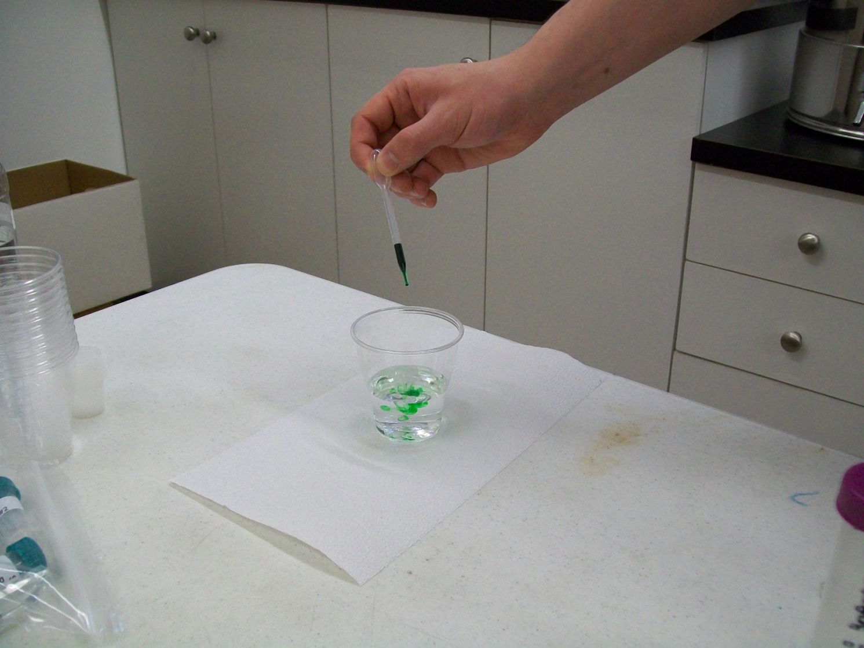
4. Add 7 drops of Methyl Purple Indicator to the cup by using the small plastic pipette.

Slide 27
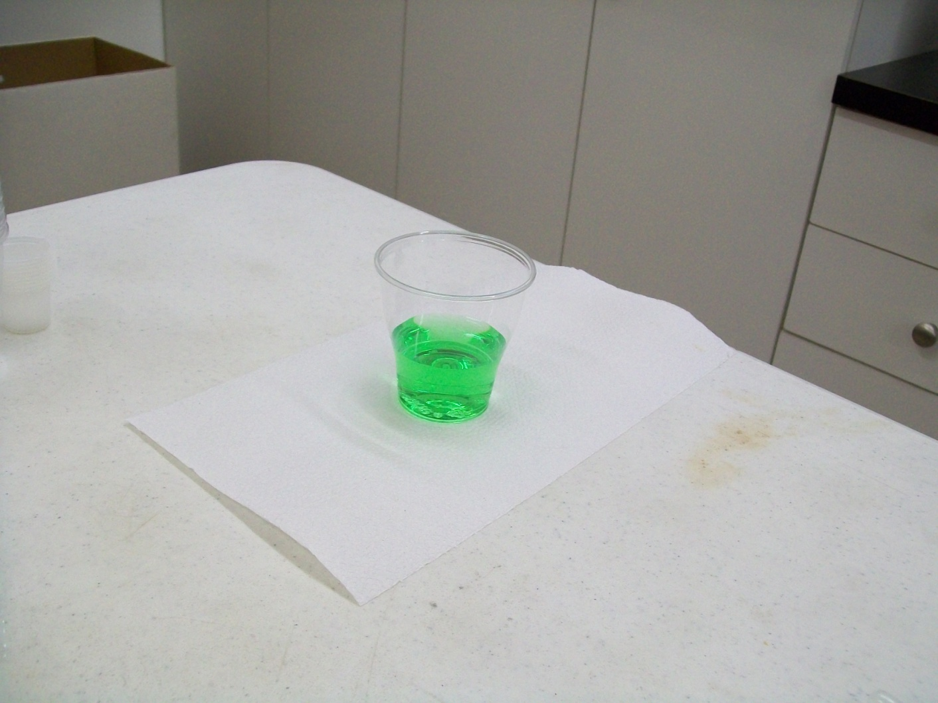
4. (Continued) This causes the water to turn green. Be careful when using the Methyl Purple Indicator as it may stain.

Slide 28
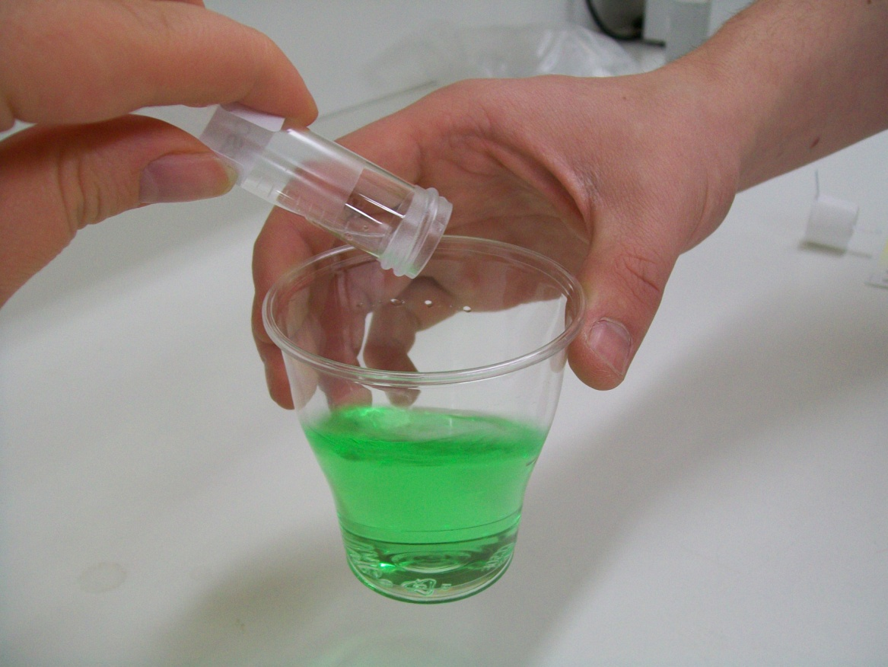
5. While swirling the water in the cup, add the 0.02 N H2SO4 slowly until the water turns purple, the LLS should take around 2.5 mL, record your reading (the volume you used is initial – the next reading, say 12.5 – 10.0 = 2.5) after you see the colour change. The other samples may take more or less than the LLS. Record the amount of H2SO4 used.

Slide 29
5. (Continued) Then add the remaining Sulphuric acid to see the colour changes (there should be a slightly darker colour after you add all of the acid). 6. Using the graduated cylinder, measure 50 mL of the Urban Treated Water sample and pour it into the cup labeled Urban Treated Water sample. 7. Repeat steps 4 & 5. 8. Measure out 50 mL of the remainder of the water samples into their appropriately labeled cups and repeat steps 4 & 5. 9. Calculate the amount of alkalinity in the different water sources. You can do that by knowing that the LLS is 50 mg/L and it required around 2.5 mL of acid. Results: If the water sample requires less than 2.5 mL of 0.02 N H2SO4 to change colour then the water may be quite corrosive. You can multiply the amount of acid added by 20 and change the units to ppm in order to get the result in parts per million. For example, if 2.5 mL of acid is added then the calculation is 2.5 x 20 = 50 ppm.

Slide 30
Copper Test

Slide 31
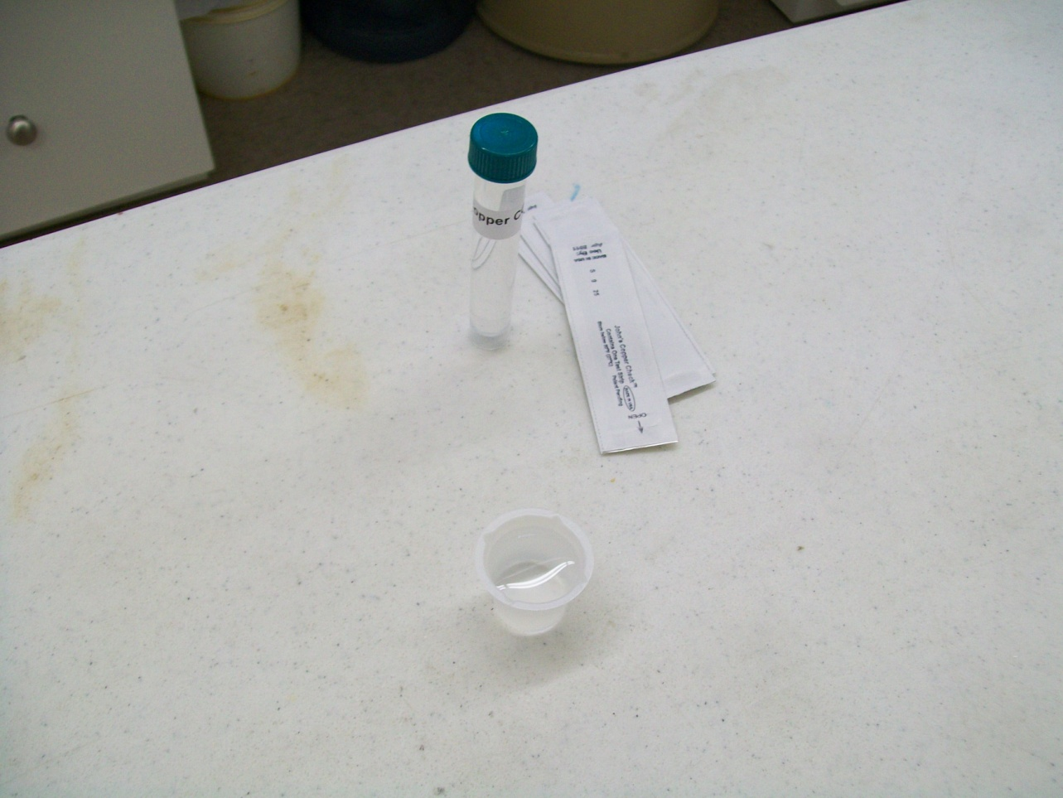
1. Label the five beakers with their appropriate water sample names. 2. Put 10 mL of sample in their respective beakers.

Slide 32
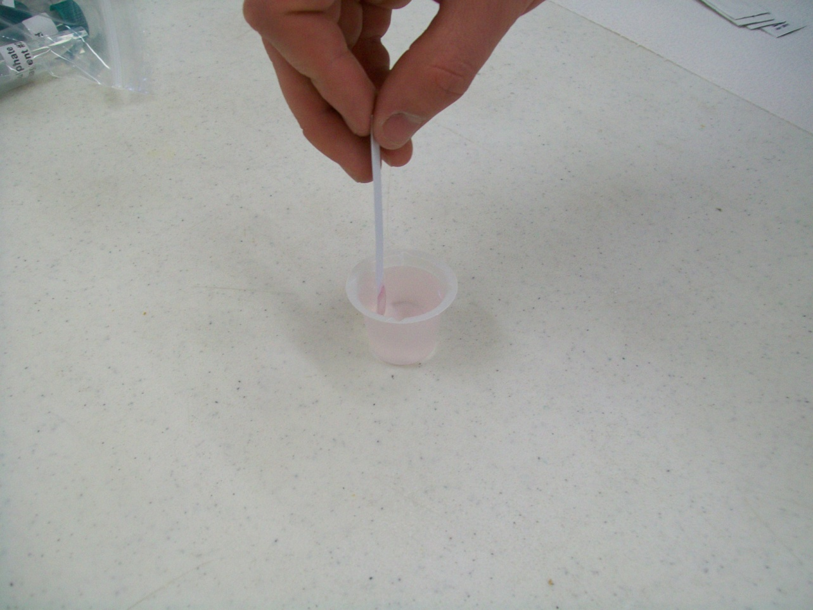
3. Dip one test strip in sample or (CGLS) beaker for 30 seconds with constant back and forth motion.

Slide 33
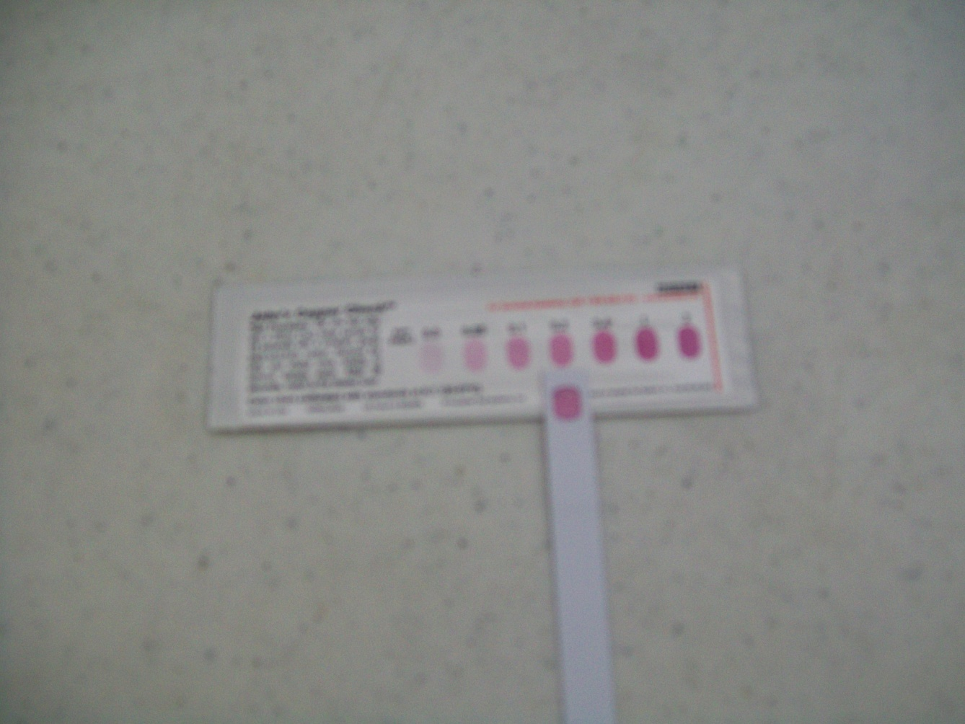
4. Remove and match colour after 2 minutes to determine the Copper concentration in mg/L or parts per million (ppm). Results: Compare results to the Guidelines for Canadian Drinking Water Quality. The Canadian Guideline should give a result very close to the 1 mg/L guideline; a darker colour means that the water Does Not meet the Guidelines for Canadian Drinking Water Quality.

Slide 34
Manganese Test

Slide 35
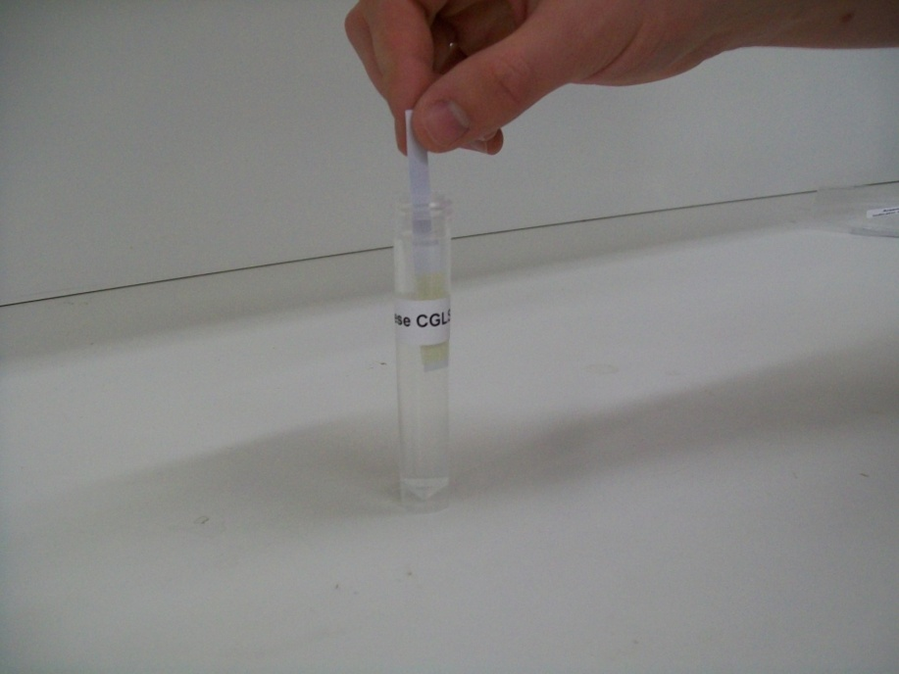
1. Label the four clear plastic vials with the names of the water samples to be tested. 2. Test the Manganese CGLS sample first. 3. Support the CGLS vial with one hand and with the other hand, dip one Manganese #1 strip into the sample and move it back and forth in a gentle motion. Do this for 20 seconds. Remove the strip and throw it away. (Vial not supported by other hand in picture to make vial visible.)

Slide 36
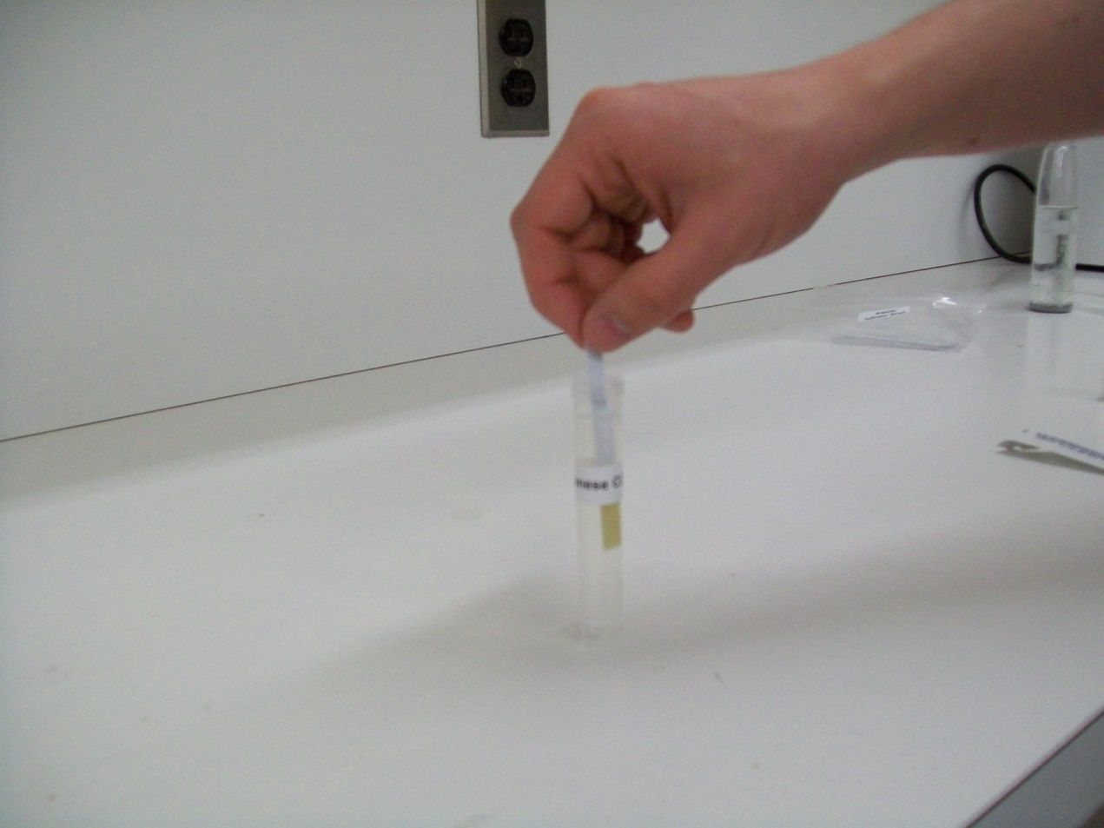
4. Dip one Manganese #2 strip into the sample and move it back and forth in a gentle motion. Do this for 20 seconds. Remove the strip and throw it away.

Slide 37
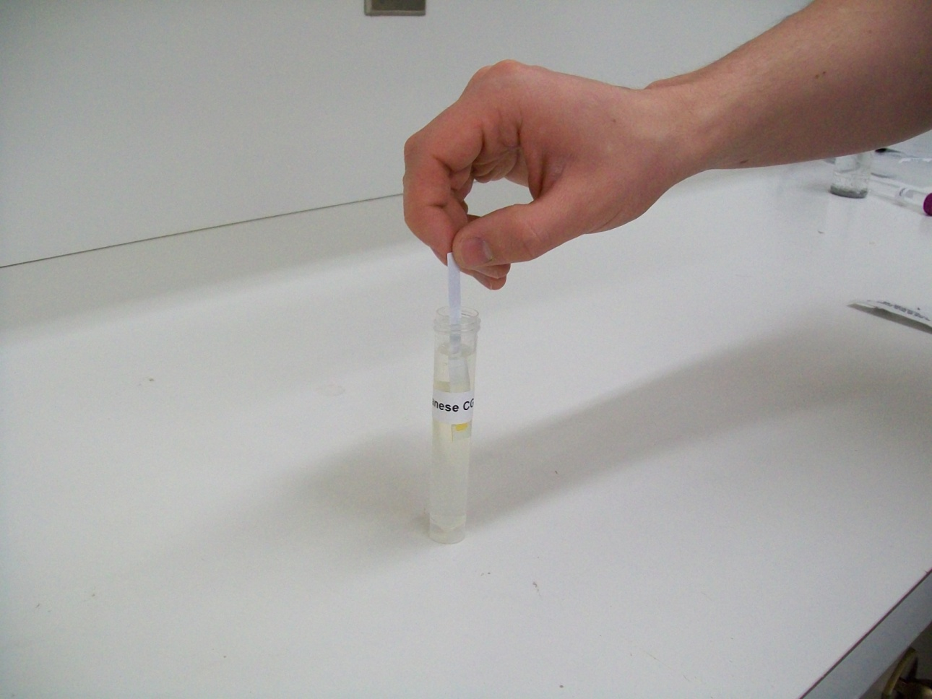
5. Dip one Manganese #3 strip into the sample and move it back and forth in a gentle motion for 30 seconds.

Slide 38
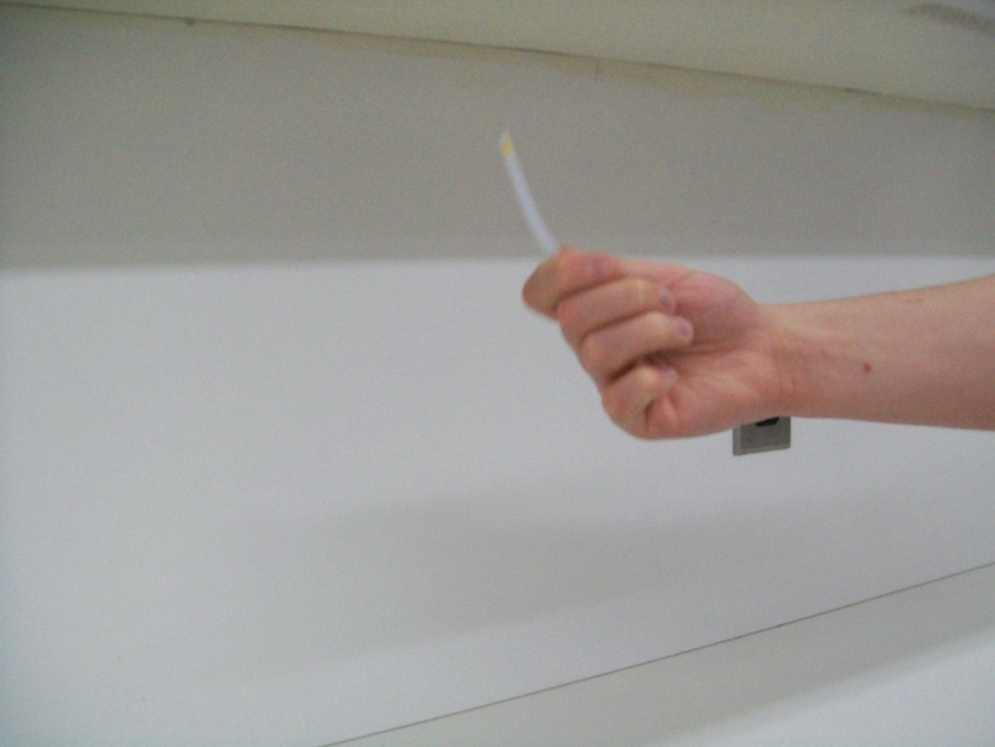
5. (Continued) Remove the strip from the sample and shake it once to remove any excess sample.

Slide 39
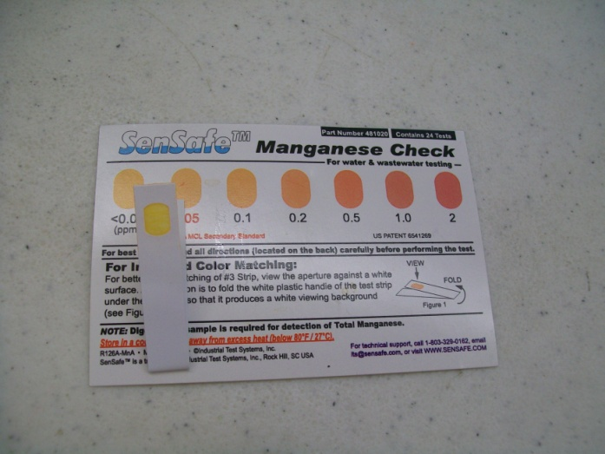
6. To determine the Manganese concentration in mg/L (same as parts per million, ppm), wait 90 seconds and match the colour of the test strip to the nearest colour on the chart. To best match the strip to the colour chart, fold the strip in half, so that the aperture is against a white background. 7. Record the results for the sample. 8. Fill up the 10 mL clear plastic vials with their respective samples. Repeat steps 3 to 7 with the four other water samples.

Slide 40
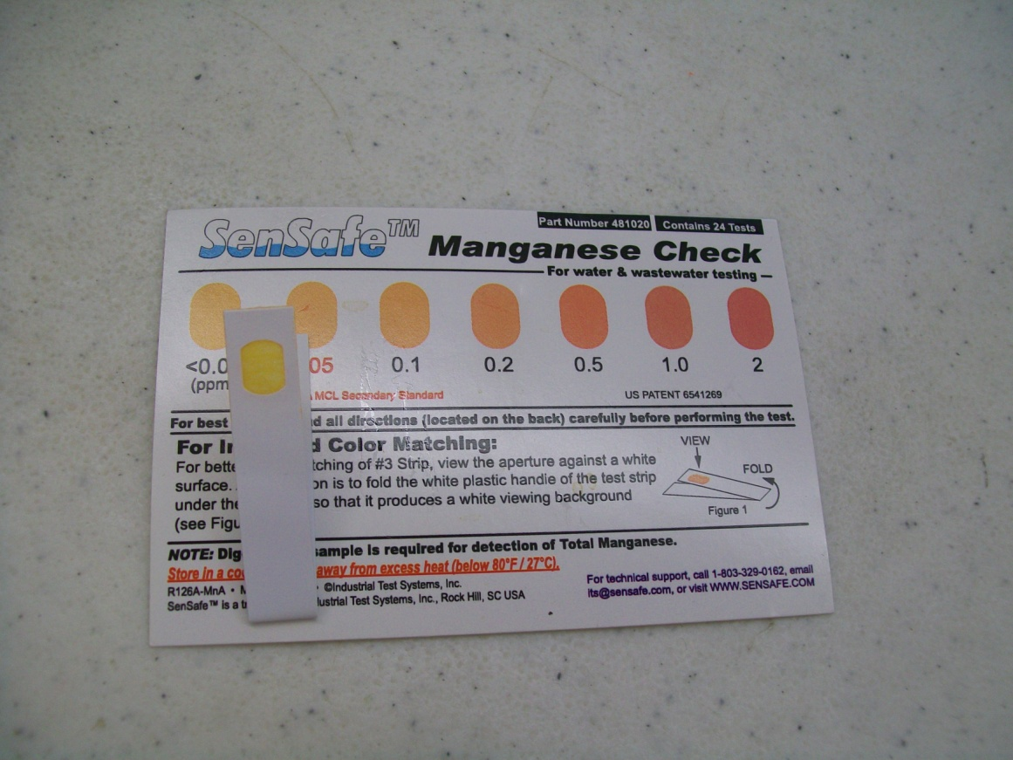
Results: Compare results to the Guidelines for Canadian Drinking Water Quality. The CGLS for Manganese should give a result very close to the 0.05 mg/L guideline; a darker colour means that the water does not meet the Guidelines for Canadian Drinking Water Quality.

Slide 41
Total Hardness Test

Slide 42
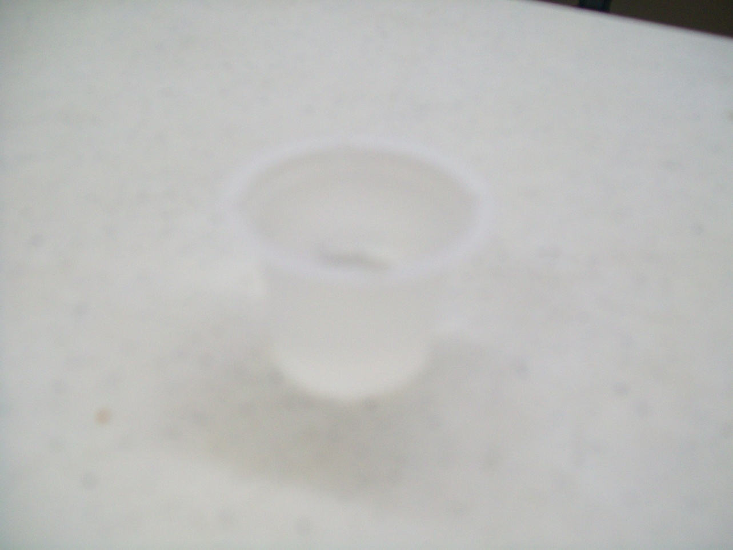
1. Label five beakers with their respective names. 2. Put 10 mL of sample in their respective beakers.

Slide 43
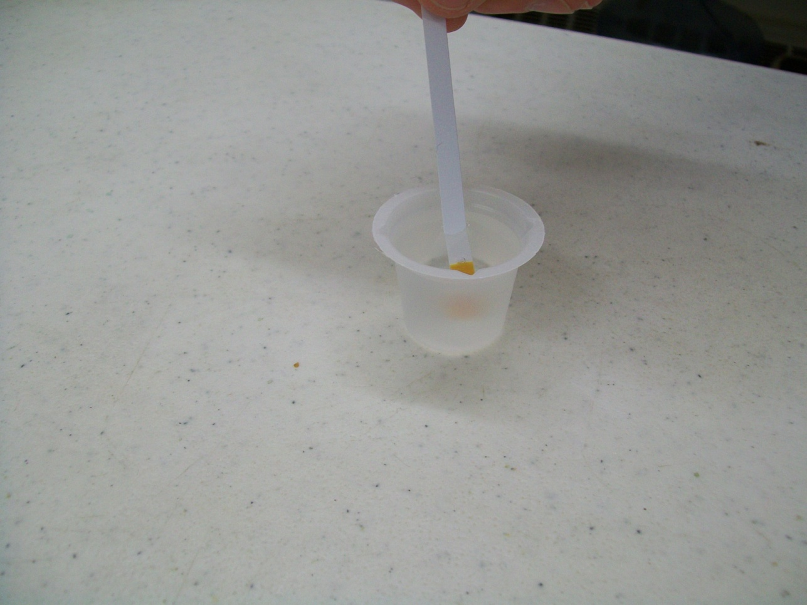
3. Dip one test strip in sample beaker for 3 seconds.

Slide 44
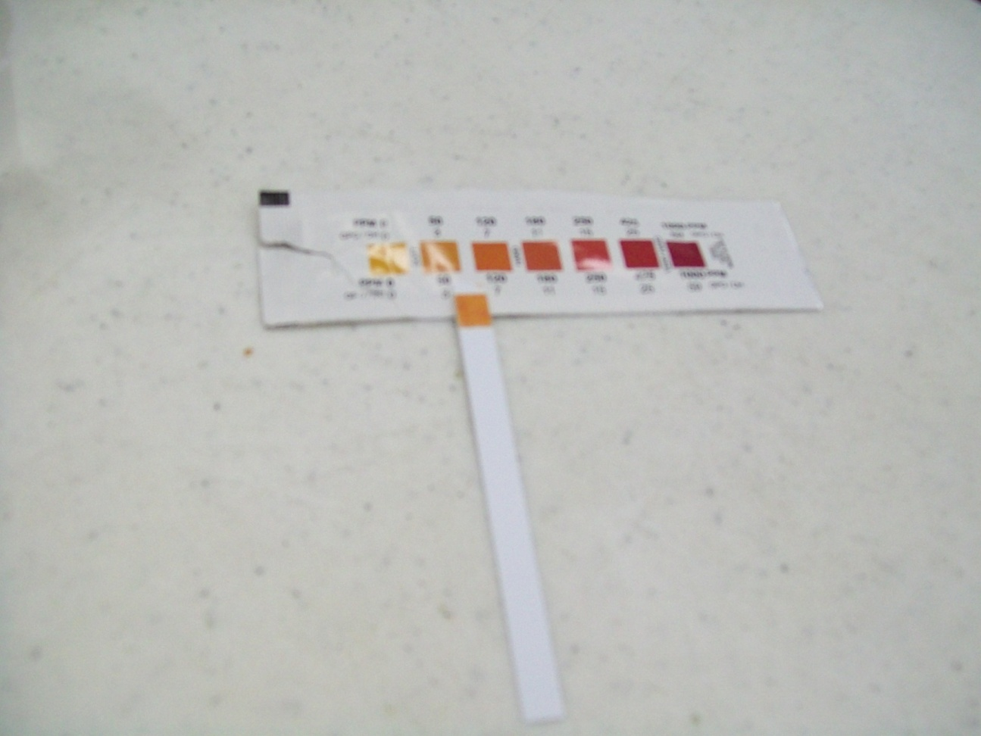
4. Remove and immediately match to the closest colour on the colour chart that is located on the test strip packet. Colour is only stable for 1 minute. 5. Read results as mg/L (parts per million), match with the best colour to determine the Total Hardness concentration. 6. Repeat steps 3 through 5 with the other water samples. Results: The Saskatchewan Guideline Limit Sample (SGLS) for Total Hardness should give a result very close to the 800 mg/L guideline; this is a very high level of hardness and should only be encountered in untreated well water sources.

Slide 45
Instructions for Group 3: Ammonium and Sulphate

Slide 46
Ammonium Test

Slide 47
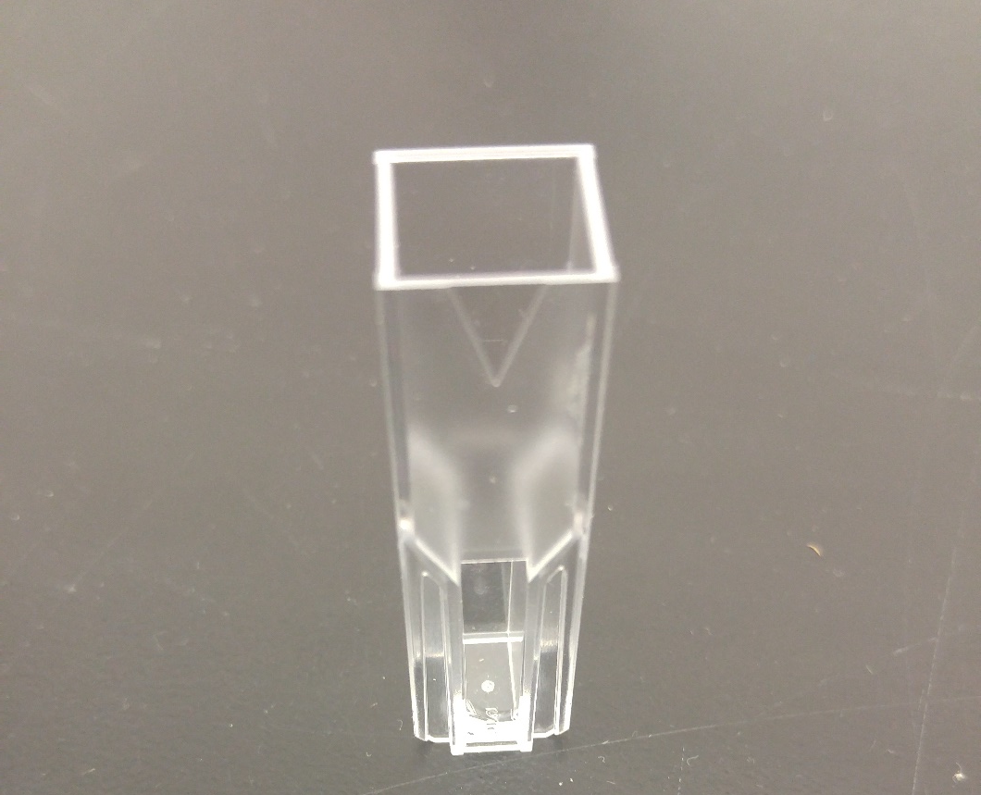
1. Find the small triangle at the top of the cuvette.

Slide 48
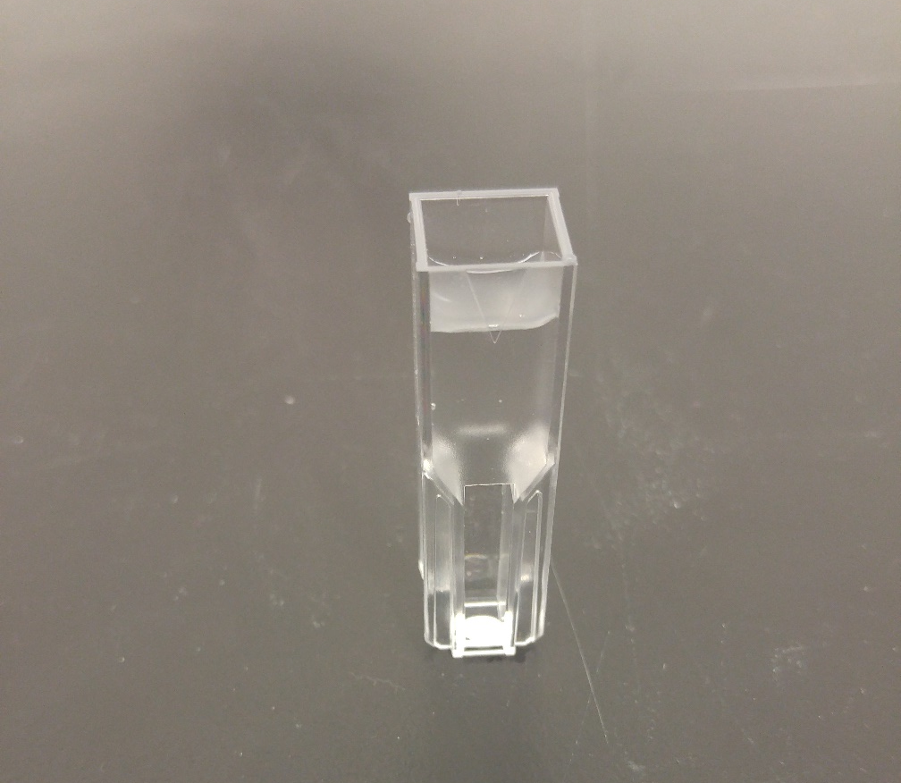
1. (Continued) Begin with the Urban Treated Water sample and pour the sample up to the bottom of the triangle. 2. Pour the 4 mL of AEUL from the vial into the other cuvette.

Slide 49
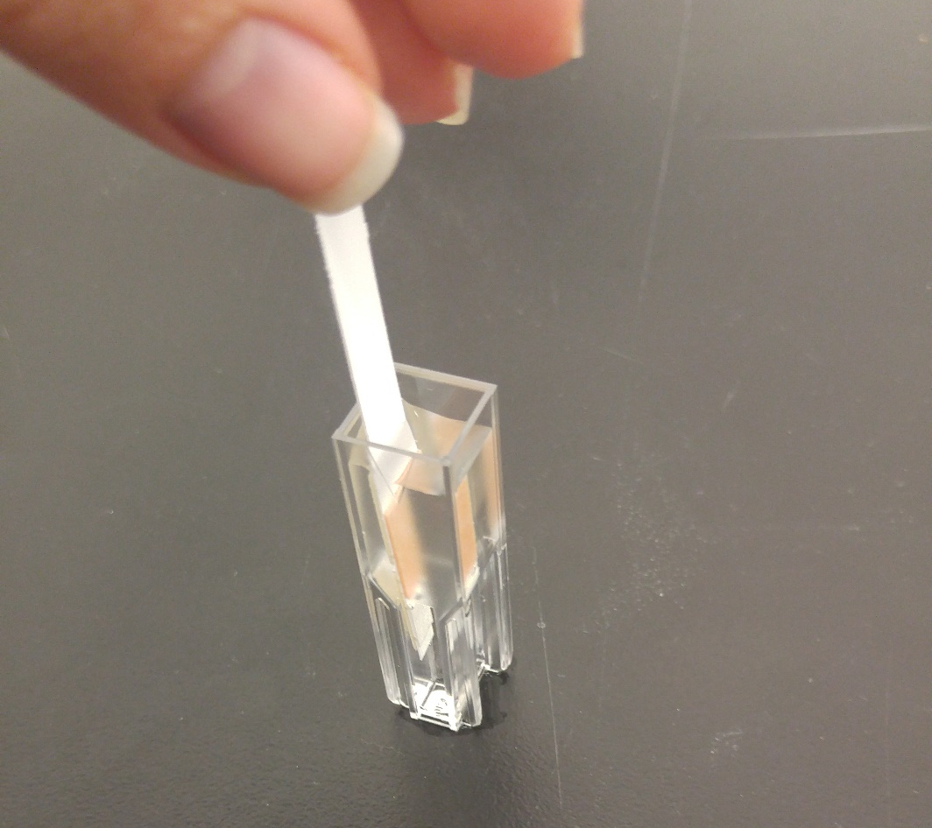
3. Dip one Ammonia Reagent Strip into the Sample or AEUL for 40 seconds with a gentle, steady, up and down motion. 4. Remove and discard the strip.

Slide 50
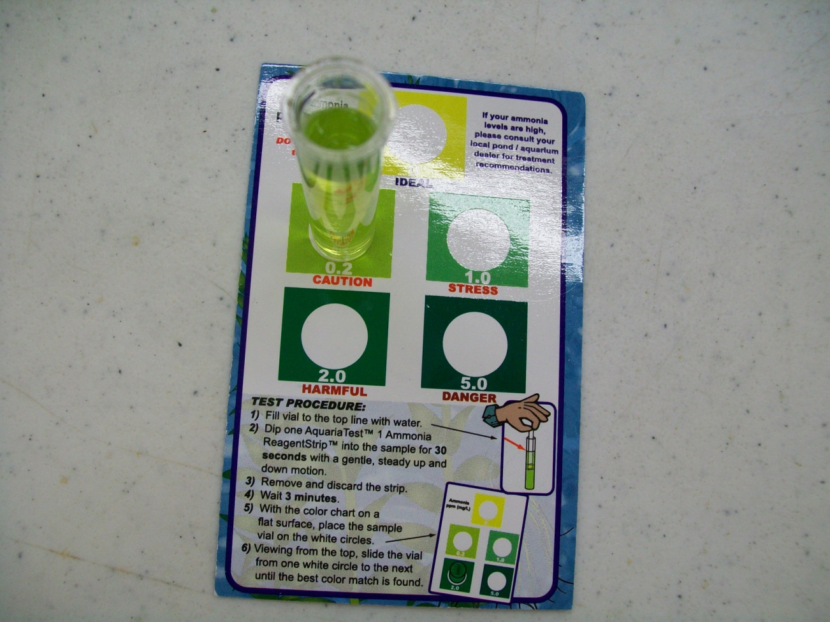
5. After 5 minutes, match the colour by placing the vial on the white circles on the card. View into the top of the vial to see which colour matches best. A colour change from yellow (< 0.1 mg/L) to shades of green indicates the presence of ammonia. Use the colour chart to determine the ammonia concentration. 6. Rinse out cuvettes with Deionized water, and repeat steps 2-5 for the remaining three samples. Results: Since there is no Canadian Drinking Water Guideline for Ammonia you will compare results to the European Union limit. The standard should give a result very close to the 0.5 mg/L AEUL; if the colour is darker then it DOES NOT meet the guidelines.

Slide 51
Sulphate Test

Slide 52
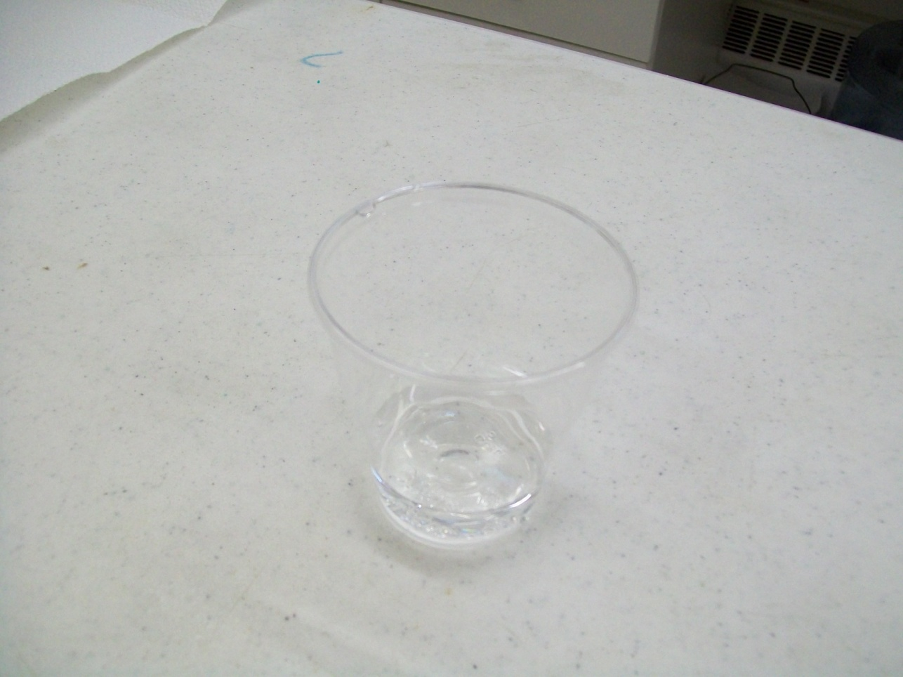
Label the 6 plastic cups with appropriate number and name:
#1 – Control (Deionized Water or DI)
#2 – Urban treated water
#3 – Rural (Aboriginal and/or non-Aboriginal community) treated water
#4 – Untreated raw source water
#5 – Local community treated water
#6 – Canadian Guideline Limit Sample (CGLS)

Slide 53
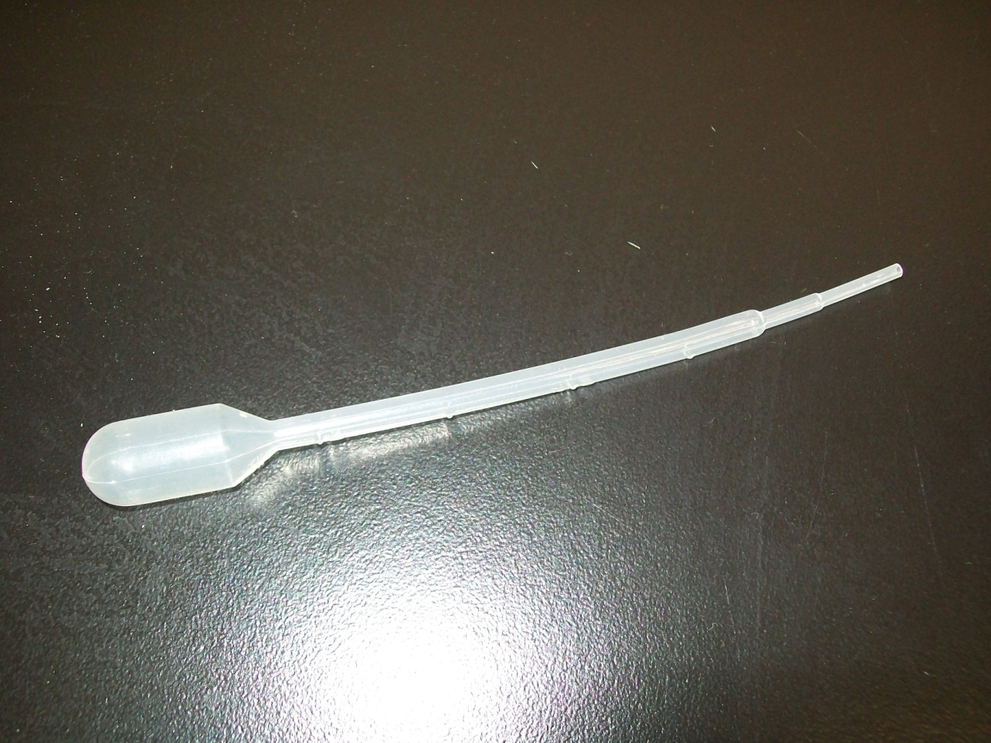
2. Label the 5 pipettes as follows:
#1 – Control (Deionized Water or DI)
#2 – Urban treated water
#3 – Rural treated water
#4 – Untreated raw water
#5 – Local community treated water

Slide 54
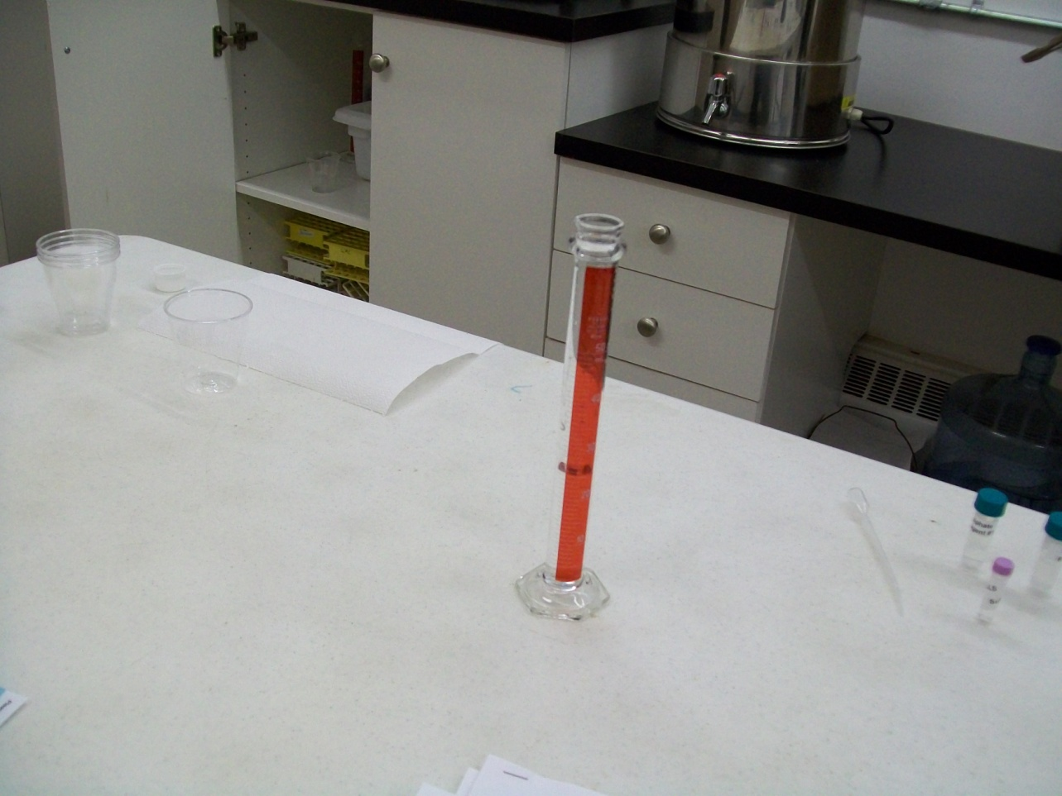
3. Using a graduated cylinder, measure out 25 mL of Deionized Water to each of the 6 cups.

Slide 55
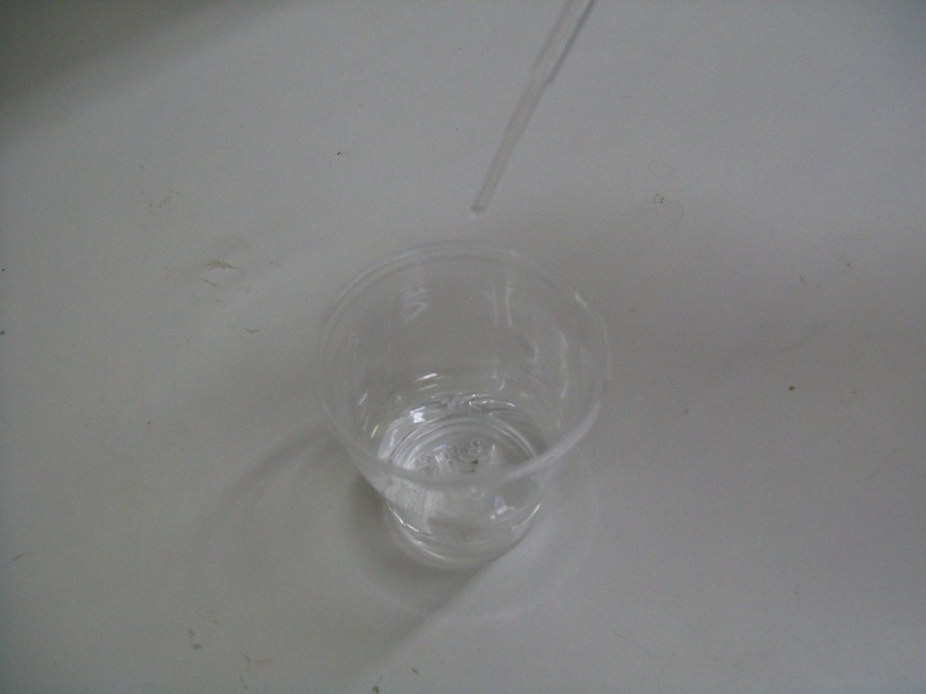
4. To the #1 cup, add 2 mL of Deionized Water using the pipette labeled #1 or DI.

Slide 56
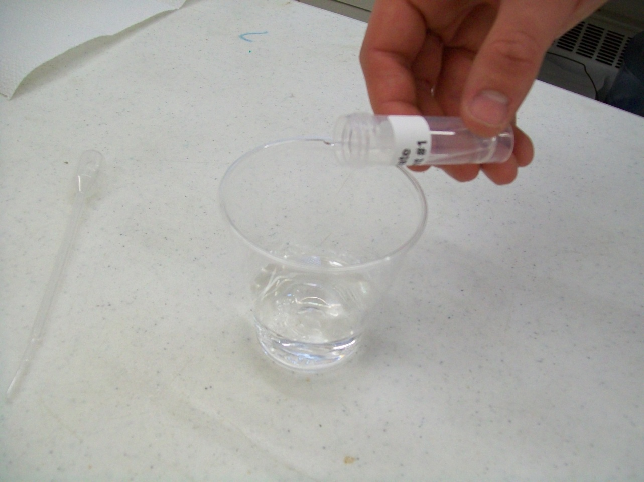
5. To the #1 cup, add contents of one of the Sulphate Reagent #1 tubes.

Slide 57
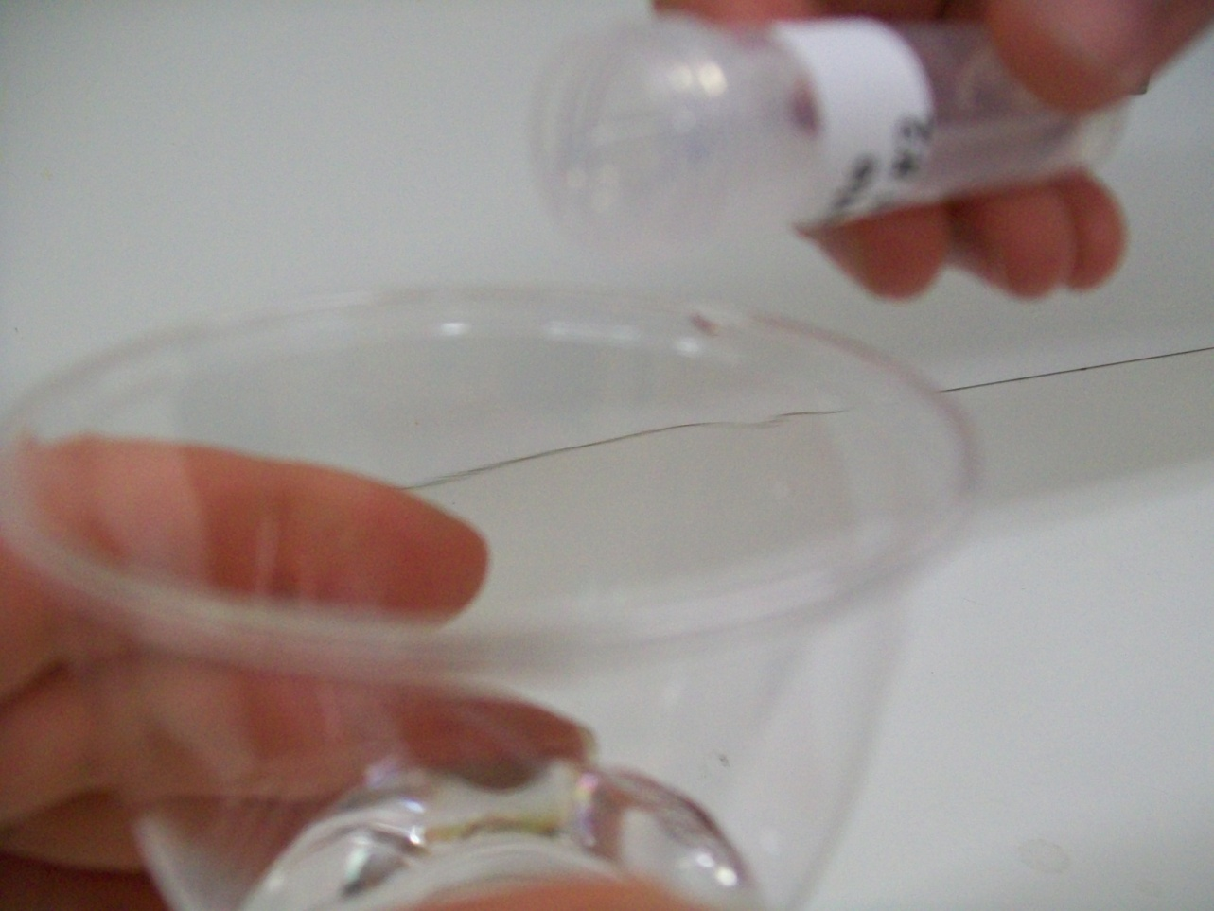
6. To the #1 cup while swirling, add contents of one of the Sulphate Reagent #2 tubes.

Slide 58
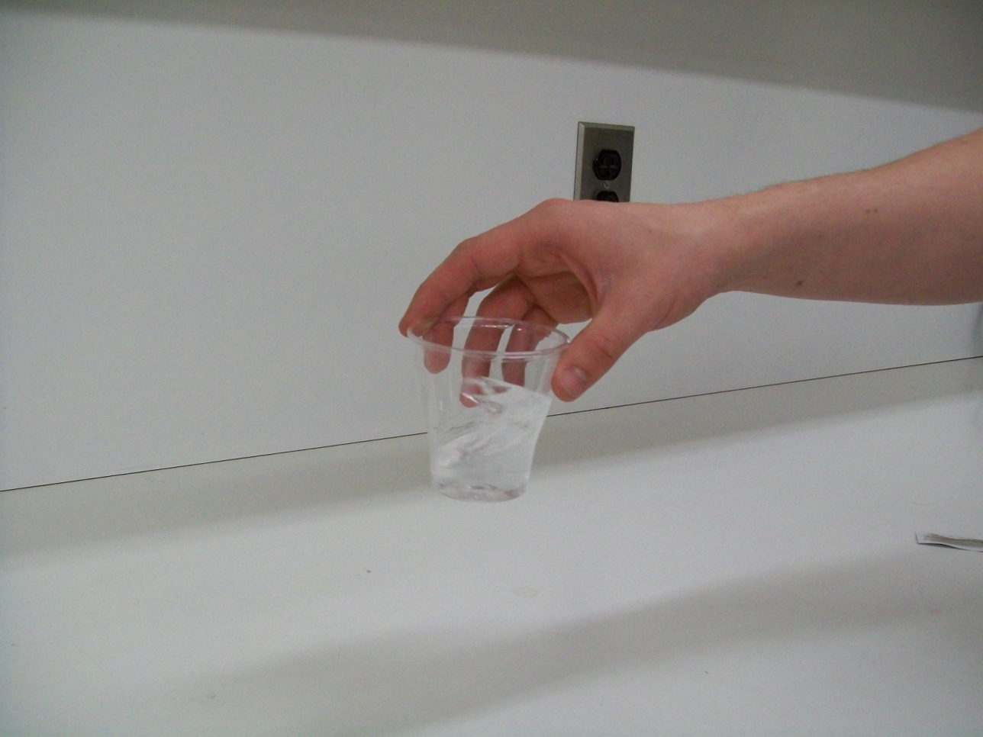
6. (Continued) Continue swirling for 1 minute and then set the cup aside.

Slide 59
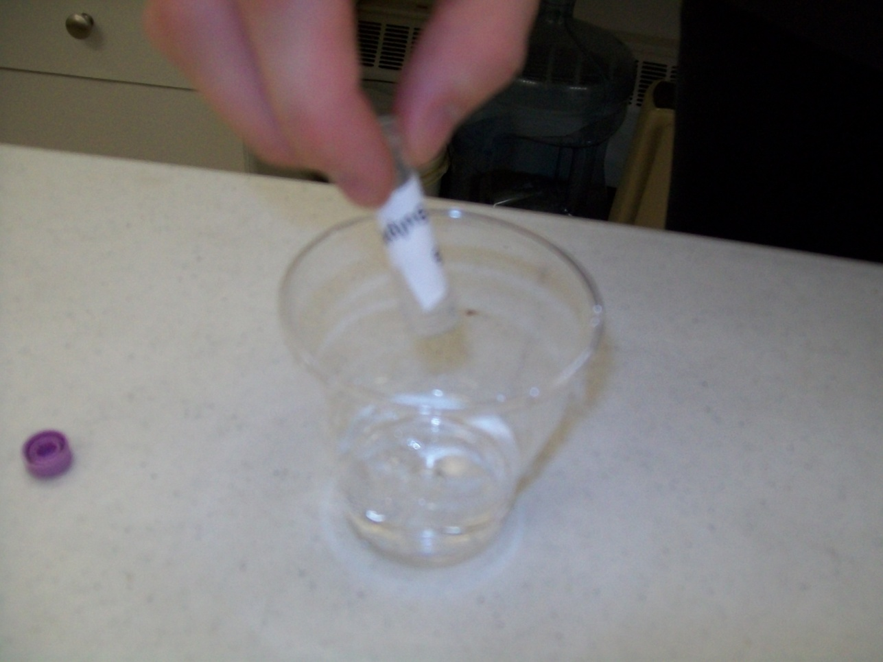
7. To the #6 cup, add the 2 mL tube of Sulphate CGLS. 8. To the #6 cup, add contents of one of the Sulphate Reagent #1 tubes. 9. To the #6 cup while swirling, add contents of one of the Sulphate Reagent #2 tubes. Continue swirling for 1 minute and then set the cup aside. 10. Repeat steps 4-6 for cups #2 to #5. Make sure to add the appropriate 2 mL water sample with the appropriate labeled pipette to the matching cup (for example: you will add 2 mL of Urban treated water with the pipette labeled #2 to the cup labeled #2 – Urban treated water; and so on.)

Slide 60
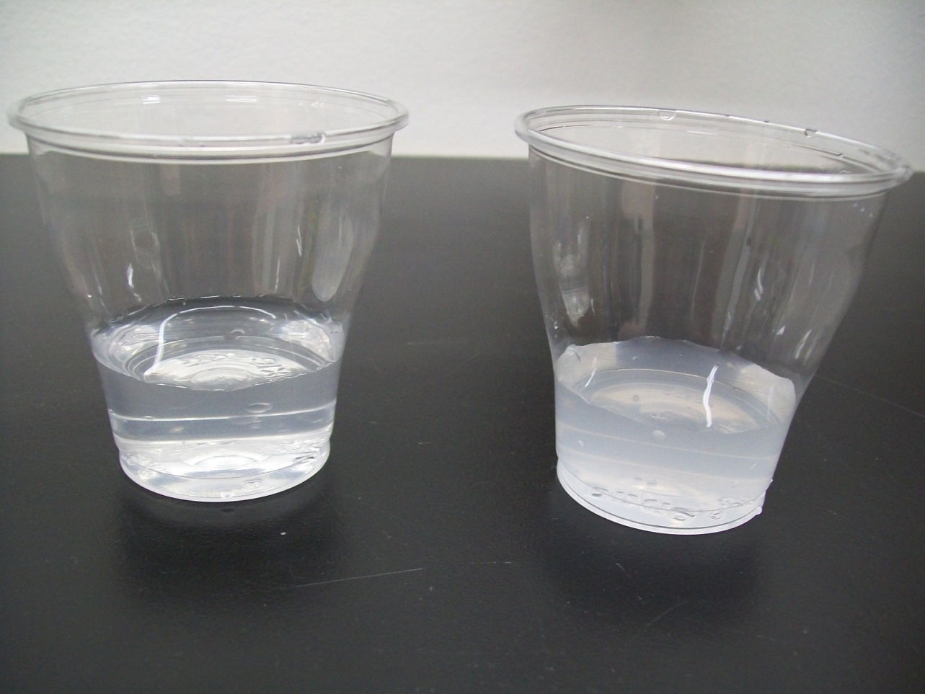
11. Determine the cloudiness of the cups relative to the CGLS and record the results, i.e. Is it less or more cloudy than? Results: The CGLS should be cloudy. The water sample may or may not be cloudy. If the water sample is less cloudy than the CGLS cup, then it passes the Guidelines for Canadian Drinking Water Quality guideline for sulphate, which is 500 mg/L. The Control should not have any cloudiness present.

Slide 61
Instructions for Group 4: Colour, Nitrate, Total Chlorine, Iron and pH

Slide 62
Colour Test

Slide 63
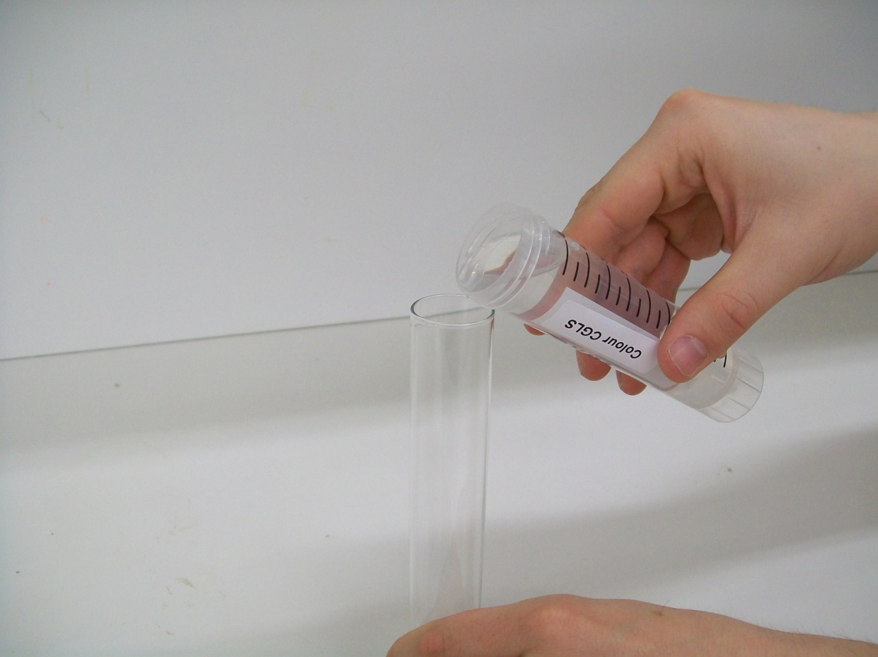
1. Label the test tubes with their number and appropriate name; #1 Control, #2 Canadian Guideline, and #3, #4, #5, #6. 2. Pour the 50 mL of Canadian Guideline into the #2 test tube.

Slide 64
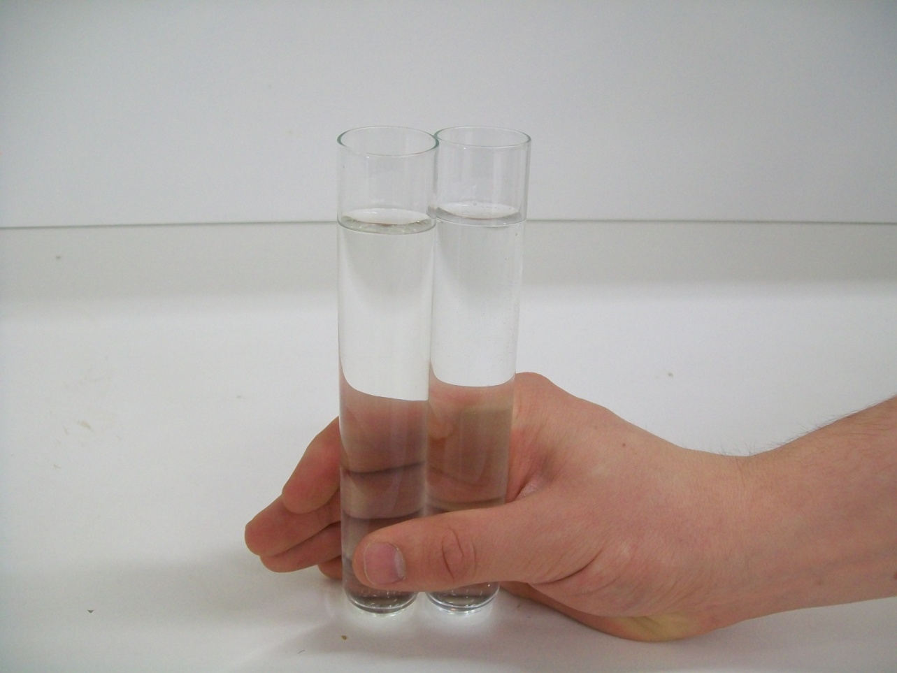
3. Fill the #1 Control test tube with the deionized water to the same level as the #2 test tube. 4. Fill the #3 Sample test tube with sample water to the same level as the #2 Canadian Guideline test tube.

Slide 65
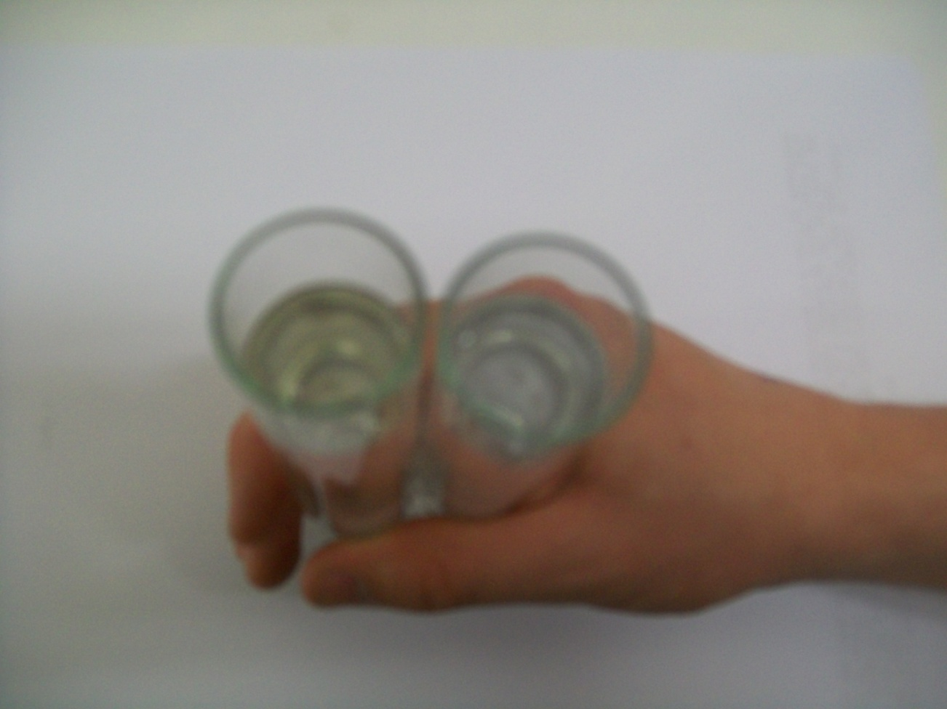
5. Hold the #3 sample test tube between the #1 and #2 tubes over a white piece of paper. 6. View the test tubes from above: Is the colour of the #3 Sample lighter or darker than the colour of the #2 Canadian Guideline Sample? 7. Record the results. 8. Repeat steps 4-6 with the remaining samples (#4, 5, and 6). Results: If the water sample has a colour lighter or equal to that of the Canadian Guideline test tube then it passes the Guidelines for Canadian Drinking Water Quality guideline for colour. If the water sample is darker in colour than that of the Canadian Guideline tube, it fails the Canadian Drinking Water Guideline of 15 TCU (True Colour Units).

Slide 66
Nitrate Test

Slide 67
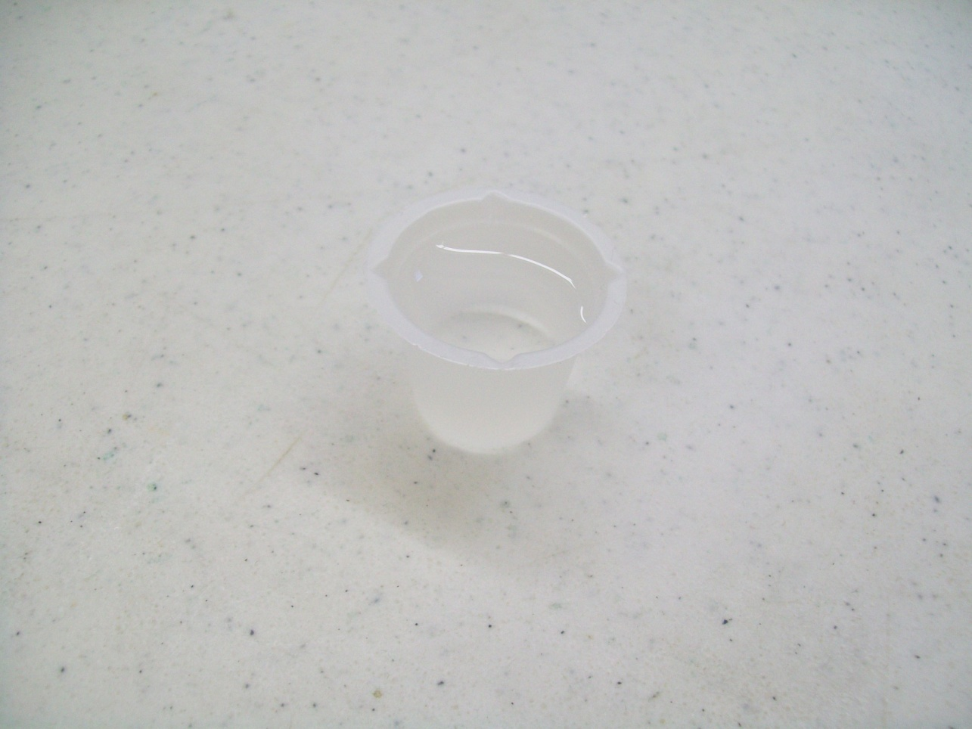
1. Label the four beakers with their respective names (no CGLS).

Slide 68
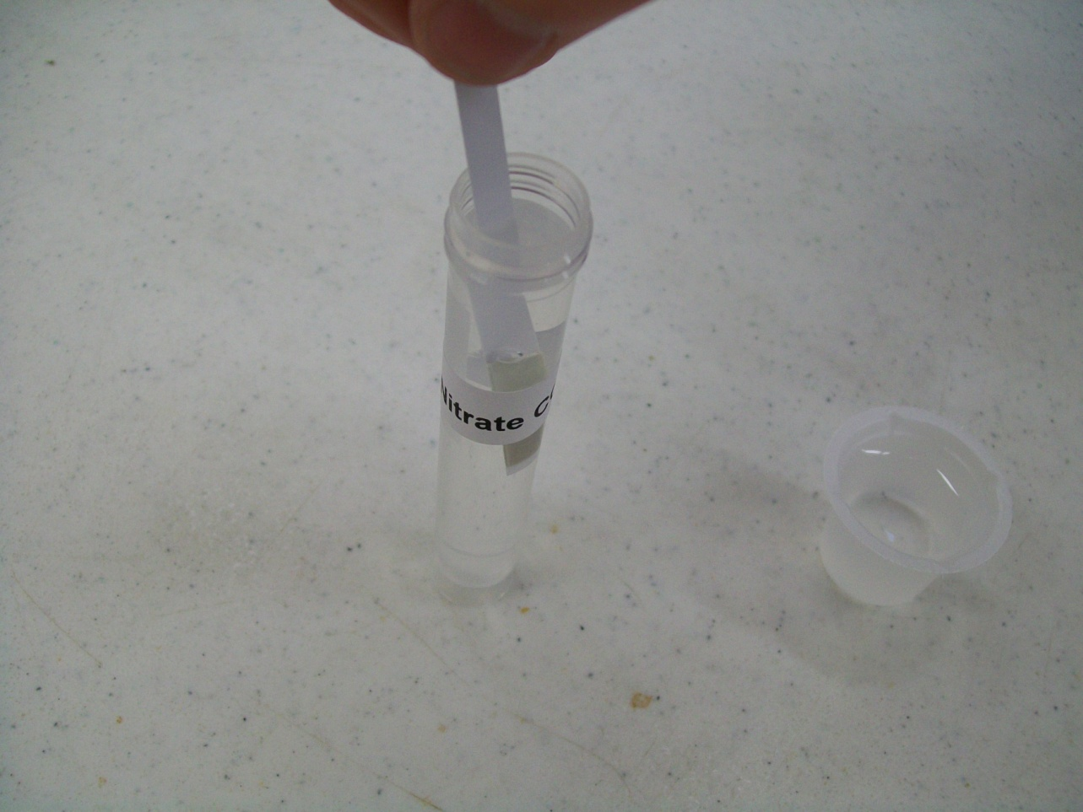
2. Put 10 mL of sample in their respective beakers; use the vial for the Canadian Guideline Limit Sample test. 3. Dip one test strip in water for 2 seconds with no motion.

Slide 69

4. Remove the test strip and allow colours to develop for 1 minute, by laying across the top of the beaker or vial.

Slide 70

5. Match the colour reading (pink number) and record. Please note: The end pad of the test strip measures nitrate; whereas the other pad on the test strip measures nitrite. With this test, we are more concerned with the nitrate reading. Results: The Canadian Guideline and those for the U.S. and the World Health Organization range between 45-50 mg nitrate/L. The Canadian Guidelines Limit Sample for nitrate should give a result very close to the 50 ppm nitrate limit; there should be no nitrite in the Canadian Guideline Limit Sample. A darker colour means that the water Does Not meet the Canadian Drinking Water Guidelines.

Slide 71
Total Chlorine Test

Slide 72

1. Label the five glasses with their respective names.
2. Put about 50 mL of sample in respective glasses (volume is really not critical).

Slide 73

3. Dip one test strip in glass for 5 seconds with constant back and forth motion, so that water passes through the small aperture in the test strip.

Slide 74

4. Remove and shake the test strip once, briskly, to remove any excess water on the strip.

Slide 75

4. (Continued) Allow the test strip to dry for 30 seconds by lying across glass.

Slide 76

5. Match with the best colour to determine the Total Chlorine concentration in mg/L or parts per million (ppm). Complete the colour matching within 15 seconds. Do one sample at a time. 6. Write up your results. Results: Compare results to the United States Environmental Protection Agency’s maximum residual disinfectant level goal for chlorine of 4 ppm; a darker colour of green means that the water sample Does Not meet the United States Environmental Protection Agency’s maximum residual disinfectant level goal for chlorine. Please refer to the facts sheet portion of the instructions for more information about chlorine.

Slide 77
Iron Test

Slide 78

1. Label five beakers with their respective names: Urban Treated Water, Rural Treated Water, Untreated Raw Water, Local Community Treated Water, Canadian Guideline Limit Sample for Iron (CGLS). 2. Put 10 mL of a water sample or (CGLS) in their respective beakers.

Slide 79

3. With scissors cut the top of each aluminum pouch, then squeeze the pouch (this opens it up)

Slide 80

3. (Continued) and add the contents of one pouch into each beaker.

Slide 81

4. Wait for 3 minutes, and then compare the colour (look at the beaker from the top) with the CGLS (giving CGLS a rating of 10), estimate what the other beakers contain, the lighter the colour, the lower your rating. Write down the ratings that you got for each sample. Results: The Canadian Guideline Limit Sample for iron of 0.3 mg/L was rated 10; a lower rating (lighter colour) means that the water meets the guideline; a rating higher than 10 means that the water Does Not meet Canadian Drinking Water Guidelines.

Slide 82
pH Test

Slide 83

1. Label the four beakers with their respective sample names (do not include the buffer; this can be tested in the tube). 2. Fill the beakers with their respective samples.

Slide 84

3. Place the pH strip into the beaker/vial. 4. Leave for 2 minutes.

Slide 85

5. Remove the pH strip and lay it across the beaker, coloured side up. Wait 30 seconds.

Slide 86

6. Determine the pH of the strip by comparing it to the pH scale card. 7. Record your results. Results: Sample water with a pH between 7.0 and 10.5 meets the Guidelines for Canadian Drinking Water Quality guideline for pH. The buffer should give a result very close to 7.

Slide 87
A Different Method of Dividing the Materials and Students

Slide 88

Tracy Webb is a member of the Safe Drinking Water Foundation Board of Directors
Welcome to Tracy Webb’s classroom!

Slide 89

How Tracy sets up the materials

Slide 90

Each group of students performs all of the tests on their water sample

Slide 91

The students enjoy performing the Operation Water Drop tests

Slide 92

Some practical tips for conducting the Operation Water Drop tests with your students

Slide 93

Did you notice that every group has a basin?

Slide 94

Give each group a sheet on which to record their results

Slide 95

Prepare your students for the Operation Water Drop tests in advance by teaching background information regarding water: water quality, water cycle, water conservation and other related topics

Slide 96
Tell me again, how do I get this awesome kit?
Many kits are sponsored by generous companies and foundations.
Kits can, of course, also be purchased by schools/school divisions themselves at reasonable cost-recovery prices. To find out whether your school is eligible to receive a sponsored kit please contact us!
E-mail info@safewater.org
Phone 306-934-0389

Slide 97
We Have Six Other Environmental Education Programs Available!

Slide 98

Operation Water Pollution (OWP)
A program for students in Grades 5 to 12 which teaches them about what water pollution is, what causes water pollution, what can be done about water pollution and what they, personally, can do about the problem.
Includes a digital TDS and digital pH meter, both are reusable for at least two years.

Slide 99

Operation Water Biology (OWB)
A series of 8 lesson plans designed for use with students in Grades 9 to 12.
Teaches students about biological water treatment, a more environmentally friendly and effective method of treating drinking water, compared to conventional (chemical) water treatment.
Also teaches students about chlorine, chloramine, ammonia and iron.

Slide 100

Operation Community Water Footprint (OCWF)
Designed for students in Grades 6 to 12.
Students calculate the amount of source water that is required to produce 1 litre of drinking water in their community, it is often more than they expect!
Then, students can “Put their school on the map” by using the website application on the SDWF website and entering their community’s water footprint as well as what they are doing in order to improve the drinking water situation and to share information with others.
This program is available free of charge online.

Slide 101

Operation Water Health (OWH)
Designed for students in Grades 5 to 12.
The students explore common disease-causing microbes found in water, how these microbes are removed or inactivated in water with water treatment, and the diseases these microbes cause when they are not identified and treated in drinking water systems.
The students ponder the question: is it cheaper to treat the illness or treat the water?
This program is available free of charge online!

Slide 102

Operation Water Spirit (OWS)
Designed for students in Kindergarten, Grade 2, Grade 5 and Grades 7 to 12.
Reinforces Aboriginal culture and perspectives regarding water for Aboriginal students - while at the same time providing an Aboriginal perspective to non-Aboriginal students about water issues.
Invites teachers to encourage classroom discussions to enable students to gain a closer understanding of Aboriginal issues and perspectives surrounding drinking water.
This program is available free of charge online!

Slide 103

Operation Water Flow (OWF)
Recommended for students in Grades 6 to 12.
Encourages students to establish the true cost of water (economic and environmental); the social responsibilities of providing safe drinking water; the need for national regulations; and the need for water conservation, source water protection, etc.
Operation Water Flow is a cross-curricular program which supports and encourages a broad understanding of information related to drinking water issues.
This program is available free of charge online!

Slide 104


SDWF Mission
We will educate the leaders of today and tomorrow about drinking water quality issues to realize our goal of safe drinking water being available to every Canadian.

Slide 105

Please visit us at:
www.safewater.org

